Slide 1
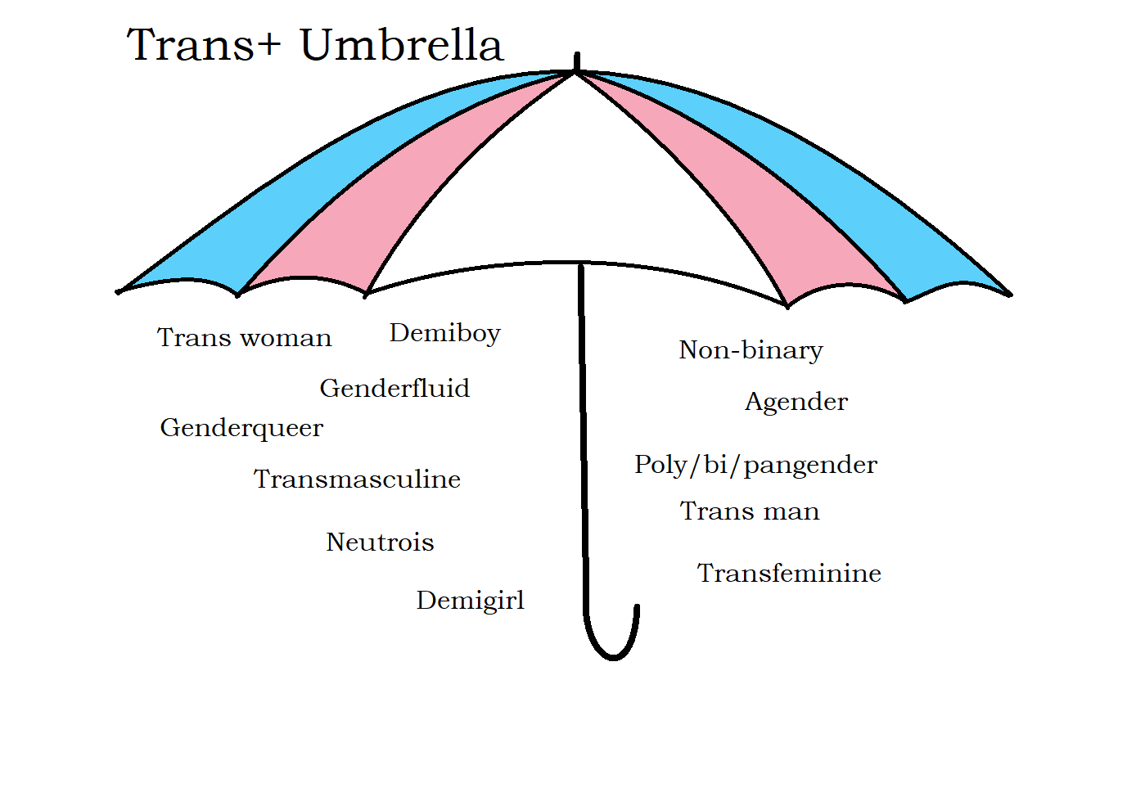
Understanding Gender Diversity

Slide 2
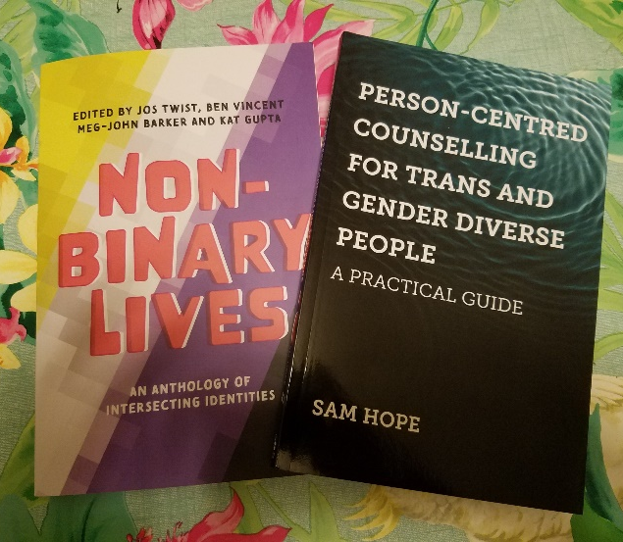
Sam Hope
BACP accredited therapist, supervisor and EDI trainer, MA Trauma Studies
Disabled, neurodivergent, bi, ace, trans, non-binary (they/them)
Author of Person-Centred Counselling for Trans and Gender Diverse People
PPI lead, ICTA Project

Slide 3
Learning Outcomes
Culturally competent language and approaches to gender diversity
Debunking myths and stereotypes
Mental health, trans people and the minority stress model
Understanding the diversity of trans experiences

Slide 4
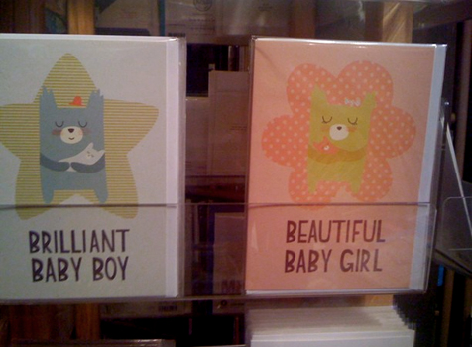

Slide 5
Observed | Assigned | Assumed
Genital shape | Legal sex, pronouns, gendered labels, gender, gendered name, social role | Gametes, chromosomes, reproduction, gender identity
Dr C Fine(2010) Delusions of Gender: How Our Minds, Society, and Neurosexism Create Difference.
Dr C Fine(2017) Testosterone Rex: Unmaking the Myths of Our Gendered Minds.
Scientific American. Sex Redefined: The Idea of 2 Sexes Is Overly Simplistic
Biology | Construct
Genitals, gametes*, chromosomes*, gender identity* (proven to have a clear biological component) *All usually unknown at birth | Birth cert, pronouns, name, legal sex, gender roles, labels (man/woman, masculine/feminine, male/female, sex/gender)

Slide 6
Example: a child is . . .
Observed as having a vulva
Assigned a legal sex, a pronoun, a (likely) gendered name, socially constructed labels, e.g. girl/woman, social rules/roles, sex segregation rules
Assumed to have womb, vagina, large gametes, XX chromosomes, ability to bear children, ability to live congruently in the social designation “girl/woman”
(all of these assumptions may be incorrect)

Slide 7
“Gender identity”
1. Endocrine Society Position Statement
Strong evidence that gender identity has a “durable biological element¹”
Many-layered experience:
Our internal sense of who we are
How our brains map onto our bodies
Which genders we do and do not emulate (unconsciously or otherwise)
How others experience our gender and interact with us
Varies in intensity from person to person

Slide 8
“Trans”
Any person who experiences incongruence with the gender they were assigned into at birth
Gender roles
Gender rules
Gender segregation
Gender enforcement
Gender expression
Other people's genders
Gender socialisation
Gendered appearance . . .
How I relate to . . .
My body
My sense of self

Slide 9
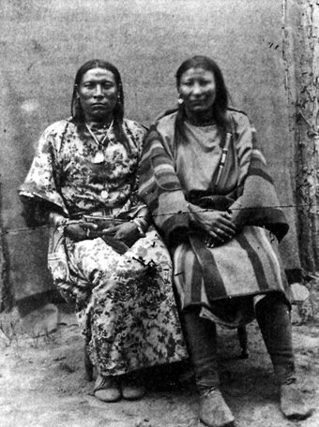
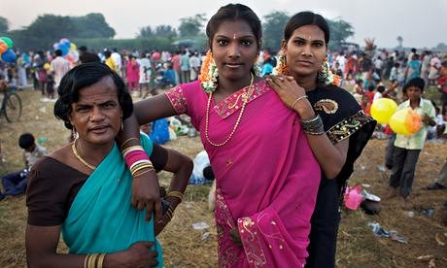
A Little Trans History . . .
Evidence of gender diversity in historic/ archaeological record
Celebrated in many cultures –
pathologised by colonialism
Indian
Hijras
Indigenous American
Two-spirit people
Notes:
Berdache, Hijiras, Two-Spirit

Slide 10
Institute was burned down by Nazis

Slide 11
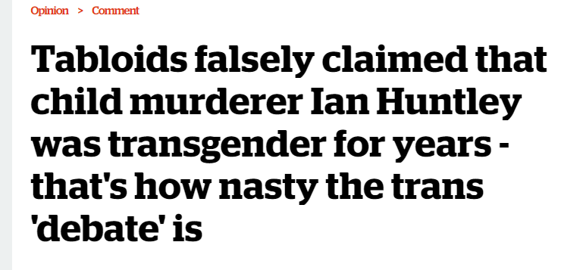
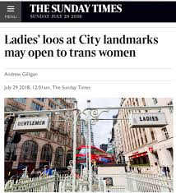
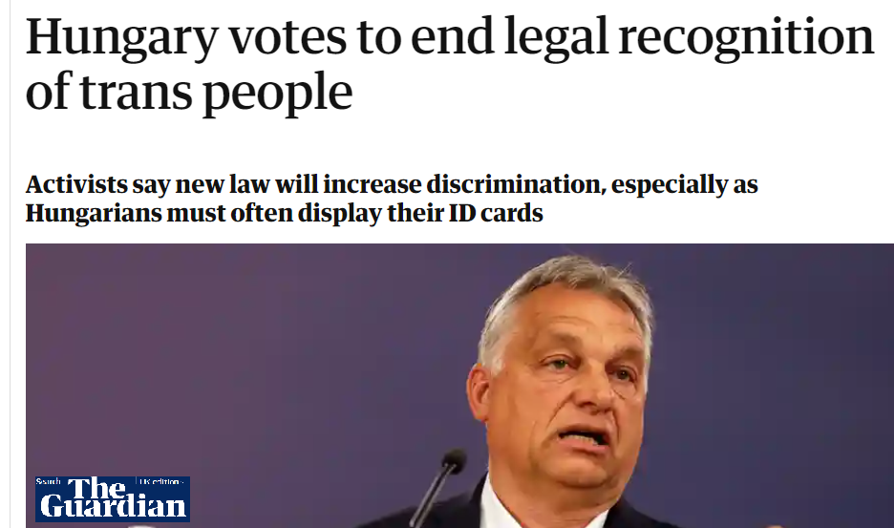
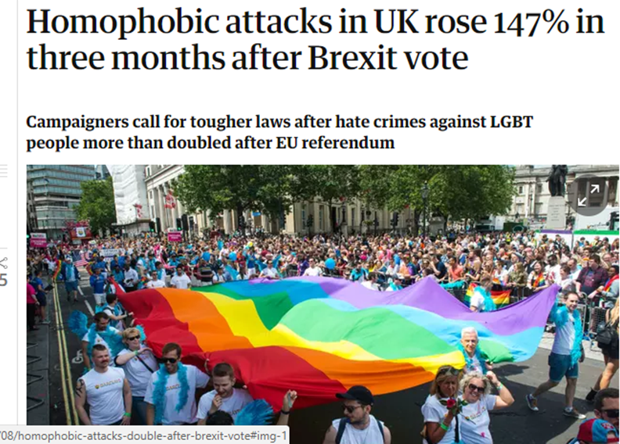
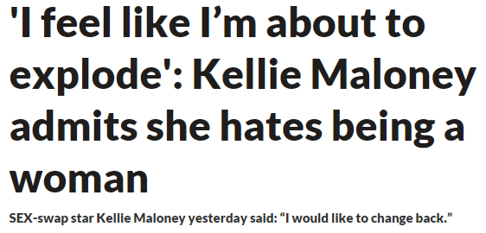

Slide 12
Declassified as a mental illness
 | Year WHO declassified
Homosexuality | 1990
Gender Incongruence | 2019

Slide 13
Minority stress model
Lancet study
Canadian Study
Canadian Study
The Amsterdam Cohort of Gender Dysphoria Study
Association Between . . . Gender Identity Conversion Efforts and Psychological Distress . . .
Multiple studies show trans people’s poor mental health is caused by the following factors:
Family and social rejection/exclusion
Misgendering, harassment and hate crime
Lack of access to appropriate documentation
Lack of access to healthcare
Stigmatising/pathologizing attitudes

Slide 14
Summary of research evidence
Lancet study
Canadian Study
Canadian Study
The Amsterdam Cohort of Gender Dysphoria Study
Association Between . . . Gender Identity Conversion Efforts and Psychological Distress . . .
Harm is well evidenced when trans people (including children)
Are denied social transition
Are subjected to conversion therapy
Are denied civil rights
Are denied appropriate, well evidenced healthcare (puberty blockers for <16s)
Are not respected in their identity
Are misgendered (wrong name, pronoun, etc)
Are excluded based on being trans

Slide 15
Suicide Statistics for Trans People¹
PACE The RaRE research report: LGB&T mental health
Nottinghamshire Healthcare Mental health survey report for LGBT+ people
trans people under 26 who have considered suicide
trans people under 26 who have self harmed
Overall number of trans people who have attempted suicide
In Nottinghamshire, UK, a 2017 survey showed that 60 per cent of trans respondents had self-harmed and 48 per cent had attempted suicide²
Notes:
Suicide around 6% in general under 26 population, self harm around 8%

Slide 16
Student’s Experiences
Fear of violence and harassment
Computer systems keep throwing old name up no matter how many times it gets changed
Getting “outed” by people or systems
Lack of gender neutral toilets/facilities
Lack of trans representation within LGBT+ groups
Lack of protocols and policy e.g. to change name, reissue certs, tackle transphobia

Slide 17
Student Experiences
May be facing difficulty with family/peers
May experience housing or financial issues as a result of estrangement
May have long wait for treatment
May be struggling with mental health and trauma
May have physical healthcare issues
May be isolated
You may not know they are trans

Slide 18
Myths
The “delusion” myth
The “detransition” or “regrets” myth
The “social contagion” myth
The “risk to cis women” myth
The “symptom of autism” myth
The “confused gay” myth
The “sexual fetish” myth

Slide 19
1. How medicine mistreats disabled trans people
Differences (like being trans and autistic) often cluster together – this does not imply causality
Left-handedness
Synaesthesia
Atypical appearance
Bisexual, Lesbian or Gay
Trans
Autistic
Joint hypermobility
Non-conforming
Physical disorders such as EDS and POTS
Intersex
Asexual
Genius
© Sam Hope

Slide 20
Gender Recognition Act
Gender Recognition Act 2004
Allows a trans person to change birth certificate
Many people don’t have one
Trans people can use single sex facilities without one
Complex administrative process
Ireland, Malta, Argentina introduced a statutory declaration (“self-ID”) process without problems

Slide 21
Equality Act 2010
Gender reassignment is a protected characteristic
“You can be at any stage in the transition process – from proposing to reassign your gender, to undergoing a process to reassign your gender, or having completed it”
Includes:
Harassment – making someone feel humiliated, offended or degraded (e.g deliberate misgendering)
Direct discrimination (e.g “you have to change jobs now you’ve come out”)
Indirect discrimination (e.g. “we won’t give you paid time off for treatment despite giving this for other health conditions)
Exceptions: “A proportionate means of achieving a legitimate aim”
Non-binary people are covered by the law

Slide 22
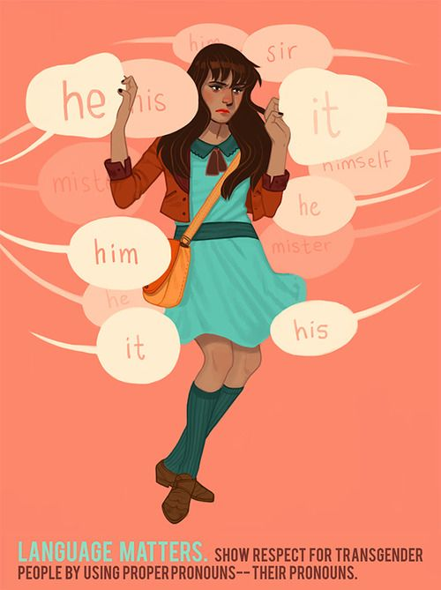
LANGUAGE
“When people are dying, you can't let any slur go unremarked” – Roz Kaveney

Slide 23
It's so hard for me to get it right!
I recognise it's hard on you when I get it wrong

Slide 24
Practice makes perfect
Say the names/terms/pronouns a lot – get comfy with them!
Challenge people when they get it wrong (if student wants that)
Don’t be avoidant, be prepared to make mistakes and gently apologise, quickly move on

Slide 25
Challenging Bullying
What are the best approaches to tackling bullying/harassment?
Positive environment where trans people are visible and gender diversity talked about
Out LGBTQA+ teachers and allies, phobic teachers challenged
Zero tolerance policy that describes what constitutes bullying
Always take it seriously and record it – no bystanders
Don’t victim blame/minimise/deny
Develop confidence and awareness (ongoing)
Challenge poor practice
Don’t agree with it? Keep it to yourself.

Slide 26
What helps
Listen
Every trans person has a unique story – take time to listen/don’t assume
Trans people are the experts on their own lives
Educate yourself
don’t expect trans person to educate you (But if you have a relevant question, do ask!)
Trust, accept and reflect person’s language and story
Treat their words, labels, pronouns with respect
No gatekeeping/ pathologising/fixing
All trans people are getting this enough already!

Slide 27
Action Plan
List 3 things you can do to change things for the better - How will I do it? - Who can help? - Deadline?

Slide 28
Any Questions?

Slide 29
Further resources can be found on my website: sam-hope.co.uk
Email me – sam@sam-hope.co.uk
Sources of support:
Mindline Trans helpline
Gendered Intelligence
Mermaids
TransUnite: list of support groups

