Slide 1
WP without a WP team?
www.heloa.ac.uk
Registered Charity numbers: 1182953 (England & Wales) and SC050285 (Scotland)

Slide 2
WP without a WP team
www.heloa.ac.uk
Morag Duffin
Head of Access and Participation
The University of Law
Elliot Newstead
Head of UK Student Recruitment and Outreach
The University of Leicester
Registered Charity numbers: 1182953 (England & Wales) and SC050285 (Scotland)

Slide 3
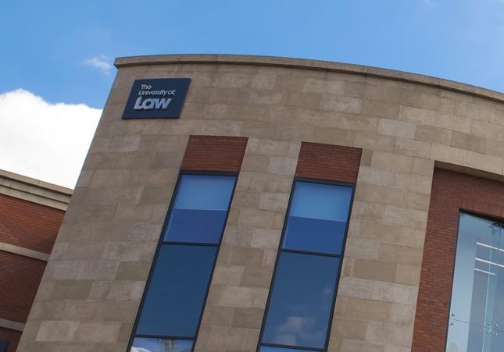
www.heloa.ac.uk
Specialist
Law, business, criminology, policing
Professionally regulated courses
Diverse student body (UG Law)
BAME – 58%
Disability – 21%
IMD Q1&2 – 58%
Income below £25k – 61%
Mature – 16%
Small?
2,500 UG
8,000 PG
Multi-campus
15 UK campuses
2 international campuses, Online campus
Private
Global University Systems
Registered Charity numbers: 1182953 (England & Wales) and SC050285 (Scotland)

Slide 4
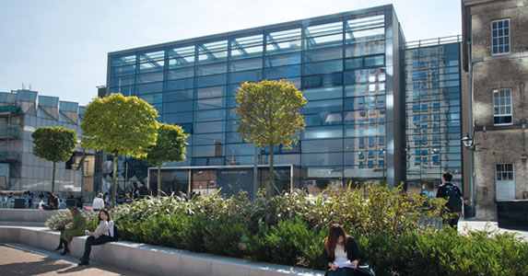
www.heloa.ac.uk
Broad, ‘traditional’ portfolio
Medicine, Law, Psychology, Biological Sciences, Criminology etc
Diverse student body
BAME – 54%
Disability – 9.2%
POLAR4 Q1&2 – 21.3%
IMD Q1&2 – 39%
Mature – 9.2%
Medium Sized?
12,000 UG
5,500 PG
Campus
1 UK Campus
1 International ‘campus’
Registered Charity numbers: 1182953 (England & Wales) and SC050285 (Scotland)

Slide 5
www.heloa.ac.uk
Widening Participation and Access Committee
Access Working
Group
Success Working Group
Progression Working Group
Data, Research and Evaluation Working Group
Registered Charity numbers: 1182953 (England & Wales) and SC050285 (Scotland)

Slide 6
www.heloa.ac.uk
Council
Executive Board
Project Groups (Vulnerable groups, awarding gap etc)
APP Strategic Group
Operations Oversight Group
Project Groups (Access, Success, Progression)
Education Committee
Registered Charity numbers: 1182953 (England & Wales) and SC050285 (Scotland)

Slide 7
Benefits of WP/SR set up
www.heloa.ac.uk
Consistent approach across student lifecycle
Engages all relevant departments e.g. marketing, admissions, DSR
Gives DSR/marketing ownership and accountability
Reduces duplication of work/confusion
Consistent approach to working with schools/colleges from Primary to Post-16
Closer alignment to APP Access focus
Reduces duplication of activity
Longer-term – change of perception of ‘outreach’ amongst academic community
Budgetary alignment

Slide 8
New APPs?
www.heloa.ac.uk
Changes
Attainment rather than aspiration
Outreach rather than recruitment
What happens to current APP-related activity?
Impact
Activity change? Tutoring/school partnerships
Importance of tracking (challenge for small providers)
Targets (challenge for recruiting universities)
Registered Charity numbers: 1182953 (England & Wales) and SC050285 (Scotland)

Slide 9
BREAKOUT
www.heloa.ac.uk
What are the current challenges with your own WP/SR structure?
How might the changes to the APPs affect your WP/SR structure?
Registered Charity numbers: 1182953 (England & Wales) and SC050285 (Scotland)

Slide 10
Our challenges
www.heloa.ac.uk
Recruitment vs outreach
WP specific knowledge and training (disparate team often from non-HE backgrounds)
Embedding an evaluation ethos
Optics of ‘WP’ vs ‘recruitment’ activity
Registered Charity numbers: 1182953 (England & Wales) and SC050285 (Scotland)

Slide 11
Takeaways: how can you streamline your WP/SR work?
www.heloa.ac.uk
Targeting
Recording and collection of data and interactions
Online provision
Use of sector organisations such as HELOA
Registered Charity numbers: 1182953 (England & Wales) and SC050285 (Scotland)

Slide 12
BREAKOUT
www.heloa.ac.uk
Which of the takeaways can be included at your institution?
Registered Charity numbers: 1182953 (England & Wales) and SC050285 (Scotland)

Slide 13
Any questions?
www.heloa.ac.uk
Registered Charity numbers: 1182953 (England & Wales) and SC050285 (Scotland)

