Slide 1
Reaching Beyond the School Gate
Dr Alex Blower, Arts University Bournemouth

Slide 2
Which groups do you regularly engage with in outreach work?

Slide 3
Which settings do you engage with them in?

Slide 4
Imagine waking up to this article in the news…
‘The number of people choosing to study as an undergraduate at university in England has plummeted by 61% in the last 10 years, according to a study published this Wednesday. The report, which was commissioned by ministers, says that the reasons for the drop include a tough economic climate, but suggests the governments decision to triple tuition fees to a maximum of £9,000 has played a decisive part. The report found that those now less likely to attend come from groups that are already underrepresented in higher education.’ (2018, 35)

Slide 5
Who should universities be for?

Slide 6
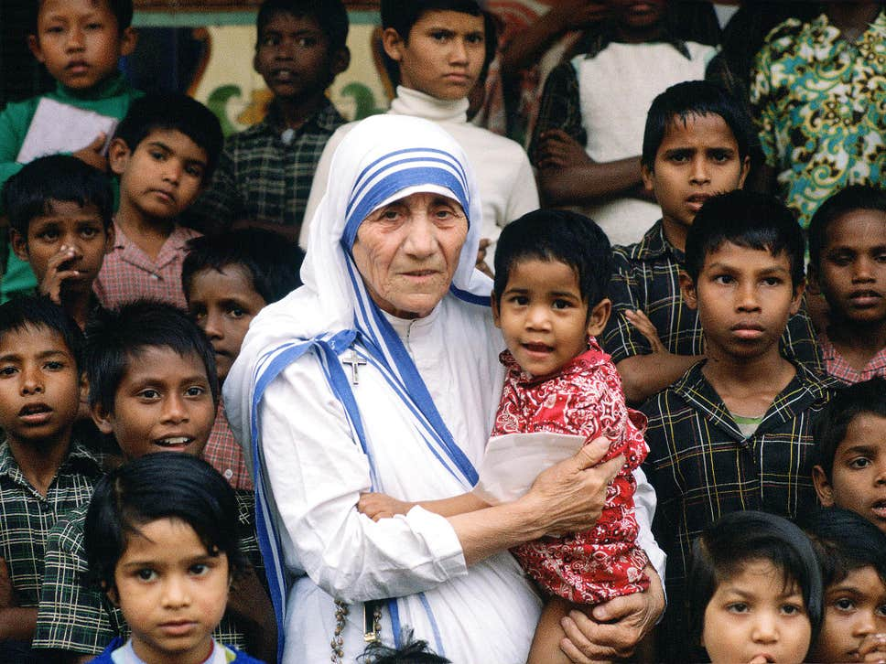
Widening Participation: The Aspiration Missionaries?
Universities
Schools and Colleges
‘Under-privileged’
‘Disadvantaged’
‘Non-traditional’

Slide 7
In Gillies’ (2006) research with working-class mothers who were experiencing marginalisation as a result of the inequalities which they experienced, she comments that working-class mothers’ involvement in school life were often more orientated toward ‘keeping children safe, soothing feelings of failure and low self-worth, and challenging injustice’ (p.292)
Ball, Stephen J., et al. Degrees of choice : class, race, gender and higher education. United Kingdom, Trentham, 2005.

Slide 8
Educational institutions: Threat and Risk
Gillies, V. (2006) Marginalised mothers: Exploring working class experiences of parenting. Routledge.
Gillies, V. (2006) 'Working class mothers and school life: Exploring the role of emotional capital', Gender and Education, 18(3), pp. 281-293.
Reay, D., David, M.E. and Ball, S. (2005) Degrees of Choice: social class, race and gender in higher education. 1 edn. Trentham Books.
Skeggs, B. and Loveday, V. (2012) 'Struggles for value: value practices, injustice, judgment, affect and the idea of class', The British Journal of Sociology, 63(3), pp. 472-490.
Rollock, N., Gillborn, D., Vincent, C. and Ball, S.J., 2014. The colour of class: The educational strategies of the Black middle classes. Routledge.

Slide 9
With this in mind why would we rely, almost exclusively, on schools as our primary sites of engagement in outreach?

Slide 10
Universities
Schools and Colleges
=
Are we really set up to engage with groups who probably aren’t already going to end up in HE?

Slide 11
The ReachOut project

Slide 12
The Reach Out project
How did the Reach Out project target groups of local young people who were not accessing services through the local community?
How did the mechanisms employed by the Reach Out project facilitate access to locally available cultural and social resources aligned with progression to Higher Education?
How did young peoples’ understanding of Level 4 opportunities develop through engagement with the Reach Out project?

Slide 13
A youth work approach
“Enable young people to develop holistically, working with them to facilitate their personal, social and educational development, to enable them to develop their voice, influence and place in society and to reach their full potential.”
https://nya.org.uk/national-occupational-standards-and-english-youth-work-policy-new-document-published/

Slide 14
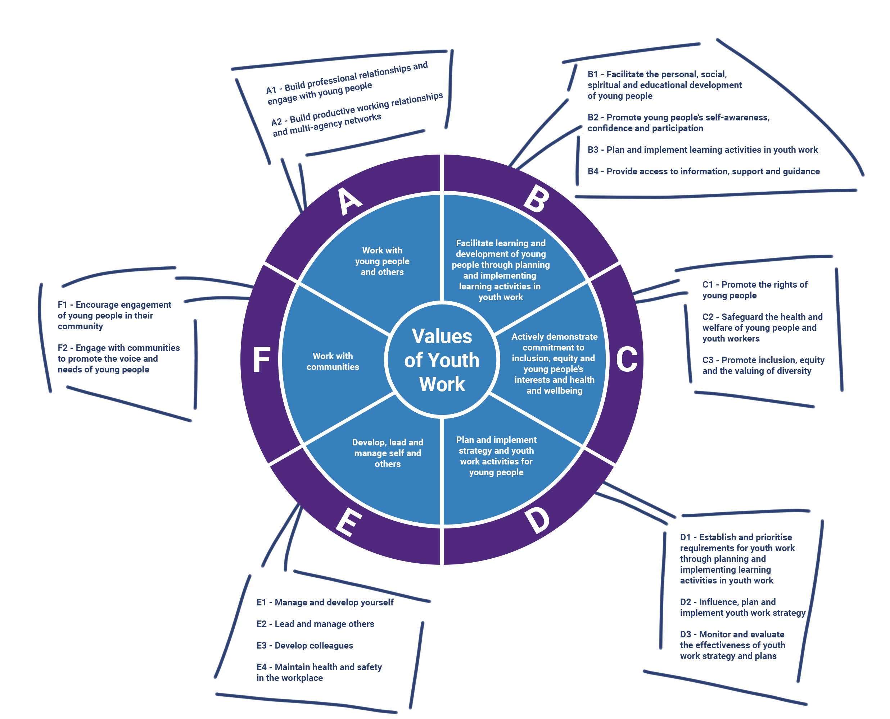

Slide 15
A youth work approach
‘(Youth) workers start where young people are at, but in a very deep sense. So not assuming that they are in deficit in terms of knowledge building up whatever the curriculum is, if you like, from young people's existing knowledge and experience. So there's a kind of a that whole notion of informal education, which has got a long history of sort of literature and training resources in youth work’ (youth worker)
‘streets or park benches or whatever, which are out of sight of parents, out of sight of teachers. There's a level of honesty, a level of openness, and that’s just the level of agency that the young people bring to that. Yeah, I would imagine most widening participation projects would aspire to in terms of understanding the reality of young people's lives, but probably seldom are able to get access to’ (youth worker)

Slide 16
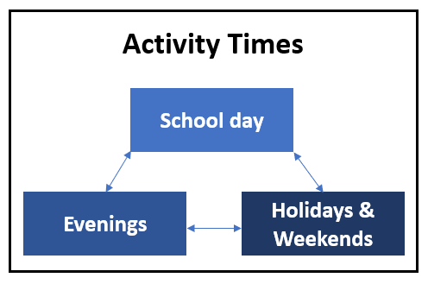
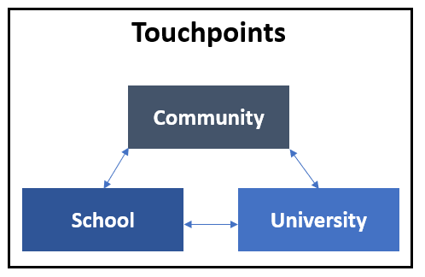
‘So a lot of the young people that you might find on the street. So had certain issues or was in contact with the police and stuff, were at the school anyway. So we could re-engage them in the school and then we also used to run obviously within the school holidays, different activities so them young people we engaged with on a walkabout tend to, kind of it's more of a holistic approach’ (youth worker)

Slide 17
Development of authentic relationships
‘the young people that I'd see at nine o'clock /half nine in the parks with the fires, unfortunately, with the same young people that got referred to me on a one to one then in school because of issues in particular subject areas, or issues with behaviour. And they were the young people that you think never in a million years are you going to get them to spend a day at a university. Because genuinely, when they walk through the door, they were like this – ‘ this just isn't a place that I will ever be’. And I thought already that their aspirations to just, you know, where are their aspirations? Of course you could be here but they're like - ‘nah it's not for a person like me.’ So the opportunities of being able to see the young people in all these different settings, there was something really genuine about the relationship that develops between us all. Because they could see me in the park, in my trainers but then I could also see me in a bit more of an official capacity’ (S)

Slide 18
Development of authentic relationships
One of the things I did, because in lockdown, there wasn't any group work, I took it upon myself to phone a group of young people every week at the same time. So between three and five o'clock, between March and end of August, I phoned them every day, every week, just to say, how are you? If it was a five minute conversation, some of them even to the point where I didn't phone they text me, say, J, you haven't phoned me up! I'm like I'm working my way through my list (J).

Slide 19
Transferable social and cultural resources
‘Before going to Reach Out I didn’t really have any experience going into a Uni at all’ (Young Person)
‘Because growing up I moved so many times. And here with my mum, alone, by myself, it’s like I didn’t really get to do many experiences. Reach Out has helped me to… first experience this reservoir. I didn’t even know you could go in the reservoir. Rock climbing’ (Young Person)
‘Actually I’d never been in a university before that, and no one in my family. But the first time I stepped through the door, I was like - who is going to be here?’ (Young Person)
A: How do you feel now about University just as a place to go? As a place you rock up to at half term and get your Starbucks voucher and do your sessions?
YP: It feels good to be honest. It’s almost like, it’s nice to know you can go somewhere and actually feel wanted and accepted.
‘I used to get angry really quickly, that’s basically gone. I don’t get angry as quick like I used to, punch walls or walk out of lessons. It’s not like I stopped, I matured, but like the things they were telling me, like how to calm down and all that, how to be mature that way’ (Young Person)

Slide 20
Understanding of level 4 opportunities
‘Okay, so back in Year 10 I wouldn’t even know the word university in my vocabulary. Because it’s so non-existent in my family, the way I grew up. I’m the first person in my family even to live in England. So to even be here is something different. And I know I am different, and Reach Out made me understand that. It made me understand my values and to consider university. At least I’m considering it’ (Young Person)
‘they were very encouraging in that aspect. And when I asked them questions, they said I don’t really know now, but next time you ask me, I promise you I’ll have researched it. And when I did ask them again, they did actually give me the answer, for example the BMAT is for Cambridge and Oxford and UKCAT is for any other university, for medicine. That was really interesting to know because I thought they were two totally different things’ (Young Person)
Hot Knowledge
(Ball,1998)

Slide 21
Findings
How did the Reach Out project target groups of local young people who were not accessing services through the local community?
How did the mechanisms employed by the Reach Out project facilitate access to locally available cultural and social resources aligned with progression to Higher Education?
How did young peoples’ understanding of Level 4 opportunities develop through engagement with the Reach Out project?
Triangulated Engagement
Deployment of Youth Work Approach
Authentic, sustained relationships
Access to locally available resources
A sense of belonging at university
A space to study
Formal CIAG
Informal ‘hot knowledge’

Slide 22
What do you see as the challenges and opportunities of a change in approach?

Slide 24
Some things we’re doing institutionally
Funded places on our short courses for NEET young people
Operating on an ‘out of classroom first’ approach
Partnership work with Local Authority, Third Sector, Youth, Community, and Housing Associations
Co-constructed activity with young people in Pupil Referral Units
‘Being a Boy’ project to amplify the voice of young working-class males

Slide 25
Small wins – meaningfully engaging as a practitioner (Marsdin,2021)
Young people choose to take part
Utilise young people’s views of the world
Treat young people with respect
Develop skills and attitudes rather than remedy problem behaviour
Develop positive relationships and collective identities
Respect and Value Difference
Champion the Voice of young People

Slide 26
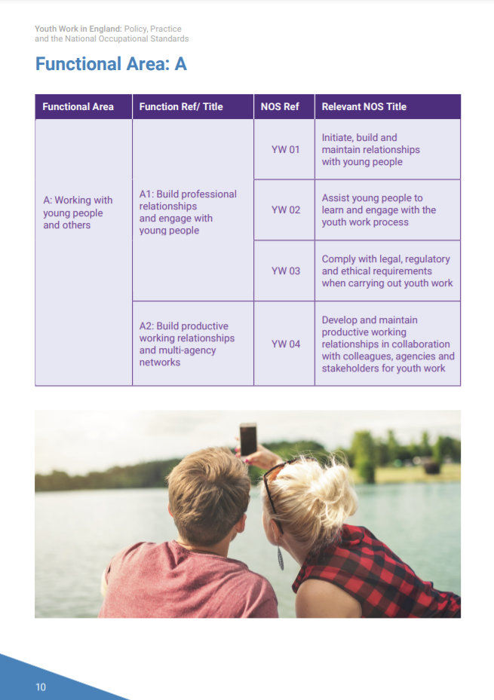
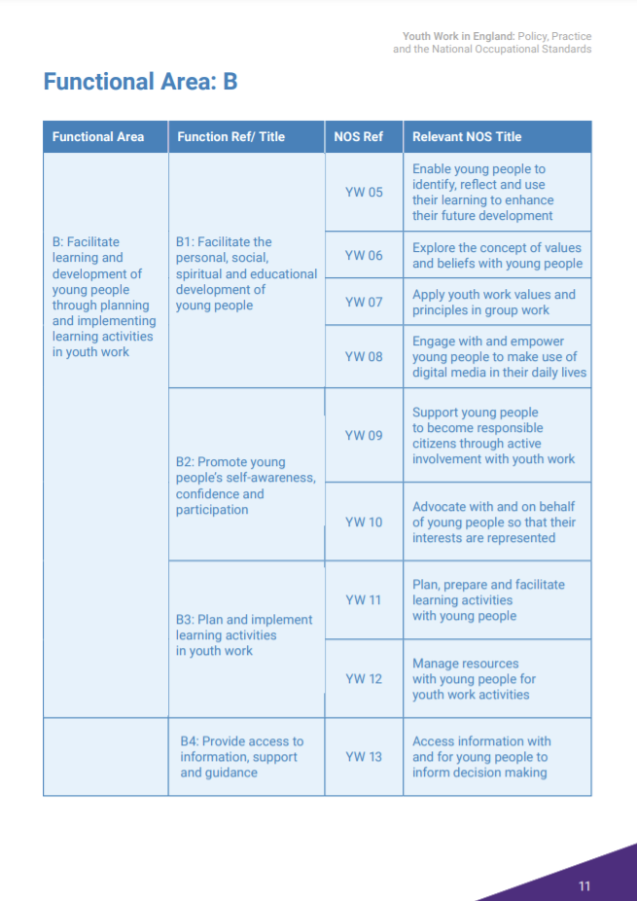
Occupational Standards

Slide 27
Questions?
Dr Alex Blower
Ablower@aub.ac.uk
@EduDetective
Nik Marsdin
N.Marsdin@lancaster.ac.uk
@MarsdinNik

