Slide 1
Leaky Hosepipe Solution

Slide 2
ENQUIRERS
APPLICANTS
OFFERS
FIRMS
PLACED
(with clearing)
THE LEAKY HOSEPIPE

Slide 3
University A
University B
University C
University D

Slide 4
1. We’re all leaky!

Slide 5
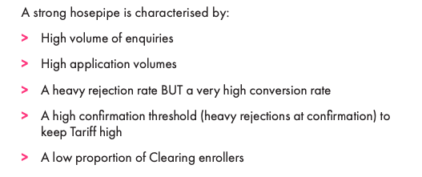
2. What does ‘good’ look like?

Slide 6
3. Two Leaks to watch
How many of your applicants were ‘known to you’ upon application?
How good is the quality of your enquiry data?

Slide 7
4. Missing (or low) interactions
Outreach
Phone calls
Social Media interactions
Interviews

Slide 8
Q. What is your value exchange?

Slide 9
5. Points mean prizes
For almost every hosepipe, the higher the number of touchpoints = the higher the enrolment rate.
5a. The most successful team is an integrated team

Slide 10
Check enquiry numbers
Your Leaky Hosepipe Checklist
Check rejection rates
Pre-application relationships
Year of entry double-check
Process for maximum capture
Work out value exchange
Minimum ‘markers of care’
Deeper integration with teams

Slide 11
Questions
penny@pennyeccles.co.uk

