Slide 1
Evaluating widening participation and outreach activities
Rain Sherlock (Evaluation Manager)
Centre for Transforming Access and Student Outcomes in Higher Education (TASO)
January 2022

Slide 2
Outline of session
1
Introduction to TASO
2
Why evaluate?
3
Monitoring evaluation framework
4
Evaluation guidance and resources
5
Questions
Notes:
RS
You can see on screen what we will cover today
This session is marked as intermediate, so we will provide just a brief overview of what a survey is and how to use it, before further unpacking the concepts we need to think about when choosing, designing and implementing a survey.
We will then go on to cover three important concepts relating to survey design:
Understanding constructs and dimensionality
We will talk through validity
And also discuss reliability
There will be time for questions at the end - please enter your questions throughout the presentation

Slide 3
Introduction to TASO
Independent hub for higher education professionals to access research, toolkits, evaluation techniques and more to help widen participation and improve equality within the sector.
An independent charity, set up by a consortium of King’s College London, Nottingham Trent University and the Behavioural Insights Team.
An affiliate What Works Centre, and part of the UK Government’s What Works Movement.
Funded by the Office for Students from 2019 to 2023.
Notes:
A quick introduction to TASO
As you can see, we are an independent hub for education professionals. We are here to support the sector and provide research, toolkits and evaluation guidance. We hope to work with you, helping to skill up the sector and also to learn from you all.
We were set up by a consortium and have very recently spun-out of King’s and are now an independent charity.
We are an affiliate What Works Centre, there are about 9 of these centres that follow the government approach to ensuring we have high-quality evaluation and evidence on what works. Ensuring that policy and practice is informed by evidence.
Finally, you can see at the bottom that we are funded by the OfS. I think this shows the support of the regulator for this type of evaluation and evidence work.

Slide 4
Our vision and mission
Our vision is to eliminate equality gaps in higher education.
Our mission is to improve lives through evidence-informed practice.

Slide 5
Why evaluate?

Slide 6
What we really want to know
What are the best ways addressing inequality in access and success?

Slide 7
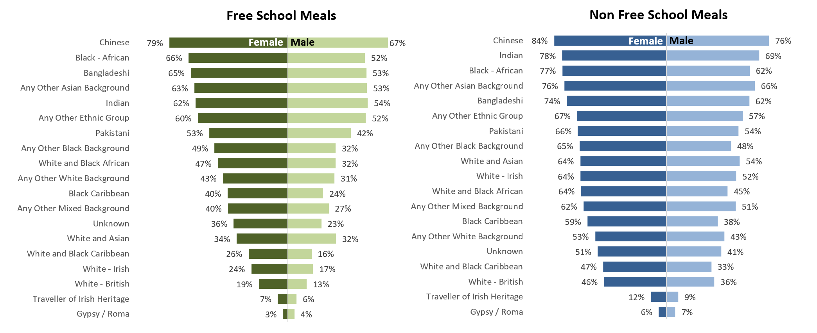
Inequality is high
Progression to HE by age 19 by FSM Status, Gender and Ethnic Group - 2018/19 (DfE, 2020)
Source: https://explore-education-statistics.service.gov.uk/find-statistics/widening-participation-in-higher-education

Slide 8
But where do we start?
Summer school
Campus visit
Tutoring
Entry to HE
UCAS application
Progression to second year

Slide 9
We form research questions
Activities
Outcomes
Summer school
Campus visit
Tutoring ​
UCAS application
Entry to HE
Progression to 2nd year
Notes:
We use the activities to form research questions ‘Does tutoring increase the likelihood of students applying to HE?
And the outcomes provide us with answers - an increase in UCAS application or an increase in enrolment to HE.
However, we often hear about this black box. One of the unfair criticisms that impact evaluation often gets is that we don’t know what happens in the middle, hat causes the change? This is why we have to carefully evaluate.

Slide 10
A big question for TASO
“Participation in outreach is associated with higher HE attendance”
Notes:
An example - outreach
A big question for TASO
The statement is that participation in outreach is associated with higher HE attendance
This is something that we have done work on recently, and we do see it in the data

Slide 11
The causal question
Does outreach CAUSE higher HE attendance?
Outreach
HE attendance
Notes:
The causal question is, does outreach cause higher HE attendance?
Some kind of relationship between the two, when one goes up, the other does up as well.
The thing we have to be careful of it, what is causing that change? What is happening within the back box

Slide 12
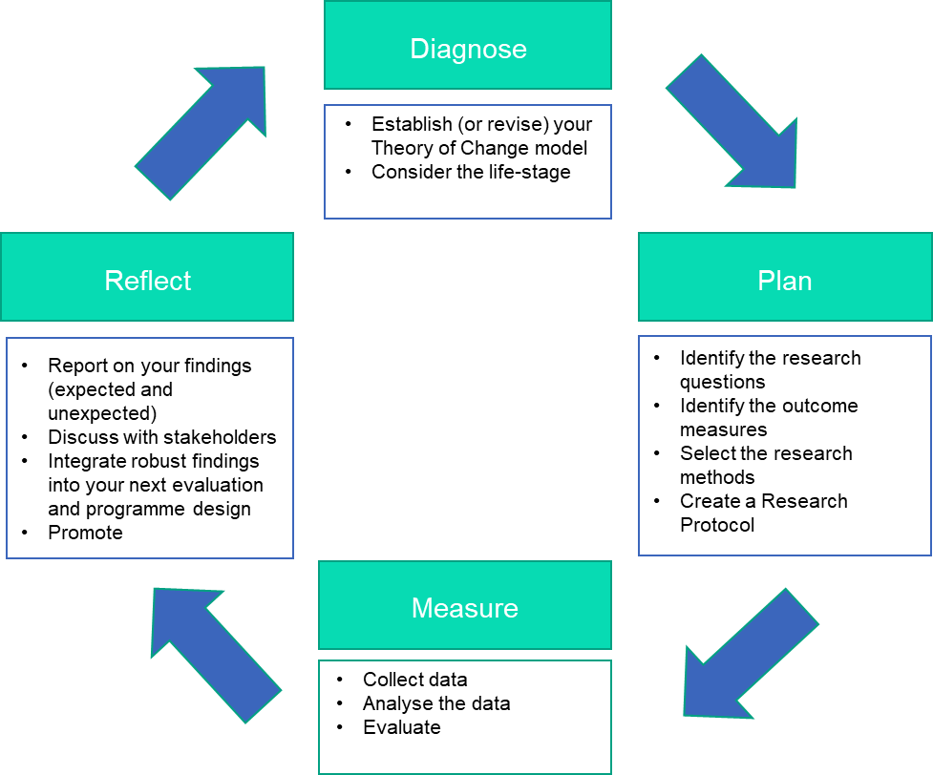
Monitoring and evaluation framework (MEF)

Slide 13
Diagnose

Slide 14
The evaluation cycle

Slide 15
What is a Theory of Change?
A tool that can help you
describe the need you are trying to address
the changes you want to make (your outcomes); and
what you plan to do (your activities)
It can help you improve your strategy, measurement, communication and partnership working.
Inputs
Activities
Outcomes
Impact

Slide 16
Questions a ToC can help with
Evaluation feels like a box-ticking exercise
For the scale-up of a pilot project
It takes too long
A programme is too small to show any actual impact
A programme seems too complex to measure
Notes:
There are also often issues around N being too small to show reliable impact and/or initiatives within WP, often being to complex and influenced by too many latent variables, to be evaluated robustly. And for a RCT, i.e. the method of causal impact that TASO promotes, this might be true but this doesn’t mean that ToCs cannot help with building an evaluation strategy that supports other forms of equally valuable and insightful evaluations, such as case studies or formative evaluations. Having said, all of TASO’s RCTs have a theory of change, which is worked through with the project and evaluation
- Often, evaluation is perceived to not be a good use of staff time. And in my work with WP teams, it was sometimes forgotten because there were more urgent priorities for the delivery team than to compile a lit review to strengthen their assumptions of why they programme works. And that is absolutely true, when a WP officer is holding an event they should not be pre-occupied with thinking about an evaluation strategy. That’s why a ToC is useful to have. It can clarify the programme impacts before the demands of delivery take over and save a lot of time (and stress) when a programme in running because thanks to the ToC everybody knows what they are doing, when and how.
Lastly, monitoring and evaluation can feel rather futile if indicators and evaluation theories do not match the actual implementation. By including different stakeholders of the programme in your ToC you can make sure that findings are meaningful and relevant for everyone involved.
essential in APP
Claim how/whether it works (and for whom)
Intervention appropriateness (too little cannot evaluate)

Slide 17
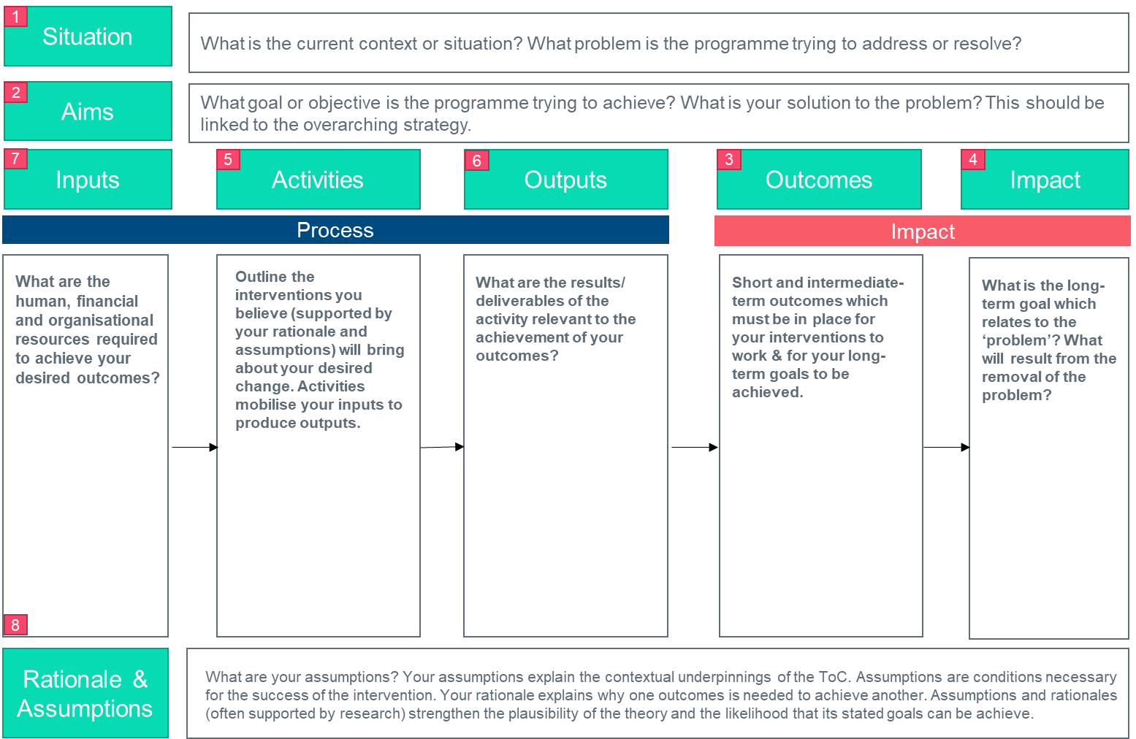
Developing a Theory of Change

Slide 18
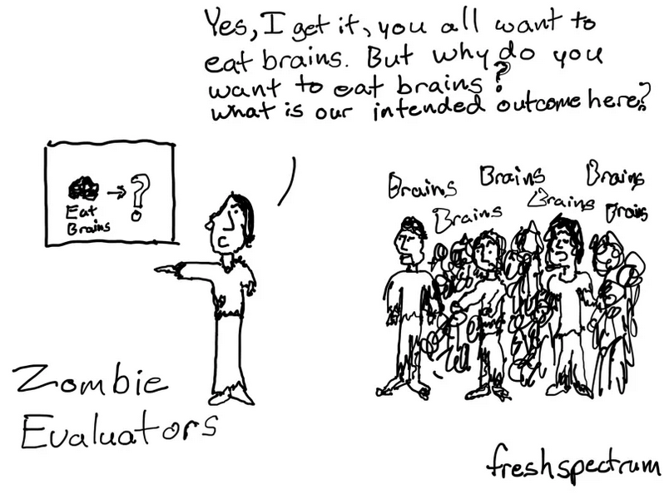
Theory of Change
Rationale + Assumptions
Notes:
At the point of designing the initiative, decisions should be underpinned by evidence to show that the intended effect it is anticipated to have is realistic and feasible.
For our summer school, we referred to the EPI evidence synthesis and the evidence collected to demonstrate the links in the theory of change.
If there is no evidence in your focus of change, new evidence can be generated by building in evaluation into the design of the initiative.
in general, when working through this element of your ToC:
Revisit all the assumptions you’ve made and the rationale behind them.
For example: Are you sure that A leads to B? And are you sure that this is the direction of travel for your desired impact?

Slide 19
Takeaway
Even with limited time and resources, a theory of change can help us challenge our assumptions and guide decisions about how to make adjustments to outreach delivery in order to maximise the impact for students

Slide 20
Plan

Slide 21
The evaluation cycle

Slide 22
Identifying Research Questions
These are overarching question that your evaluation will seek to answer. They will determine the scope and approach of your evaluation.
Primary Research Question
Secondary Research Question
Process Evaluation Question
Causal impact of your evaluation
Did [scheme] increase [main outcome] among [group]?
Did Summer School attendance improve enrolment rates among
participants?
Focus on specific groups or intermediate outcomes
Did [scheme] increase [main outcome/ secondary outcome] among [group/subgroup]?
Did Summer School attendance improve enrolment rates among estranged students?
Focus on implementation and efficiency of your set-up
Was the initiative delivered the way we expected?
Are we targeting the right students?
What was the cost-effectiveness of the initiative?
Notes:
So, starting with how to identify the right research question(s).
As a starter, a research question is the overarching question your evaluation seeks to answer. This will, in return, determine the scope and approach of your evaluation.
At TASO, we recommend to develop three research questions.
Starting with your primary RQ, ideally identifying the causal impact of your evaluation,
And from there, breaking it down into a secondary question, which could focus on intermediate outcomes (e.g. did SS increase sense of belonging to HE or granular sub-groups (i.e. did Summer School increase enrolment rates for participants with experience of family estrangement).
And lastly, because we’re interested in the how as well, think about appropriate process evaluation questions:
Was the initiative delivered as expected (did everyone attend all the session and if not, does that tell you sth about
In general, to help formulate your questions, you should also consider:
Who will use the findings and how?
What do stakeholders need to learn from the evaluation?
What questions will you be able to answer and when?

Slide 23
Outcome measures
“I’ll know [outcome reached] when I see [indicator]”
Observable indicators are those we can build into the evaluation and control out; e.g. demography, observed behaviour, measured attitudes.
Unobservable indicators are those we can’t observe and therefore can’t build into the evaluative model; e.g. motivation, unobserved behaviour, unmeasured attitudes; anything that influences the outcome that we don’t know about or can’t measure.
Notes:
So now we have our research question we need to decide what is the best outcome measure or indicator we can see to do this. Indicators show what a situation is like: (they don’t need to be perfectly matching your outcome concept but they need to be valid enough to give us a good proxy).
We’ve got observable indicators, which are indicators we can build into our evaluation as they are very easy to measure (such as clear demographic data such as age but also observed behaviour or attitude, such as attendance at the summer school and an academically validated scale measuring sense of belonging).
Next to these, there are unobservable indicators. Unobservable indicators are also known as confounding variables. These are variables that influence (or are associated with) both the treatment assignment (so whether participants are applying and engaging with the summer school) and the outcome (enrolling at HEPs), and that we can’t control for.
Confounding variables are why correlation ≠ causation.
To help us all work towards a common framework we have a Common Outcome Measures table (Appendix to the MEF) which you have been sent before the session.

Slide 24
Common outcome measures
Year group | Objectives | Indicators for Process Evaluation | Indicators for Impact Evaluation (short-medium term) | Indicators for Impact Evaluation (long -term)
KS4 (Years 10-11) | Raising attainment Engaging parents Increasing awareness of subject options at HE | Was the programme delivered as intended? Were students targeted correctly? Did students attend? Which students attended? Was the content delivered as intended by deliverers? (academics, ambassadors etc.) Participant experience as measured by evaluation survey Experience & perceptions of stakeholders e.g. key influencers such as teachers, ambassadors, project leads, academics | Improved GCSE attainment GCSE attainment (through NPD) | A level attainment (through NPD/HEAT) Progression to university (HEAT) Progression to research intensive/ highly selective HEIs (HEAT)
KS5 (Years 12-13) | Improved knowledge and confidence – academic skills, culture Increased knowledge of how to apply to HE Enhance attainment Increase preparedness for study in HE Mentoring (current student as e-mentor) | Was the programme delivered as intended? Were students targeted correctly? Did students attend? Which students attended? Was the content delivered as intended by deliverers? (academics, ambassadors etc.) Participant experience as measured by evaluation survey Experience & perceptions of stakeholders e.g. key influencers such as teachers, ambassadors, project leads, academics | Pre-&-post common survey questions Pre-&-post attainment tests Offers received (from home HEI) Successful offers (from home HEI) A level attainment (through NPD) | Progression to university (HEAT) Progression to RG HEIs (HEAT) Progression to HEI (HEAT & internal) Graduate outcomes (GOS)
Notes:
IMO finding the best proxy measure is the most difficult bit (And you shouldn’t need to do this alone. You are the experts on the programmes you are running, but TASO can help to share some of the work we’ve been doing when looking at available evidence in the sector and, consequently, available data sources in HE to translate all those out/in-reach activities into measurable outcomes measures).
IN my experience, there is a common set of indicators that a lot of projects use for different key stages. So to help with that, we’ve developed a common outcome measures framework.
This is an excerpt of what it looks like, and we encourage you to use these measures as they are available. Going from the top left corner, measures are divided by year group (we are looking at KS3-5, first year, subsequent years of studies and post-graduation), common objectives for activities within these year groups and then give examples of indicators for process evaluation as well as short/medium/long-term impact evaluation.
For some programmes that are unique to your HEIs (parent power at KCL) you may need to create indicators outside of those provided.
- For these you will need to consider how reliable and valid your indicators are.
more information about this can be found in the MEF and our next webinar can support you in this process.
Key though is choosing the most reliable and valid indicator that you have. So questionnaires and scales previously verified by academics will be better than ones we create ourselves. Indicators where we don’t need the participant to give a subjective answer are better than questions where people need to self report.

Slide 25
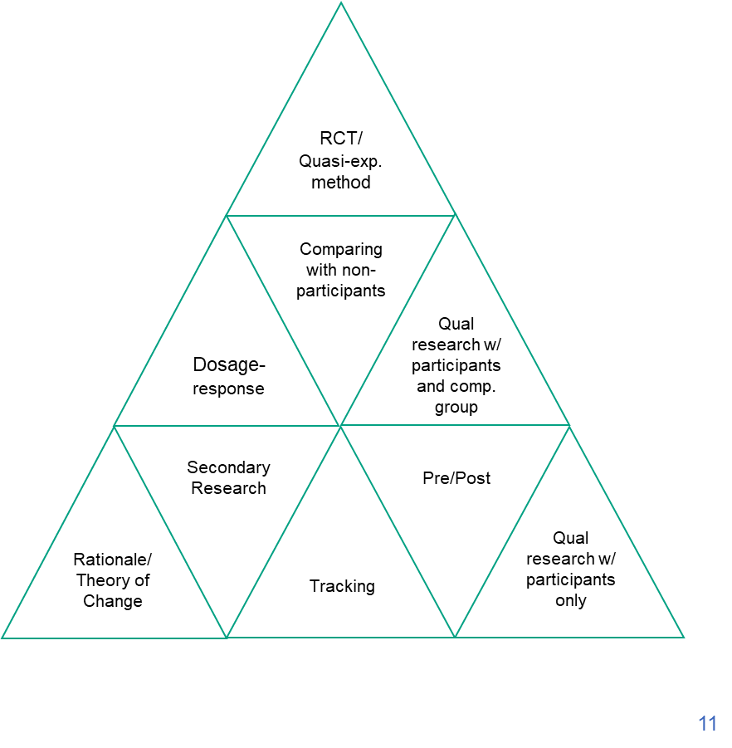
Selecting the appropriate research method
Level 3 - Identify (OfS Type 3)
Level 2 – Compare (OfS Type 2)
Level 1 – Monitor (OfS Type 1)
Notes:
As mentioned before, certain research questions align themselves better to certain research questions.
For matters of simplicity, TASO groups these RQs into three distinct levels. These purposefully align to the standards of evidence promoted by the Office for Students so hopefully will also be of use when reporting on findings in the Monitoring and Evaluation section of your institutional AAP.
For some programmes some research methods will be better than others. It will not be possible for all your evaluations to be L3.
be ambitious - but don't force it.
In the next slides, we will outline examples of evaluation for each level in a bit more detail.

Slide 26
Level 1: Theory of Change
Level 1: Theory of Change
Notes:
As the base without which the pyramid couldn’t stand we have the Monitoring – level 1.
On this level, your programme will have a coherent strategy and activities that are selected to directly contribute to that strategy. We know why we expect particular activities to work (based on a Theory of Change and secondary research) and we are tracking participants’ outcomes and experiences or test for lift-effects in our outcome measure via pre-post evaluation methods.
If you are unsure about this, feel free to revisit the webinar recording and material from earlier this month on the TASO website. Which guides you on the hows and why to develop your own Toc.

Slide 27
Level 2: Matched Comparison
Level 1: Theory of Change
Notes:
Moving evaluation to the second level, Compare, the main difference is that you are monitoring your participants and comparing them other similar individuals who have not participated in the programme.
A great example of the Compare Level is UCAS’ STROBE service that allows providers to upload a set of participants to UCAS, who in return, will provide a matched comparator group of individuals on their database that match the observable characteristics of your participant group. As in this example, you have a group of SS participants. UCAS will match these to individuals within their UCAS database and tell you how your outcome (for example, enrolment at different universities) might differ or not between your participants and the group of matched non-participants. As you are holding everything else but the participation constant, i.e. you are matching on, for example, gender, age, school type and ethnicity, you get a clearer idea about the effect your programme participation is having on your desired outcome.

Slide 28
‘Hold everything constant’ is a nice idea, but…
Level 3: Identifying causal evidence
18
18
Female
Female
Same school
Same school
BAME
BAME
Moderate GCSEs
Moderate GCSEs
Likes her teachers
Doesn’t like her teachers
Wants to be a midwife
Isn’t sure what she’d like to do
Has family support
Doesn’t have family support
Study habits improved
Study habits stayed the same
Applied for scheme
Applied for scheme
‹#›
Notes:
Which brings us to Level 3 – identify.
So, the idea to control for other variables such as age, gender, ethnicity etc is nice (and definitely deserves its merit) it unfortunately cannot control for confounding variables, these unobservable indicators that we cannot easily measure and who can have an effect on our outcome measure –
as an example, imagine two participants in your summer school: Eliza and Miriam
Both are 18
Both are female
both go to the same school
Both are from a BAME background
Both applied for the Summer school and got in
and both have so la la GCSE results
So, controlling for obvious factors that we know can have an effect on study success and enrolment at uni – Eliza and Miriam seem really identical
However, what we cannot measure but what is true for Eliza is that she really likes her ss teacher leading her to be much more motivated and enthusiastic in class – Miriam is the opposite
Moreover, eliza is pretty set on becoming a midwife giving her clear direction on her study subjects AND how to write the UCAS application –plus, again loads of motivation to achieve her dream profession – well, Miriam doesn’t reallt know what she wants to do
And so on, Eliza has the family support to enter and succeed in HE , Miriam doesn’t
And lastly, Eliza’s study habits improve as a result of the SS attendance where Miriam’s more or less stay the same…
So, even though the two women seemed to be identical when controlling for relevant factors, the underlying unobservable indicators may have biased or results and under-estimate the lift-effect of the summer school on Miriam’s attitudes and behaviours to HE whereas it might over-estimate them for Eliza
Comparing outcomes for treated and untreated does not usually give the ‘right’ answer.
Examples:
Students who are selected for a summer school will probably have a higher baseline likelihood of going to university than those who don’t.
Students seeking dissertation advice may be (a) more engaged with the institution, (b) lower achieving, and (c) more extraverted, than those who aren’t.

Slide 29
RCTs – how they help
Randomisation does not aim to hold everything constant
Instead, we aim to balance the treated and control groups in expectation (i.e. on average).
In other words, although there may be no perfectly matched treated/control cases, on average, the groups are the same, and therefore we expect the same outcomes from the groups in the absence of treatment.
Notes:
One of the ways to get around this way of unbalanced comparisons is a research method called a Randomised Controlled Trial (RCT).
With an RCT we are not trying to account for differences between the groups by holding everything else constant.
Instead, we randomly allocate our candidates (so for example, all the students who applied for the Summer School) and to the treatment group (So people who attend the summer school). As this allocation is explicitly random, we expect that on average, the control and treatment groups are balanced in regards to the observable and unobservable indicators.
So, extrapolating the example of Eliza and Miriam. We might not have a perfect match between one Eliza and one Miriam in each group but it is, on average, the same. Therefore, we can expect that the outcomes for each group would be the same and any distinct effect that we might see can we attributed to the treatment (in our case attendance of the summer school).
The fact that we can attribute any changes in the outcome measure to the treatment (as the only difference we expect between the two groups) is the reason we call RCTs and similar experimental/quasi-experimental research methods on level 3 causal research – i.e. they identify whether a treatment sth is working to change your desired outcomes or not.

Slide 30
RCTs – how they can help (cont.)
Treatment
Control
‹#›
Notes:
So, for visual representation, this is what it looks like we’ve got our sample size of eligible applicants of the summer school in the bubble on the left. We run our randomisation and produce two groups who have a balanced number of Eliza, Miriam and Omars in each of them.
After that randomisation, it is valid to assume that the two groups are roughly similar on their observable and unobservable characteristics.
When we measure the difference between the two groups, it gives us a more valid estimate of the effect of the programme.
The selection method is explicitly random, and therefore we have no prior reason to suspect the groups are systematically different from one another.
Randomisation can, however, still produce unbalanced groups (especially with small samples).
We can check balance on observables, as with other methods, but not on unobservables.
However, the assumption that the groups are balanced on unobservables is weaker because there is no clear reason why they wouldn’t be.

Slide 31
RCTs – how they can help (cont.)
Treatment
Balanced Group 1
Balanced Group 2
Control
‹#›
Notes:
WARN SMALL SAMPLES So, for visual representation, this is what it looks like we’ve got our sample size of eligible applicants of the summer school in the bubble on the left. We run our randomisation and produce two groups who have a balanced number of Eliza, Miriam and Omars in each of them.
After that randomisation, it is valid to assume that the two groups are roughly similar on their observable and unobservable characteristics.
When we measure the difference between the two groups, it gives us a more valid estimate of the effect of the programme.
The selection method is explicitly random, and therefore we have no prior reason to suspect the groups are systematically different from one another.
Randomisation can, however, still produce unbalanced groups (especially with small samples).
We can check balance on observables, as with other methods, but not on unobservables.
However, the assumption that the groups are balanced on unobservables is weaker because there is no clear reason why they wouldn’t be.

Slide 32
Takeaway
Carefully select a research methodology that is suitable for your RQ and sample.
We would prefer a well-designed case study than a poorly designed RCT

Slide 33
Measure

Slide 34
The evaluation cycle

Slide 35
Data Collection – Where can we get data?
From existing sources (Secondary Data)
Publicly available data
Administrative data
Other secondary data
Collected by researcher (Primary Data)
Surveys
Non-survey methods
Notes:
So, starting with data collection
Very quickly on this part, as it will be obvious to most of you as implementors. managers or evaluators of WP/SS activities,
there are different sources to collect data
Secondary data, researches been using for long time
-public; made public and researchers use them to run analysis
-some not public, but you need authorisation to do so (can take long). like administrative data, also data collected by other teams, like teams in schools,
other secondary data, by research teams collected in different contex
CLICK
Primary data
data you collect yourself in order to obtain the data needed to answer your programme-specific research questions
those can be collected roughly separated by non-survey or survey collation methods

Slide 36
Primary data collection
Surveys
Exams
Games
Direct observation
Diaries
Focus groups
Interviews
Notes:
Primary data collection: Many ways of doing that;
surveys
exams, etest,
games (play behavioural games)
vignettes
direct observation (not asking question but observing what they are doing)
Diaries.logs
focus groups, interviews
large possibility to collect primary data
modesL
paper-basd
computer-assisted/digital
telephone based (effort especially during covid)
self-administered
-sent questionnaires without anu survey repsondensts

Slide 37
Administrative data
The outcomes and metrics required for an evaluation may already be tracked by a government or organisation.
Available retrospectively
Enable long-term follow-up
May include nearly all of your population
Reduce logistical burden and expenses
May reduce bias and error
Notes:
admin data:
collected by someone else not for research purposes
why useful?
available retrospectively
long-time there
reduced administrative burden and less expensive for you
may reduce bias and errors (but less adapted to what you want to measure)
CLICK sources for that in HE are …
often using different triangulation

Slide 38
Takeaway
Make use of administrative data where possible and use validated survey scales when collected your ow data

Slide 39
Reflect

Slide 40
The evaluation cycle

Slide 41
Knowledge Mobilisation: Capacity Building
Find
Understand
The capacity to access available research.
Capacity to identify a topic, problem or question
to start an evidence synthesis
to know where to search and how to access relevant evidence
How to review found evidence
The capacity to understand and evaluate research evidence
Research/Data Literacy
Assess the quality/appropriateness of research
Synthesis across different research
Assess implications and utility for your context
Share
Act on
The capacity to communicate research evidence
interpersonal sharing of research and professional knowledge
to use research understanding in daily practices and routines
to develop networks of sharing learning and developing practice
The capacity to take action informed by evidence
to inform changed in knowledge, skills, ideas, behaviours and practices (individual level)
to inform larger changes in policy and practice (school, sector or local authority level)
More information on EEF’s approach to Knowledge Mobilisation at: https://educationendowmentfoundation.org.uk/eef-support-for-schools/supporting-schools-with-evidence-eef-timeline/
Notes:
So in detail, what we’d like to achieve with the production, mediation and use of robust evaluation in FE and HE is the gradual increase in capacity for evaluation.
In detail, this can be split in four arears:
Find: A starting point for research use is the capacity to access available research.
This includes the capacity to identify a topic, problem or question for investigation,
to know where to search for relevant research,
to be able to access and to review the materials found.
Understand:
This requires ’research and data literacy’
to be able to read, review and understand research
including the capacity to assess the quality and appropriateness of a research design, methods, and findings, to critique research
and to evaluate the potential implications and utility of the research evidence for a given context.
Share:
Research use and mobilisation involve interpersonal and social processes to share and spread evidence.
to connect with and across groups of people and organisations to spread research and professional knowledge,
to build understanding and use into daily practices and organisational routines,
and to develop networks for sharing learning and developing practice.
Act on:
to use and act on evidence in education policies and practices.
At the individual level, research can inform changes in knowledge, skills, ideas, behaviours and practices.
At the organisational level of schools and at the system levels of networks of schools, local authorities and national agencies, research can inform larger changes in policy and practice

Slide 42
Reporting on your findings (internally)
01
START WITH YOUR EVALUATION RESULTS
02
DECIDE ON THE DATA YOU THINK NEEDS TO BE SHARED
03
SHARE RESULTS WITH INTERNAL STAKEHOLDERS AND WORK TOGETHER TO CREATE REALISTIC PROGRAMME IMPROVEMENTS
04
REVISE YOUR EVALUATION PLAN AND RE-EVALUATE
Notes:
So, after all the theory and contextual grounding, let’s have a look on how we can apply that to our evaluation reporting.
How to use your evaluation insights and findings to inform decisions that improve your program.
1)Start with your evaluation results!
You’ll have numbers, stories, and formative feedback that you can share with anyone involved with the program.
When you’re mining your data to establish your internal evaluation story. This should be guided by your research questions and will situate your hypothesis in the context of your programme and its respective findings.
2)Decide on the data you think needs to be shared internally (vs externally).
What data tells the full story of your evaluation results?
Think about feasibility, accuracy, accessibility and utility
3) Share your results with the appropriate internal stakeholders and work together to create a realistic program improvements Using the data, identify what steps you can take to address areas for improvement, and if/how you can amplify what is working well.
4) REVISE YOUR EVALUATION PLAN AND RE-EVALUATE
Based on your findings, integrate your insights into a revised and improved evaluation strategy. Consider every new implementation that includes major changes to your programme as a pilot evaluation and apply the same rigour to your Moitoring and evaluation activities.
Knowledge mobilization planning toolkit: http://toolkit.youthrex.com/wp-content/uploads/2016/03/Knowledge-Mobilization-Planning-Form-1.pdf

Slide 43
Takeaway
Knowing is not enough, it is important that we share our findings and revise our activities based on these findings

Slide 44
Evaluation guidance
Guidance on our website:
Diagnose
Plan
Measure
Reflect
Notes:
RS
There are resources on our website – existing webinar recordings of the Monitoring and Evaluation Framework

Slide 45
Evaluation webinars
Survey design & validation
Correlation versus causation
Pre and post-test design
Notes:
RS
There are resources on our website – existing webinar recordings of the Monitoring and Evaluation Framework

Slide 46
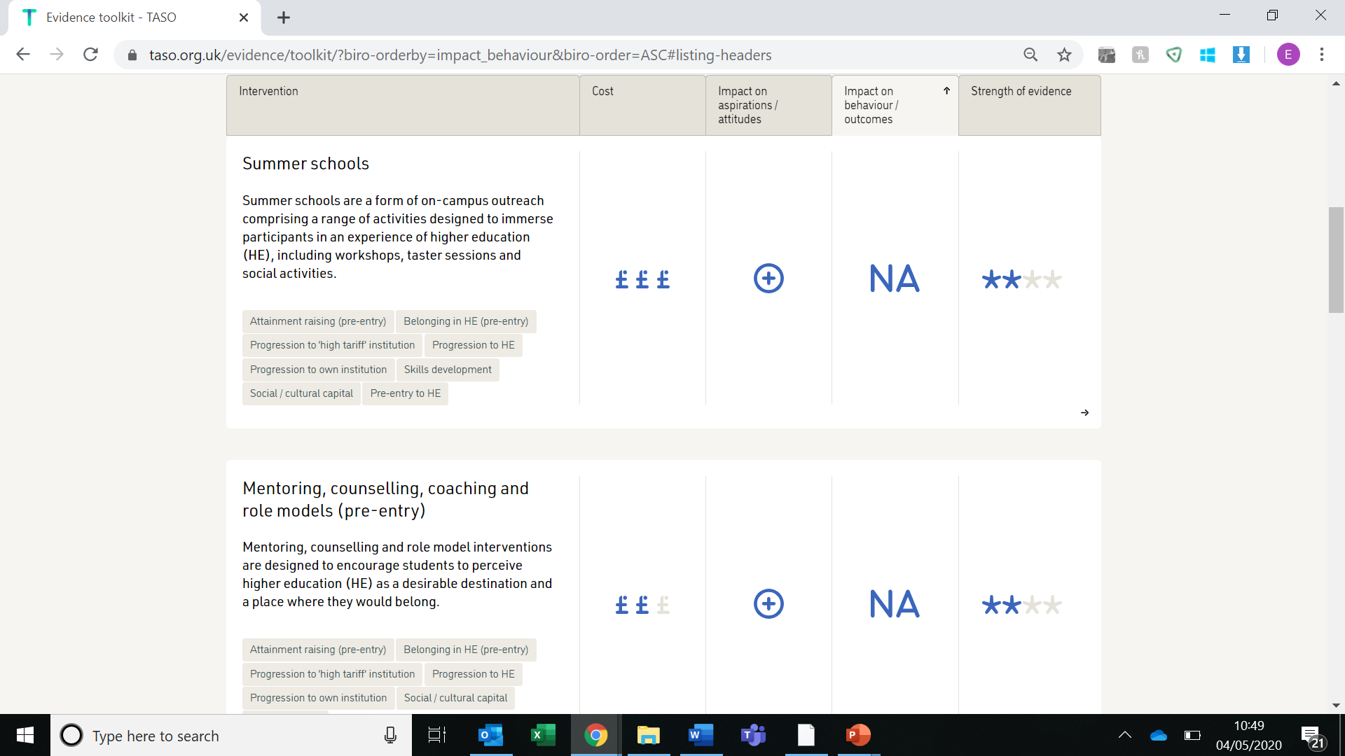
Evidence toolkit
Evidence toolkit
taso.org.uk
Notes:
RS
The toolkit is also on our website, it summarises existing evidence on approaches to WP and SS.

Slide 47
Questions?

