Slide 1
Supporting schools with the Gatsby Benchmarks and ‘meaningful’ encounters Charley Fowler – UK Education Lead and Area Manager charley@unifrog.org

Slide 2
Session aims
Insight into who we are and what we do.
Understanding of the Gatsby Benchmarks, especially GB7.
Awareness of how you can support schools/colleges with meaningful encounters with HE, as part of their GB7 work.

Slide 3
The Unifrog mission

Slide 4
UNIFROG IN NUMBERS
Who we work with, and how we do it
2,500+
Schools
300,000+
105,000+
Students in KS3
Teachers
400,000+
96%
Students in KS4
Resubscription rate
550,000+
9.2/10
Students in KS5
Customer support rating
Notes:
Add note to this slide

Slide 5
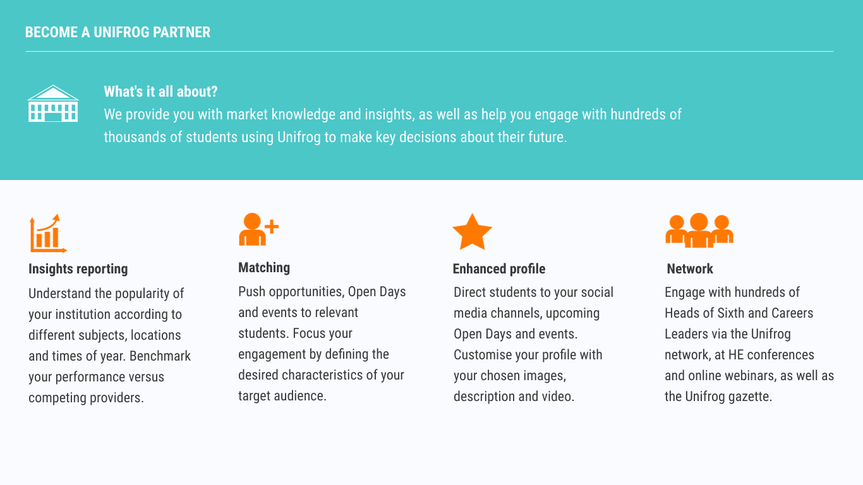

Slide 6
Gatsby Benchmarks
Stable careers programme
Learning from career and labour market information
Addressing the needs of each pupil
Linking careers to the curriculum
Encounters with employers
Experiences of the workplace
Encounters with FE, HE and apprenticeship providers.
Personal guidance
The backbone of the DfE’s statutory guidance for careers education in schools and colleges.
Considered in Ofsted inspections.
Support is offered to schools via the Careers and Enterprise Company.
Performance is measured via Compass+ (run by the CEC).

Slide 7
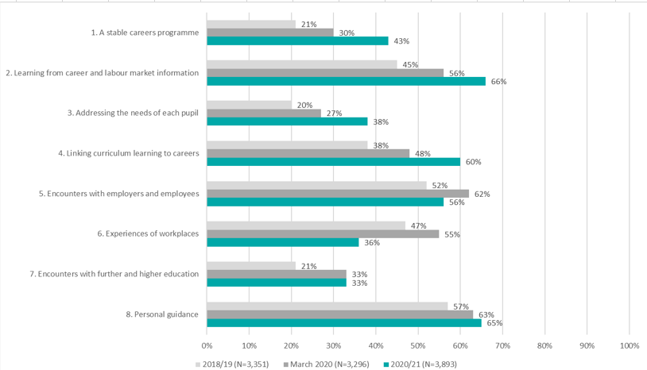
Gatsby Benchmark progress
This table demonstrates the % of schools and colleges who have fully met each benchmark, across the past 3 academic year.
Data published by the Careers and Enterprise Company in Dec 2021.
Notes:
https://www.careersandenterprise.co.uk/our-evidence/evidence-and-reports/trends-in-careers-education-2021/

Slide 8
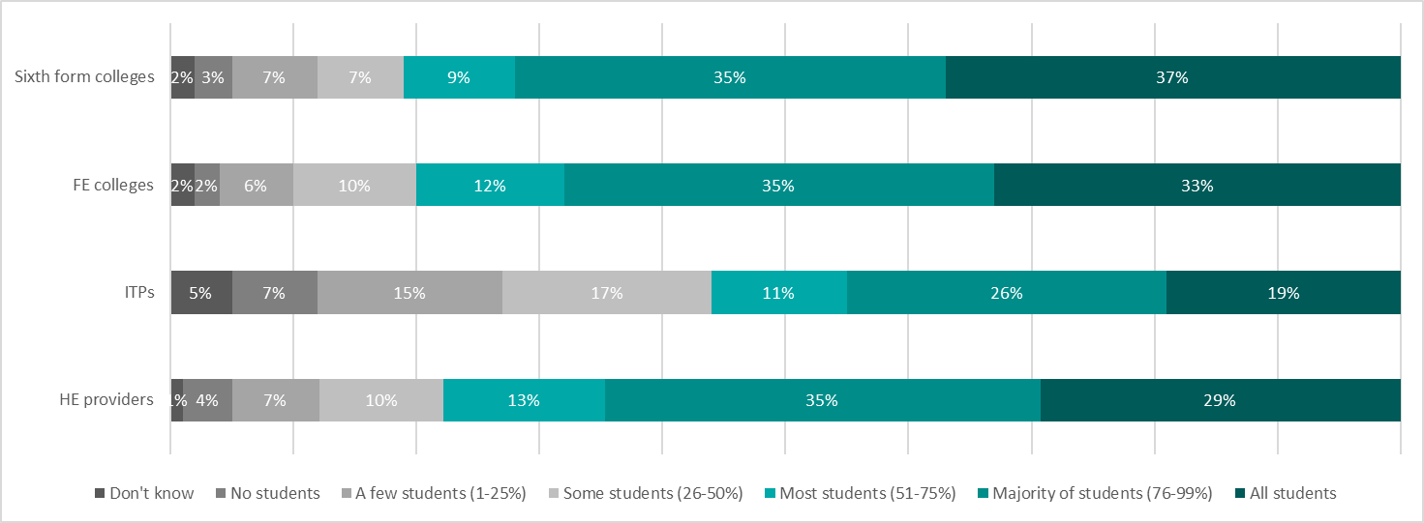
GB7 in focus
Proportion of students who have had meaningful encounters with education providers
The % of students who have received information about the full range of apprenticeships, and the % of students who have been on at least two HE visits, is also taken into account.
Notes:
Apprenticeship info – 46% all students, 38% - majority of students
HE visits – 14% all students, 28% majority of students (75% to 99%), 18% most students (50% to 75%), 18% some students (25% to 50%), 22% few or none.

Slide 9
Feedback from teacher champions
Start HE engagement as early as possible
Tailor engagement to the school and the needs of its students
Make workshops practical and deliver more taster style sessions
Link all the activity you deliver to careers
Incorporate student voices, ideally from the school’s local area
Notes:
Start HE engagement as early as possible – get them familiar with what uni is and it benefits from Y7 onwards. Optimum time to inspire before they get a apth fixed in their head. Start building their knowledge and aspiration. Teachers have found that some students get to sixth form and still don’t know the basics, what is a gap year, placement year
Tailor engagement to the school and the needs of its students – adapt the sessions and presentations delivered to suit the demographics of the school and student. Consider demographics, is the school high PP, what is the HE progressions rate? Ask the teachers how best to engage the students ahead of time, what format will respond best to? Identify the knowledge and skills gaps by asking students questions in the session.
Make workshops practical and deliver more taster style sessions – where suitable, make every engagement activity interactive and don’t just deliver a presentation, even lecture tasters. One teacher does a Problem Solving session with 5 different subjects, students rotate and have practical problems to solve for each.
Link all the activity you deliver to careers – at every stage tie content to careers, think about subjects as a whole journey, what can a student do with a degree in… Got a passion in this area? Help them figure out where this can lead them.
Incorporate student voices, ideally from the school’s local area – this will help students visualise themselves at uni and hearing from a peer is more meaningful. Schools Said ideally find an ex student of their or someone who at least comes from the local area.
Link all the activity you deliver to careers
Incorporate student voices, ideally from the school’s local area

Slide 10
The ‘make it meaningful’ framework from the Careers & Enterprise Company

Slide 11
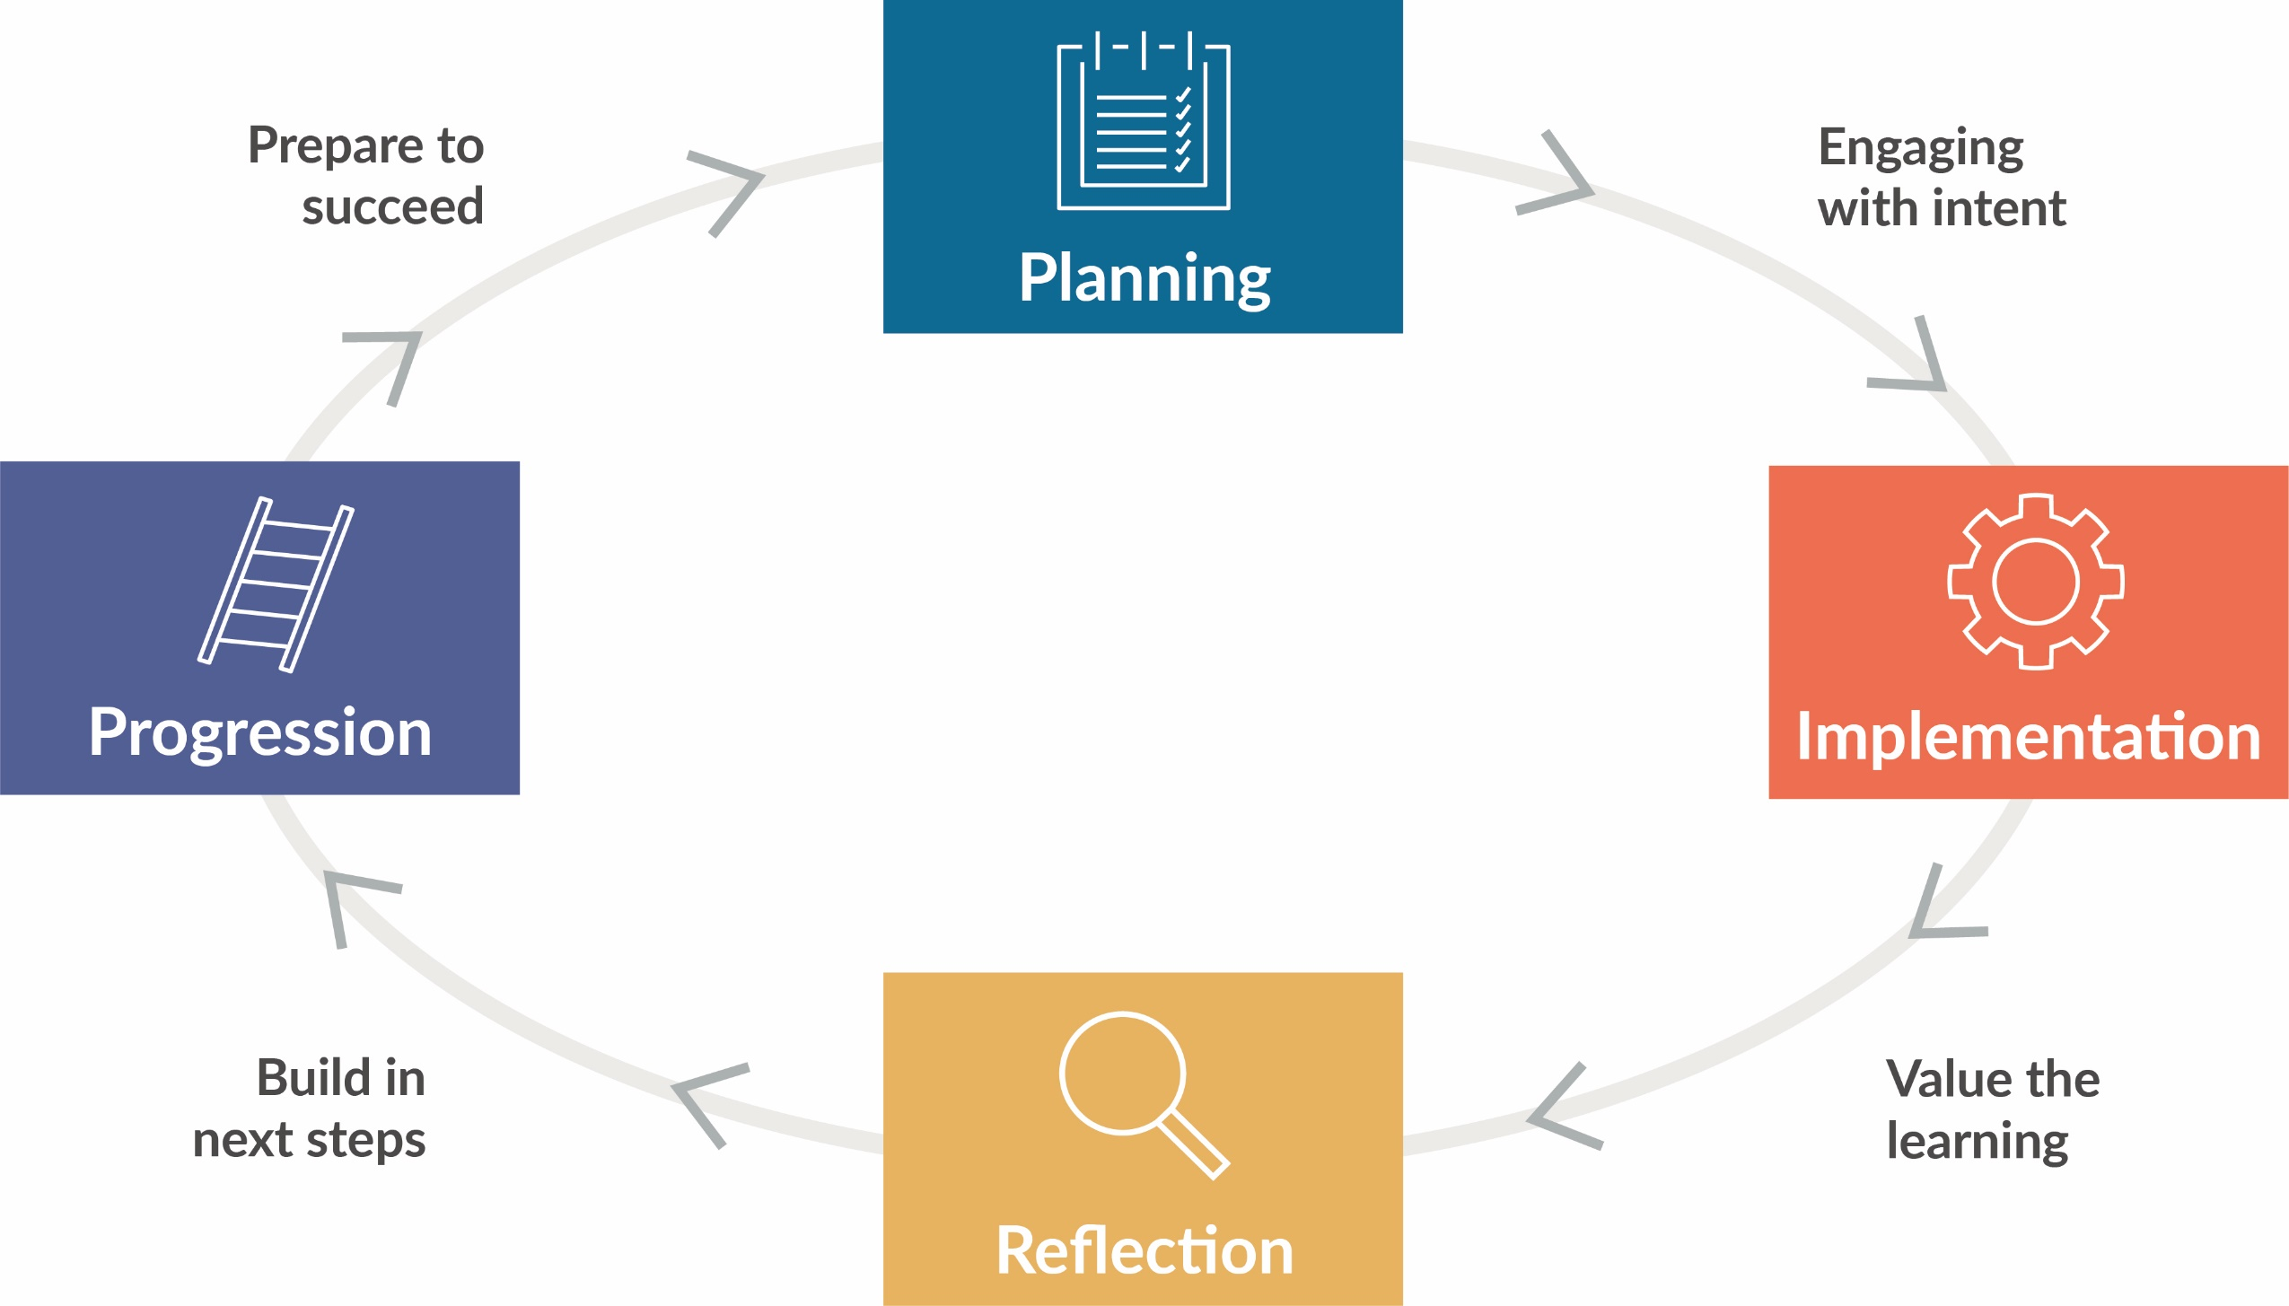
Overview of the framework

Slide 12
Planning a meaningful encounter
How do you work with the school to identify the needs of the students?
What happens before, or after the event, to prepare the students and ensure their learning continues?
How do you set objectives, and intend to measure impact?
Do you plan for differentiation and accessibility?
Best practice ideas:
Surveying students
Flexible communication with teachers
Make use of contextual data
Notes:
Think about alternative sessions not just the standards ones, can there be more subject tasters, more careers and soft skills focused workshops? What are the school career gaps in the school? Set joint objectives with the school, reflect on whether these were achieved.

Slide 13
Implementing a meaningful encounter
How do you set expectations for students?
Do you include parents and carers at all?
What opportunities are there for students to take ‘ownership’ of their learning during the event?
Which methods are most effective for gathering feedback during the event, and at the end?
Best practice ideas:
Barometers of confidence
Interactivity and actionable next steps
Content for parents
Notes:
Teachers want more parent and carer engagement, could resources be made available for them? Making everything interactive will help students take ownership and build investment, support them in making goals in the session and share these with their form tutor or parent ect.

Slide 14
Reflecting on a meaningful encounter
Do you engage with school after the event? How?
How do you respond to feedback and evaluation?
Best practice ideas:
Log notes in a shared space
Aim to plan the next encounter straight away
Notes:
Use surveys for staff and students. Give teachers feedback on how the session went that is both qualitative and quantitative.

Slide 15
How Unifrog has supported HE providers over the past 2 years

Slide 16
Text
Text

