Slide 1
Getting to grips with T Levels
HELOA national conference
Catherine Sezen

Slide 2

Agenda
T Levels
Rationale
T Level overview
Student perspective
Assessment, grading and progression
T levels one year on
T Levels in context
Level 3 review
Questions

Slide 3
Skills Plan Rationale

Slide 4
Skills Plan rationale
Raising productivity & meeting the skills gap
‘Academic’ path = well understood
Technical/vocational path = complex

Slide 5
Skills Plan Overview

Slide 6
Independent Panel – Review of Technical Education
Led by Lord Sainsbury - advised Ministers on improving the quality of technical education in England. The expert panel found a compelling case for change and recommended comprehensive reform:
The development of 15 technical routes, encompassing all employment-based and college-based training (apprenticeships and T Levels)
The development of new flagship technical education programmes (T Levels) to be delivered through exclusive license
A radical streamlining of existing technical qualifications, aiming to simplify the system for students and employers
Government accepted all recommendations in the 2016 Skills Plan, and committed to deliver first T Levels from September 2020

Slide 7
How the academic and technical options will work
Academic option
Technical option
Years
10-11
KS4
14-16
GCSEs and technical awards
GCSEs and technical awards
16+
Optional
Optional
Transition year??
Transition year
T Levels (two year)
College-based education including placement in industry/ Other technical quals
Apprenticeship with at least 20% college-based education
A levels and/or some applied general qualifications*
Higher education
(undergraduate degree)
Higher education (Level 4/5 technical education)***
Degree apprenticeships & higher apprenticeships
Skilled employment
*Some students will move directly from A Levels and/or applied general qualifications to degree and higher apprenticeships.
** Where a student does both, the traineeship will follow the transition year. Students doing both the transition year and a traineeship may progress directly to employment.
*** HNC, HND, Foundation Degree
Notes:
Two main options at 16. Academic route (GCSE/A level) or Technical route (college based T-levels) or apprenticeship. Both routes could lead to higher education. Those students who are not ready would take transition year on either route.

Slide 8
T levels

Slide 9
T Levels are…
New, two year technical education courses for 16-19 yr olds that will follow GCSEs
Developed in collaboration with employers, so that the content meets the needs of industry and prepares students for work
Course includes a mixture of classroom learning (80%) and ‘on-the-job’ experience (20%) during an industry placement of a minimum of 45 days
Qualifications comprise a core component and one or more occupational specialisms
Progression options include skilled employment, further study or a higher apprenticeship (T Levels will attract UCAS points)
More rigorous and substantial than most existing technical qualifications, with longer teaching time – one T Level is comparable in size to 3 A levels.

Slide 10




Rollout of T Levels from 2020 onwards
Agriculture, Environmental and Animal Care
Business and Administrative
Catering and Hospitality
Construction
Creative and Design
Agriculture,
Land Management and Production
Management and Administration (C&G)
Catering
Building Services Engineering (C&G)
Craft and Design
Design, Surveying and Planning (P)
Media, Broadcast and Production
Animal Care and Management
Onsite Construction (C&G)
Digital
Education and Childcare
Engineering and Manufacturing
Hair and Beauty
Health and Science
Legal, Finance and Accounting
Digital
Business Services (N)
Education and Childcare (N)
Design and Development
(C&G)
Hair, Beauty and
Aesthetics
Health (N)
Accountancy (P)
Digital Production, Design and Development (P)
Maintenance, Installation
and Repair (C&G)
Healthcare Science (N)
Finance (P)
Science (N)
Legal
Processing and controlling (C&G)
Digital Support Services (N)
T Levels for 2020 delivery
T Levels for 2021 delivery
T Levels for delivery in 2022
T Levels for delivery in 2023
Human Resources T Level still being considered
AOs: P= Pearson; N =NCFE; C&G = City and Guilds

Slide 11
T Level programme
1800 Hrs over 2 years
TECHNICAL QUALIFICATION (TQ)
900 -1400 GLH
Occupational specialism
At least half of the qualification
Knowledge and skills required to enter employment in that occupational specialism
As close to full competence as possible
English, maths and digital competence integrated where relevant
CORE
Up to half the qualification
Knowledge and understanding of the concepts, theories and principles relevant to that sector
Assessed through an external examination and a substantial project
T Level Industry Placement
ENGLISH and maths Requirements
Students required to achieve a level 2 in English and maths.
Either GCSE (grade 4 and above) or level 2 Functional Skills (pass)
Additional mandatory requirements
Occupation-specific requirements, included where possible if essential to enter employment
Between 315-420 hours
Undertaken with an external employer
Chance to apply skills and apply knowledge in a workplace environment
Support for travel and subsistence costs but employers not expected to pay students

Slide 12
Route, T level & specialisms
Route
T Level
Specialisms
Accounting
Assistant Accountant
Legal services assistant : Business, Finance & Employment
Legal services assistant : Dispute resolution
Legal, Finance & Accounting
Legal
Legal services assistant : Private client
Legal services assistant : Justice system
Legal services assistant : Social, welfare & immigration
Retail and Commercial Banking Analyst
Investment Banking and Asset and Wealth Management Analyst
Finance
Insurance Practitioner
Financial Compliance/Risk Analyst
Financial Operations Analyst

Slide 13
A student perspective

Slide 14
Assessment, grading and progression

Slide 15
Technical Qualification: content, assessment and grading overview
Core
Core knowledge exams typically no more than a third (can be as low as 12%) of marks.
Employer Set Project focus on employability skills in occupational contexts up to 20% of the marks.
Graded A*-E and fully compensatory.
Occupational Specialisms
Performance outcomes set by employers always occupationally specific
To be valid assessment must also be occupationally specific applied and practical.
To Pass students need to be competent – in line with employer expectations, which will be exemplified
Graded PMD as pass threshold will need to attest to competence

Slide 16
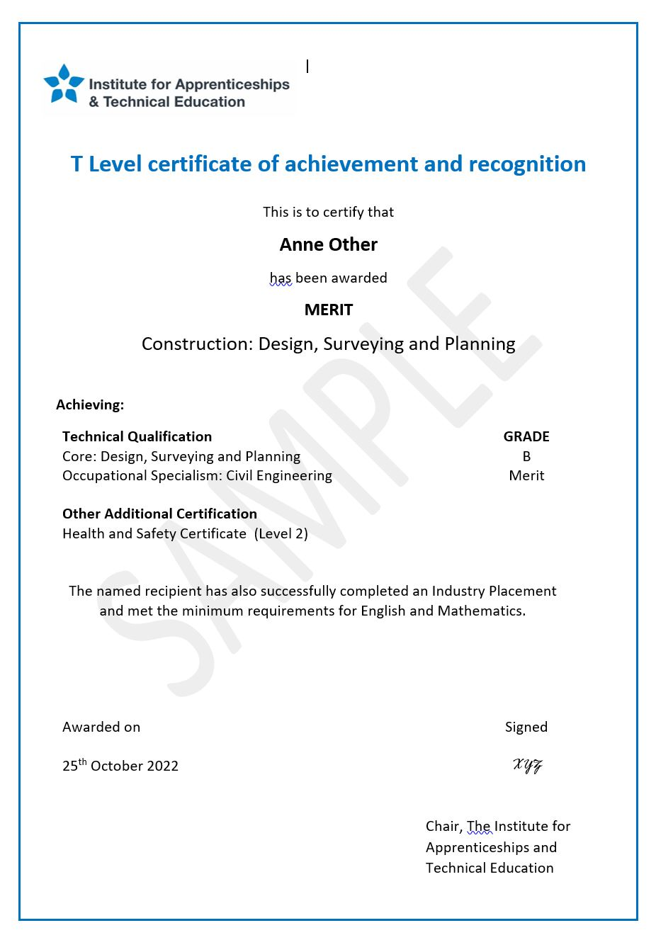
T Levels: Overall GRADING
We are introducing ‘Look up tables’ for T Levels to make it easier to see how higher overall T Level Grades are derived from the TQ components.
 | Occupational Specialism Grade
Core Component Grade |  | Distinction | Merit | Pass
 | A* | Distinction* | Distinction | Distinction
 | A | Distinction | Distinction | Merit
 | B | Distinction | Merit | Merit
 | C | Merit | Merit | Pass
 | D | Merit | Pass | Pass
 | E | Pass | Pass | Pass
Overall T Level Grade
We are also introducing a Distinction* overall grade.
Help admissions practitioners better determine suitability for HE pathways.
Recognise the exceptional achievement of the highest T Level performers.
Notes:
If students need to take more than one occupational specialism these are graded and reported separately on student’s certificates.

Slide 17
T Levels: Overall GRADING
To ensure fairness, the table would look different for different T Levels depending on the size of the Core Component and Occupational specialisms. For example:
Core 50%/Occupational Specialism(s) 50%
Core 40%/Occupational Specialism(s) 60%
Core 30%/Occupational Specialism(s) 70%
 | Dst | M | P
A* | Dst* | Dst | Dst
A | Dst | Dst | M
B | Dst | M | M
C | M | M | P
D | M | P | P
E | P | P | P
 | Dst | M | P
A* | Dst* | Dst | M
A | Dst | Dst | M
B | Dst | M | M
C | Dst | M | P
D | M | P | P
E | P | P | P
 | Dst | M | P
A* | Dst* | Dst | M
A | Dst | Dst | M
B | Dst | M | P
C | Dst | M | P
D | M | P | P
E | M | P | P
There will be just one look up table for each T Level.
And there will always be the same instances of each grade available in each look up table: six Passes, six Merits, five Distinctions and one Distinction*.
To be awarded a Distinction*, the student must achieve an A* in the Core and a Distinction in the Occupational Specialism(s).

Slide 18
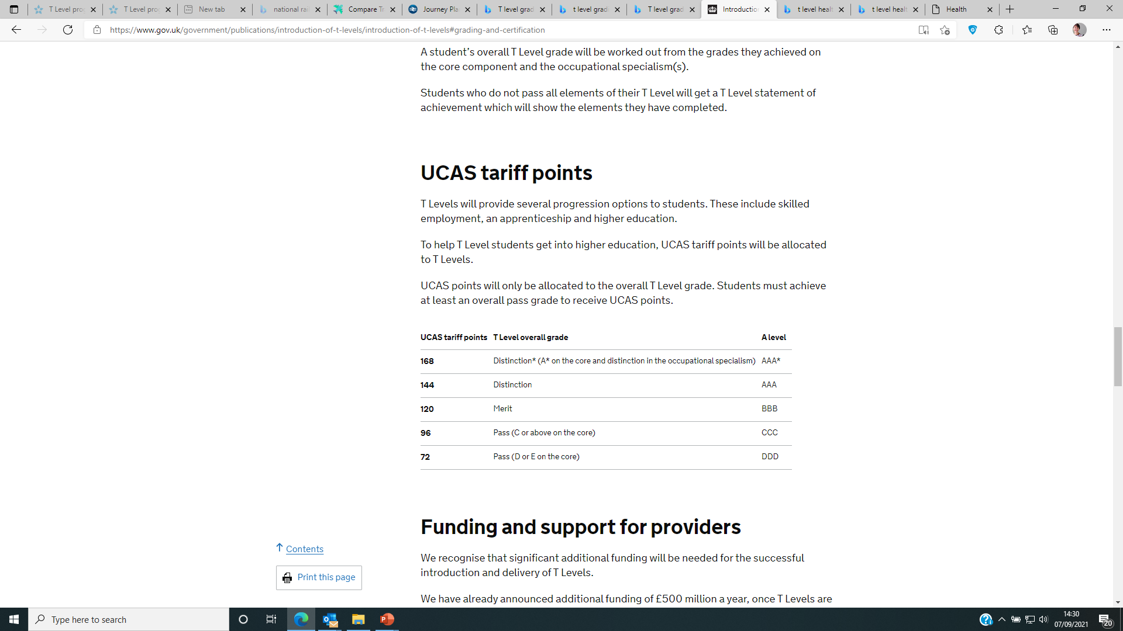
UCAS Points

Slide 19
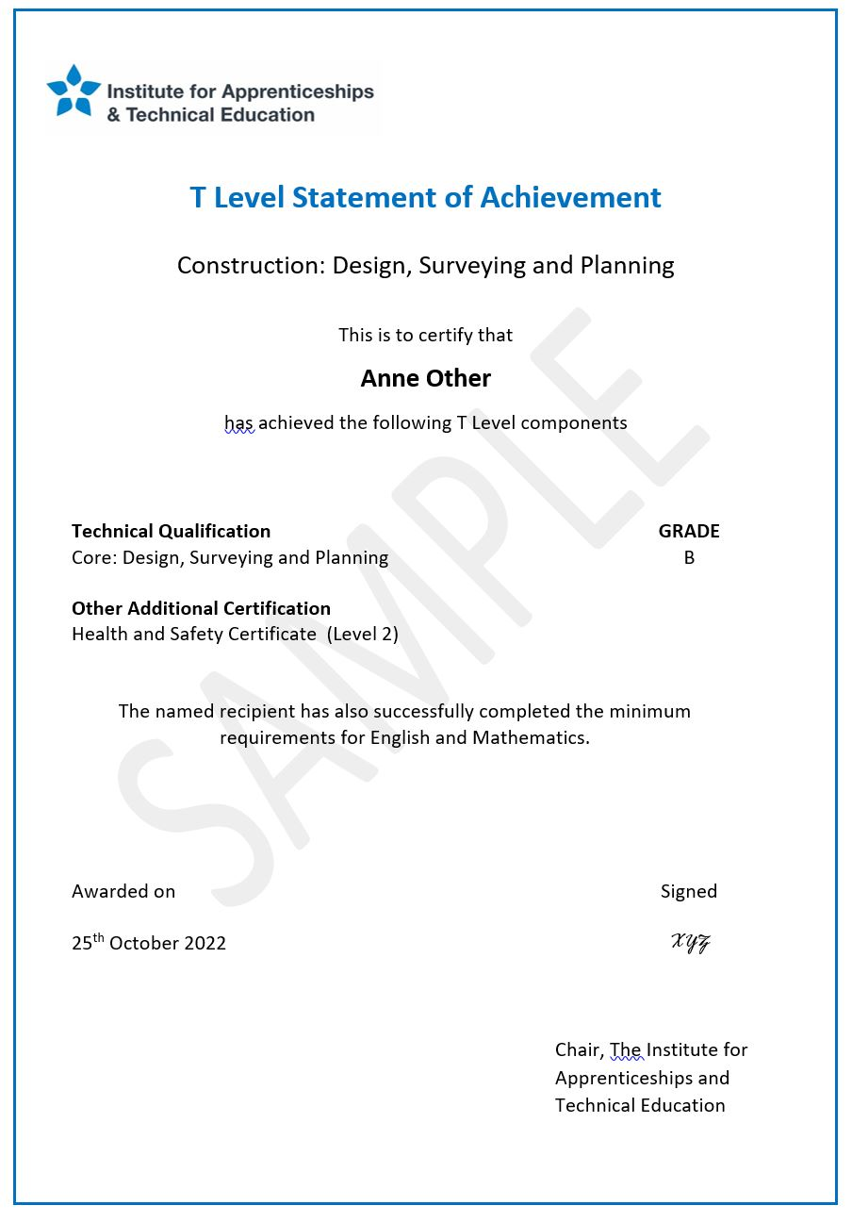
T Levels: Statement of Achievement
If students leave the course early or do not pass a T Level overall they will be issued with a statement of achievement.
This indicates what students have achieved.
The back of the statement will describe what is required to pass a T Level.
Separate UCAS Tariff points will not be allocated to the TQ components.

Slide 20
T Levels – one year on

Slide 21
Despite the pandemic T Levels have had a positive impact on…
T Levels
students
employers
staff

Slide 22
but there are still some challenges…
Challenges
English & maths
Industry placements
Progression
Funding

Slide 23
T Levels in context

Slide 24
T Levels in context
T Level Transition Programme (targeted at students who are not ready to start a T Level but have potential to progress to one) - phased implementation starts with a small number of providers from this September.
Review of qualifications at level 3 and below continues - aiming to simplify the qualifications landscape. Second stage will consult on firm proposals for change and criteria for funding
The consultation on Higher Technical Education (levels 4-5) in England closed on 29 September 2019. Government response published July 2020
FE reform programme - White Paper aimed at delivering ambitious reform for the FE sector.

Slide 25
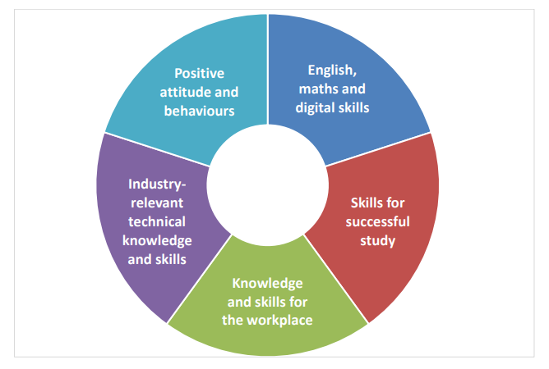
T level Transition Programme: Areas of core knowledge, skills and behaviours
For further details see framework for delivery

Slide 26
Higher technical qualifcations
Higher Technical Qualifications are level 4 or 5 qualifications that have been quality marked by the Institute to indicate their alignment to employer-led occupational standards.
New or existing level 4 or 5 qualifications submitted to the approvals process will receive a quality-mark if the qualification satisfies the Institute’s approvals criteria.
Higher Technical Qualifications align to existing occupational standards, providing learners with entry-level competence and allowing them to enter their chosen profession or progress onto higher education.

Slide 27
Level 3 review

Slide 28
Review of qualifications
14 July: DfE published:
consultation response
policy document – Key read
impact assessment
Guidance for post 16 providers
Approvals process for qualifications which sit alongside T levels and A Levels
There will be a further consultation on Level 2 and below.

Slide 29
How are things changing at Level 3?
Technical 19+
Adults will have access to a broader range of technical qualifications including qualifications for occupations served by T Levels (e.g. Data Technician) and smaller qualifications offering transferrable skills such as IT
Clearer distinction between academic and technical qualifications
Academic - 16-19 and 19+
Technical – 16-19
A levels
Small (AGQ style) qualifications to be taken alongside A Levels as “mixed programmes” – good for HE progression in some areas e.g. health, engineering
Large alternative qualifications taken instead of A Levels e.g. sports / performing arts. Can’t overlap with T Levels.
Other – e.g. IB, Access to HE, or Core Maths
T Levels
Other qualifications delivering competence against a standard
- can’t overlap with T Levels (e.g. marketing or protective services)
Specialist qualifications (e.g. marine engineering)
Apprenticeships
Some small AGQs etc defunded if they do not meet quality and necessity tests
Large VTQs defunded if they overlap with T Levels e.g. engineering or health and social care / do not meet new quality and necessity tests.
Existing qualifications defunded because they aim towards the same occupation as a T Level e.g. in Digital or Construction
Existing specialist qualifications defunded if they do not meet new quality criteria
Impact on current qualifications

Slide 30
Policy updates

Slide 31
Updates to plans for T Level implementation and the qualifications review
Changes to the English and Maths requirement for T Levels
We want to make sure that as many young people as possible have access to T Levels and can successfully complete the programme. T Level providers and others from across the sector have been telling us for some time that the English and maths exit requirement is a real barrier for students in taking up T Levels. We have therefore decided to remove the exit requirement with immediate effect for all T Level students - those who have already begun their courses and those who have yet to begin.
Maths and English study will remain of central importance to T Levels and the exit requirement will be replaced with the condition of funding, bringing T Levels into line with other level 3 post-16 programmes. Attainment in these subjects will also continue to be referenced on T Level certificates and statements of achievement.
Changes to timeline for reform of level 3 qualifications
The Secretary of State has announced plans allowing an extra year before our reform timetable is implemented. This extra year will allow us to continue to work hard to support the growth of T Levels and gives more notice to providers, awarding organisations, employers, students and parents so that they can prepare for the changes.
The extra year means that we will remove 16-19 funding approval for qualifications that overlap with wave 1 and 2 T Levels from AY 2024/25, and from wave 3 and 4 T Levels from AY 2025/26. We will be publishing the provisional list of qualifications in scope for defunding in 2024 in the coming months. It is important to note that the removal of funding approval from a qualification will only apply to new starters – students who are entering the second year of a two year qualification will be able to complete it.
The timeline for the introduction of reformed technical and academic qualifications will also move back one year, starting with the pathfinder in the Digital route in AY 2024/25, followed by remaining routes in AY 2025/26 and 2026/27.

Slide 32
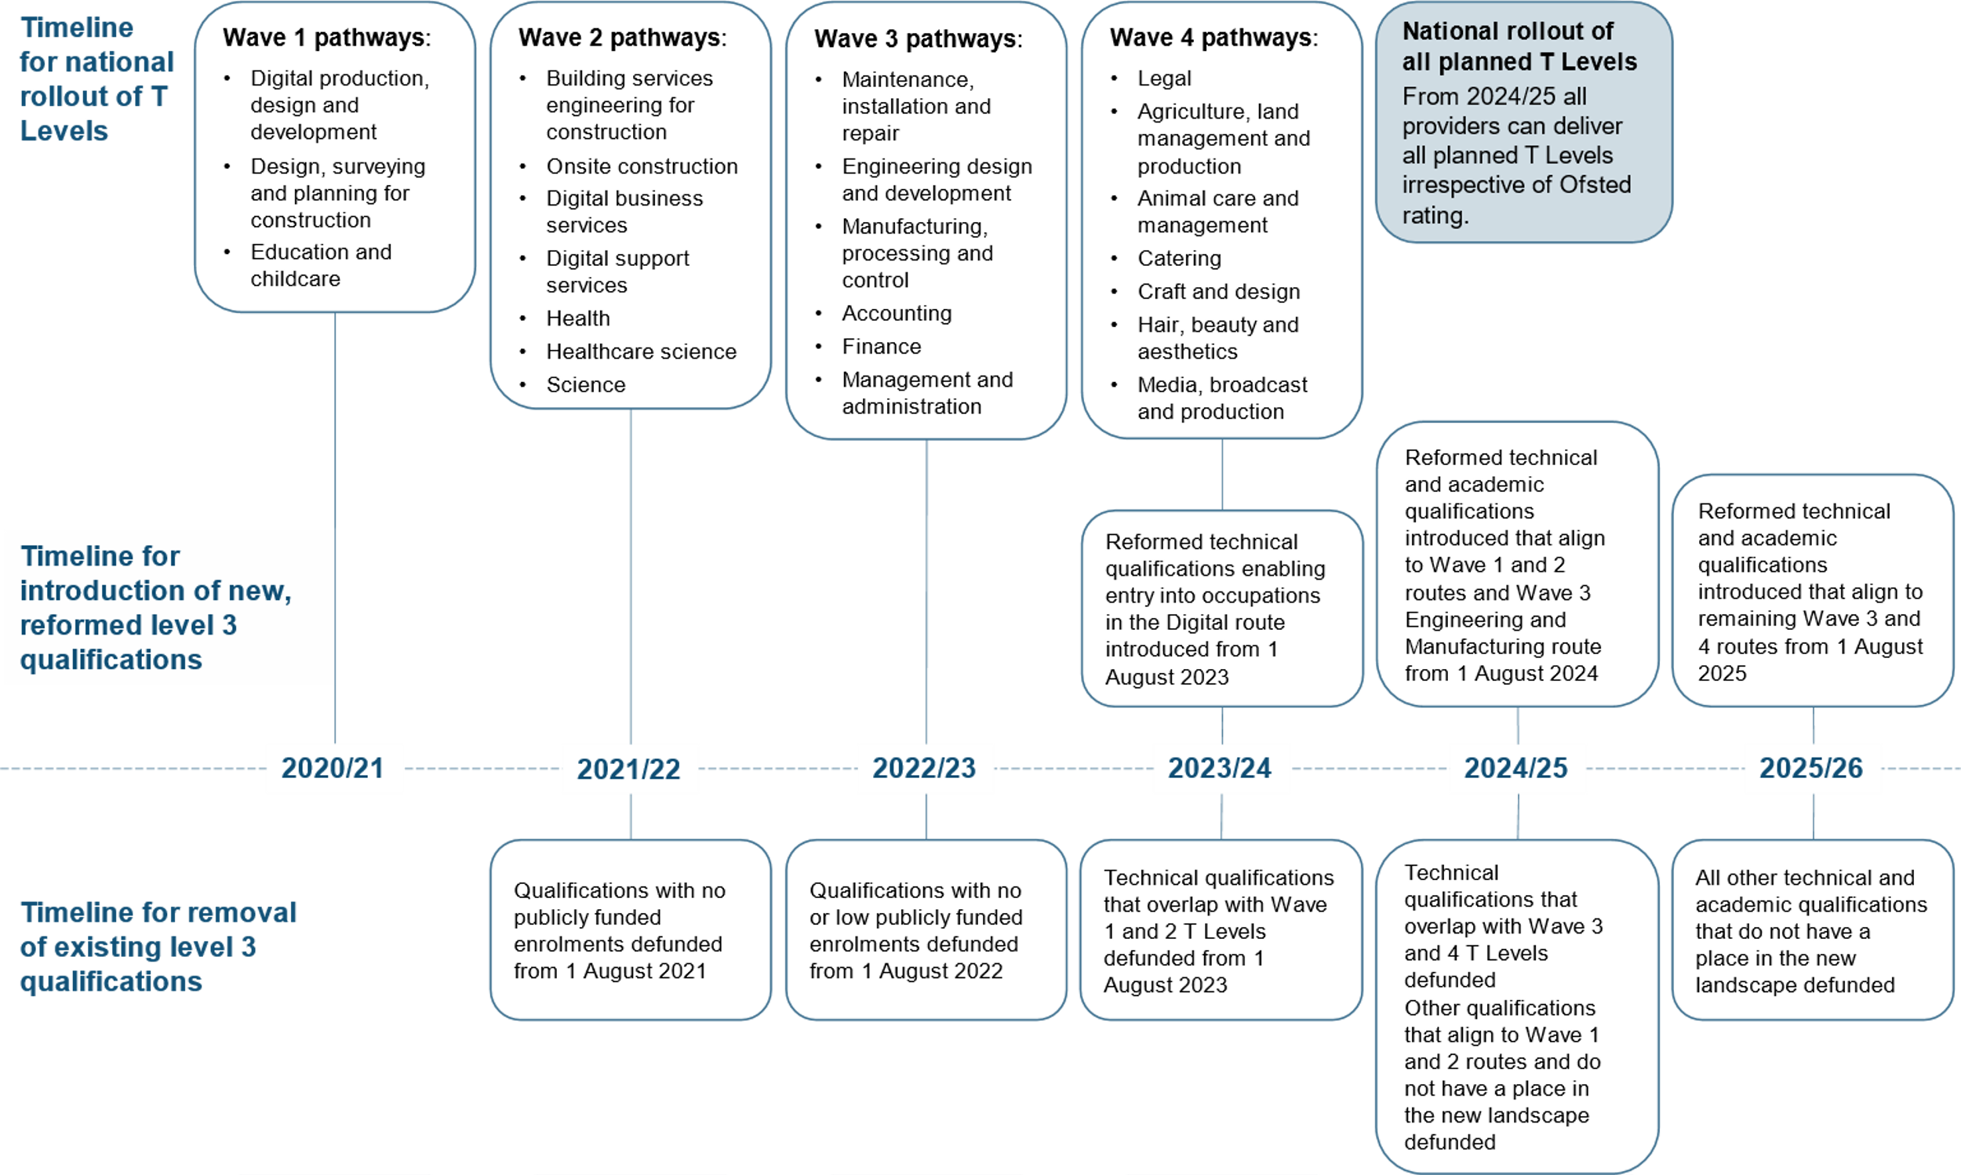
Qualification reform timeline
Now 2025/26 & 2026/27
Now 2024/25
Now August 2024
Now August 2025

Slide 33
Updated timeline for the qualifications review

Slide 34
Further reading

Slide 35
Useful documents
Gov.uk T level overview
T Level action plan
Ncfe – HE info pack
City & Guilds – T level overview
Pearson – T Level overview

Slide 36
Questions?
catherine.sezen@aoc.co.uk

