Slide 1
HELOA Mentoring: How it works and how it can work for you! Jamie Graney – NW&NI VC (Comms. & Membership); Project Lead Chris Mullen – NW&NI Group Chair
www.heloa.ac.uk
Registered charity number 1182953

Slide 2
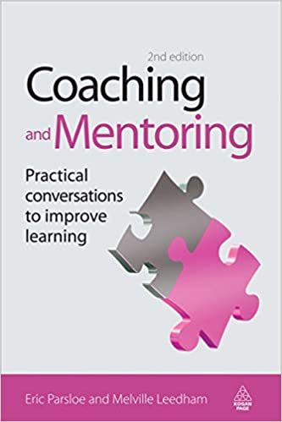
What is ‘Mentoring’?
www.heloa.ac.uk
"The purpose of mentoring is to support and encourage people to manage their own learning in order that they may maximise their performance and become the person they want to be."
- Eric Parsloe (Author of ‘Coaching & Mentoring: Practical Methods to Improve Learning’, 2000)
Registered charity number 1182953
Notes:
Jamie Write down what you think mentoring is.
If anyone has encountered mentoring programmes in the past, the guidance usually provides an overall theme towards what it actually means to mentor someone, or be mentored. It differs from ‘coaching’, which can be confused sometimes, as coaching involves the ‘coach’ giving direct instructions to the participant and setting tasks themselves that they think the participant should do.
Meanwhile, mentoring is much more holistic and is led entirely by the mentee. This quote sums it up pretty well.

Slide 3
Notes:
Jamie – Before we go into detail; 4min video on mentoring (referred to here as coaching but process displayed is more mentoring); Was shown this in mentoring training at my institution; mentoring much less direct and instructional than ‘coaching’

Slide 4
Image source: https://en.wikipedia.org/wiki/Sounding_board
Notes:
Jamie – So the idea is to be one of THESE – does anyone know what this is?; Sounding board – AN IMPARTIAL SOURCE OF REFLECTION

Slide 5
Why we came up with the programme?
www.heloa.ac.uk
Members told us they had limited opportunities to progress within their institutions due to a lack of development opportunities
Newer members wanted guidance from outside their own institutions and to develop long-term contacts
All members are welcome to become part of the programme as either a mentor or mentee
Zero-cost peer-led programme of self development
The end-goal is to equip members with new and improved tangible skills that they can evidence when progressing within their role or into brand new areas and careers!
Registered charity number 1182953
Notes:
Chris Members told us they had limited opportunities to progress within their institutions due to a lack of development opportunities
Newer members wanted guidance from outside their own institutions and to develop long-term contacts
All members are welcome to become part of the programme as either a mentor or mentee
Zero-cost peer-led programme of self development
The end-goal is to equip members with new and improved tangible skills that they can evidence when progressing within their role or into brand new areas and careers!

Slide 6
Does it make a difference?
Universally positive (no, really!)
Seen real-world changes from members
Some have secured work experience opportunities in brand new areas
Some have achieved promotions based on guidance and reassurance from the mentors
Others have enjoyed developing new contact networks
“As a mentor it gave me the opportunity to reflect on my experience (I actually surprised myself after 6 years at officer level) and provide useful advice to my mentee on how to position themselves when looking to progress to officer level. The biggest benefit was the outcome, my mentee secured a new job (albeit in a different role) and I felt that I contributed with planning for interviews etc.”
“…[My mentor] was really helpful and shared her experience around presentations, styles and approaches to various situations and gave me specific examples of how to approach presentations where I do not feel confident in… It ran like an informal chat where I was able to pick her brain which was really relaxed over a coffee.”
Notes:
Jamie Read through for both mentors and mentees, that this is a mutually beneficial process. That for those looking to act up but struggling to fin the opportunity this could be it.
For Mentees that we have a wealth of expertise's and information and to use this as a chance to have a more formal ways of learning from colleagues in a number of roles and at institutions.
Great for learning new ideas and expanding your sector knowledge.

Slide 7
Does it make a difference?
“Well I certainly succeeded in my goals of building new skills and securing a new job! Seeing myself grow in confidence to put myself forwards for different opportunities which I would not have thought of myself doing if I didn't have a mentor. For example, I delivered a talk for a NEON training day which I would not have put myself forwards for! I received excellent feedback and has built my confidence up. Also understanding line manager techniques - it was my first time line-managing someone, and I received lots of hints and tips on how to support this person. I also wanted to learn more about the strategic side of things which would help for future roles, and again I would not have asked my own manager if I could attend APP meetings and Steering Group meetings if it was not for my mentor suggesting it and supporting me. This in turn has helped with my interview for my new role.”
“Building a relationship with another colleague from the sector and finding out lots of useful information about topics I haven't yet experienced in my career.”
“Initially I wasn't sure about the scheme, but being in a rut with work I thought this may be a good opportunity to think about ways I could develop and gain more skills from an outside perspective. I think this is a fantastic experience for anyone who is looking to build in confidence, but also it's been great seeing my mentor on a regular basis and having a good catch up. At the end of every meeting I always felt extremely positive and I really enjoyed it. If I wasn't leaving for a new job outside of HELOA I definitely would have carried it on.”
Notes:
Jamie Read through for both mentors and mentees, that this is a mutually beneficial process. That for those looking to act up but struggling to fin the opportunity this could be it.
For Mentees that we have a wealth of expertise's and information and to use this as a chance to have a more formal ways of learning from colleagues in a number of roles and at institutions.
Great for learning new ideas and expanding your sector knowledge.

Slide 8
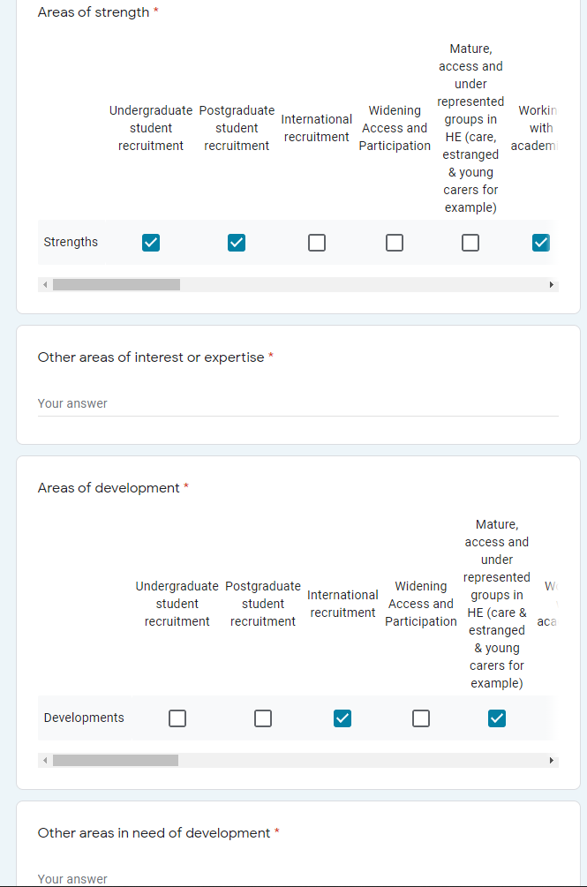
Setup and running a programme
www.heloa.ac.uk
Easy to fill out Google form, asked for areas of strength and development needs
From this, the committee will match you with a mentor or mentee based on these skills gaps
Initial contact from mentee – sometimes this does take a little while!
Freedom to devise a plan best for themselves – contact or meet up!
Relationship can continue for as long as they feel mutually beneficial
Mentors and Mentees can ask to change their partner at any point
Once relationship is complete, members can be placed back in the pool!
Registered charity number 1182953
Notes:
Chris Easy to fill out Google form, asked for areas of strength and development needs
From this, the committee will match you with a mentor or mentee based on these skills gaps
Initial contact from mentee – sometimes this may take a little while!
Freedom to devise a plan best for yourselves
Contact or meet up, your choice
Relationship can continue for as long as you feel mutually beneficial
Mentors and Mentees can ask for to change if circumstances occur
Once relationship is complete, you can be placed back in the pool!

Slide 9
Activity! h Match the mentor!
www.heloa.ac.uk
Registered charity number 1182953
Notes:
Chris

Slide 10
Feedback! Who did you match with whom? Was it difficult matching them up? Do you think this is the best way of matching members?
www.heloa.ac.uk
Registered charity number 1182953
Notes:
Chris

Slide 11
What are the responsibilities?
Being a Mentor
Helping mentees to find their own solutions A strong desire to develop others A good understanding of your sector and role Set initial structure to meetings Demonstrate good practice Regular communication
Being a Mentee Consider what you want from mentoring What do you need to develop or learn Be open and honest about your involvement Utilise this as part of your PDRs / Reviews Consider who may be a good mentor Think about how long you want it to last
Time – Commitment – Professionalism – Respect - Trust
Notes:
Jamie This should be something you are interested and committed to. The relationships will work when both mentor and mentee have an agreed structure, respect for the others time and communicate well. It is a confidential process to allow a non judgemental and safe place to discuss and explore ideas.
Mentors – it is a way to give advice, it is a way to help someone find their own answers through conversation
Mentees – it is a process that will allows you to reflect on your develop and explore ideas about your career
This will ultimately be what you make it, please be respectful of each other and each others time and committments

Slide 12
Activity! h Give it a go!
www.heloa.ac.uk
Registered charity number 1182953
Notes:
Jamie

Slide 13
Mentoring activity: give it a go!
In pairs, both have a go at practising being a mentor and a mentee (mentee leads)
Imagine it’s your first session and you are discussing:
What you both want to get from the relationship?
What do you need to learn or develop?
What your future aims or aspirations are?
How long do you want it last?
How will your structure your meetings?
How frequently will you have your meetings and where will you have them?
Remember your responsibilities!
(See page one of your sheet if you need hints!)
Time – Commitment – Professionalism – Respect - Trust
Notes:
Jamie This should be something you are interested and committed to. The relationships will work when both mentor and mentee have an agreed structure, respect for the others time and communicate well. It is a confidential process to allow a non judgemental and safe place to discuss and explore ideas.
Mentors – it is a way to give advice, it is a way to help someone find their own answers through conversation
Mentees – it is a process that will allows you to reflect on your develop and explore ideas about your career
This will ultimately be what you make it, please be respectful of each other and each others time and committments

Slide 14
Feedback! Was it easy to start the conversation? What structure do you think works best? How did you feel as a mentor and mentee?
www.heloa.ac.uk
Registered charity number 1182953

Slide 15
What can members take from this?
www.heloa.ac.uk
Look at your PDRs
Is there some training missing from your institution?
Flexibility is key
Time & Commitment
Keep innovating, keep listening
It’s perfect for new members
It’s a zero-cost form of informal support
It makes real-world differences to yourself and your colleague(s)
Registered charity number 1182953
Notes:
Jamie

Slide 16
Top Tips
www.heloa.ac.uk
Real interest or buy in from teams, managers, members
Quite a bit of background work – but once complete a programme can run itself
Boundary setting – what a programme will do, what you expect from participants
Utilise courses, training and development at your institution to influence your programme
Always continue to innovate and improve! Especially listen to participant feedback
☺ GIVE IT A GO! ☺
Registered charity number 1182953
Notes:
Jamie

Slide 17
So… what IS ‘Mentoring’?
www.heloa.ac.uk
Registered charity number 1182953
Notes:
Chris With everything you’ve learnt, write down what you NOW believe ‘Mentoring’ to be.

Slide 18
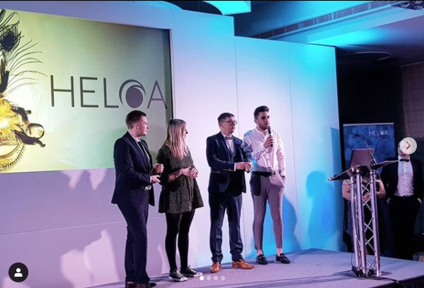
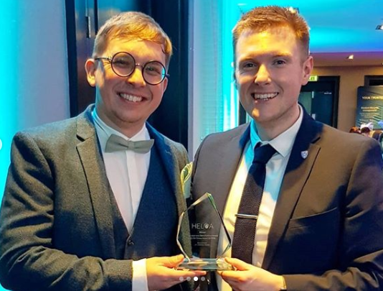
Thanks for listening!
www.heloa.ac.uk
Any questions?
jamie.graney@liverpool.ac.uk
chris.mullen@edgehill.ac.uk
Registered charity number 1182953
Notes:
Jamie

