Slide 1
How to get a degree in parenting
what you don‘t know but need to know
Sarah Frend
Brendan McGrath

Slide 2
Our research sample
School Students
Online survey
Collected between Jan and Mar 2017
13,000 school/college students
1,800 schools/colleges across the UK
Parents
Online survey
Collected between Dec 2018 and Jan 2019
100 parents
Coverage across the UK and socio-economic backgrounds
Notes:
Schools survey looked at careers aspirations of students. Asking them what they would like to do in the future, how they like to receive careers information and who/what influences them most.
Parent survey is initial research into understanding how parents support their children on their university choices and future career options. It provides a snapshot into how rapidly situations and opinions can change as a result of the various educational announcements in 2018 (Brexit, budget cuts, push on apprenticeships, the accuracy of SAT results, changed grading system for GCSEs, etc.)
We are launching large scale research of both surveys in March/April time.

Slide 3
Would you encourage your children to attend university?
Notes:
Now from parents research....
74% of parents said they would encourage their children to go to university. 25% said they would let them make up their own mind. 1% said they actively discourage it.

Slide 4
Would you encourage your children to attend university?
Notes:
If the parent attended university, they were then more likely to encourage their children to go to university.

Slide 5
Why do parents encourage their children to go to university
Notes:
We need A5 sets of cards for each table. Each table to have a set of 9 cards with each option printed on a separate card
We need 6 sets

Slide 6
Why do they encourage university?
Notes:
The biggest reason that parents encouraged their children to go to university was because they felt it would be better for long term career prospects. Job security was also important.

Slide 7
University education and life at university as a young adult would be most beneficial at that stage of their life. Where there is structure and routine - a good mid-way transition from scholar living at home to adult out in the world, where they will receive the support they need.
It is very difficult to go to University later in life. Those who go straight to work and do part time courses have a harder life, endure the pain but none of the pleasure of being at University and are, in my experience nowhere near as rounded because they have had no exposure to anything other than their first job and their first employer and still live with their parents.
Because I believe that a degree will open more doors in every field of employment and give them an advantage in an environment where there is a lot of competition for jobs.
I personally believe that it is very important that my child should go to university, not just for their academic development and future career prospects, but because it broadens their horizons and teaches them to be more independent when they move away from home, as well being in a stimulating and challenging environment which will hopefully lead to a more fulfilling time in later life.

Slide 8
Why do parents encourage their children NOT to go to university

Slide 9
1.
2.
It is better for their long term career to go straight into work, an apprenticeship or school leaver programme
University is too academic; practical skills and work experience will benefit them more
Notes:
Straight split 50/50 attended and not attended uni

Slide 10
96% of parents said that the career choices available to their child from their university degree was the biggest factor when discussing university options
Notes:
The career choices on offer/available to their child from their university degree/alternative path was the largest factor parents used to influence their child's choices
80% +16% choices in graph form slide 4.4

Slide 11
97% said the single most important factor when giving advice about your children’s choice of profession is choosing a career they enjoy and are good at
Notes:
An overwhelming majority of parents want their children to choose a career that they enjoy and are good at.

Slide 12
77% of parents would offer some advice about potential employers but would mostly leave the decision to their children.
Notes:
23% are concerned about specific employers. However, the employer must suit their child. This implies job satisfaction is still a key influencing factor.

Slide 13
60% of parents say that the single most important factor when giving advice about your child’s choice of employer is job satisfaction.
Notes:
60% of parents say that the single most important factor when giving advice about your child’s choice of employer is one they would enjoy working for. In conclusion, when looking at longer term plans, parents influence students to choose an employer that they would enjoy working for. This was deemed as more important than influencing them to go to an employer that offers a high starting salary.
23% for training and development opportunities.
13% for career prospects
Location and salary are not influencing factors.

Slide 14
What does your university do to demonstrate career outcomes, future prospects and likely employers?
Notes:
Discussion & feedback from groups
Sharing on each table what they do and how successful
Link back to the research
Radical ideas – parents webinars/ parents website section/ understanding the lingo e.g. BSc
Could they learn from Ind schools? Parents portal

Slide 15
Employability
Current
students
Internal
departments
Alumni
Websites
Notes:
As a careers adviser I work backwards – where do I want to be and which course.
Parents don’t know where to look for this info
Incorporate career outcomes in marketing the degree – the real life applications. The full journey
Alumni. Qualis = career sectors, employers, key skills gained, careers within curriculum
“Home of Firsts” – campaign to show graduates doing things Uni of Limerick – got increase in booking on open days

Slide 16
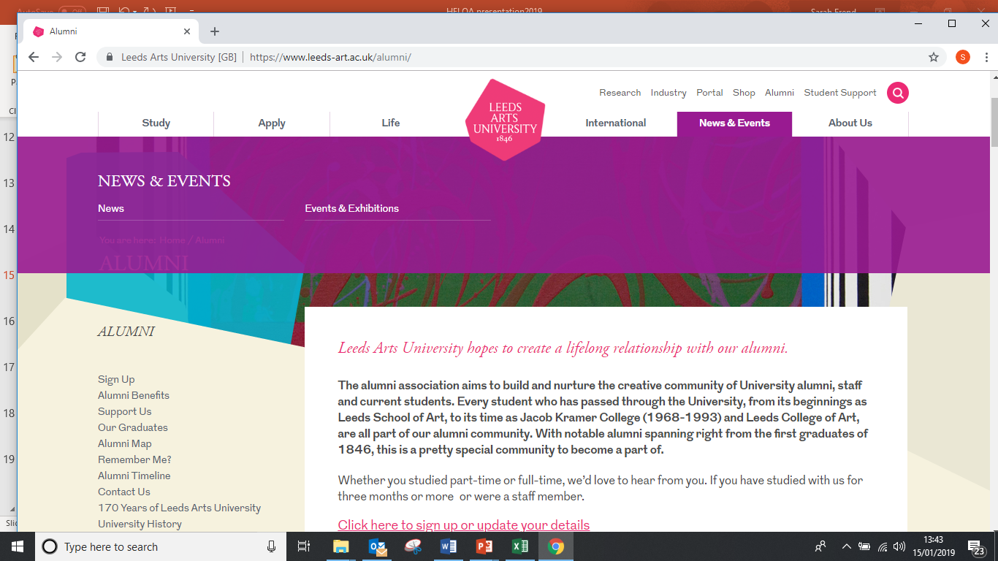

Slide 17
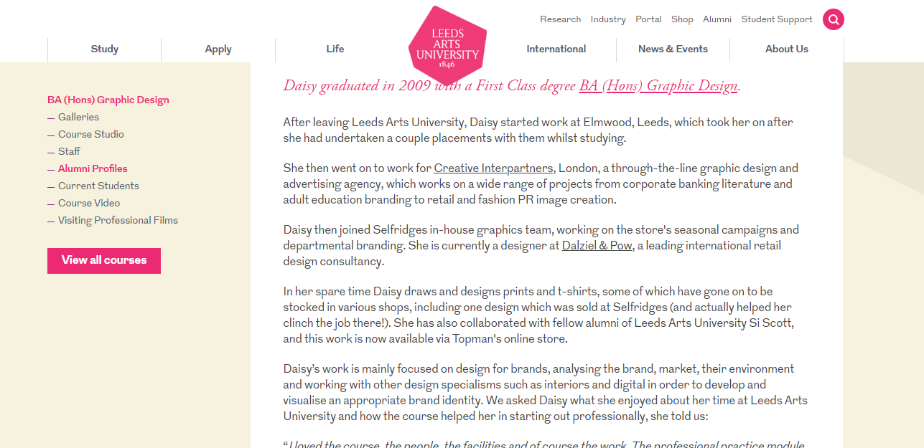

Slide 18
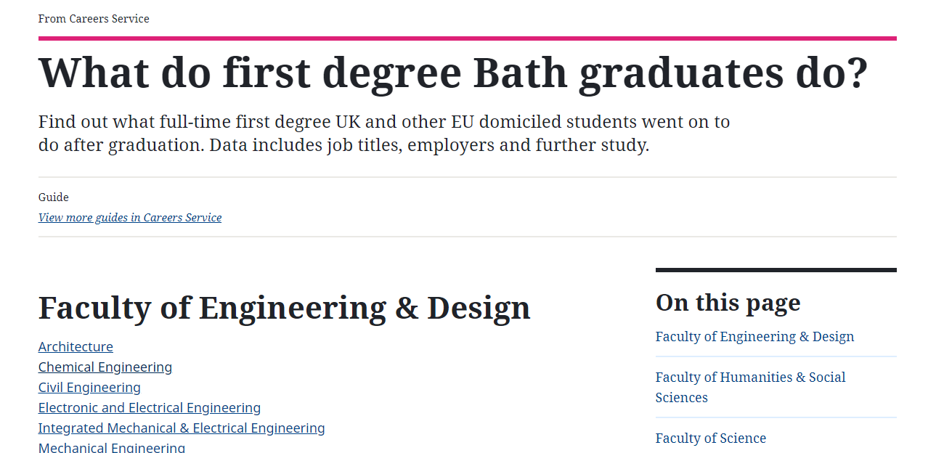

Slide 19
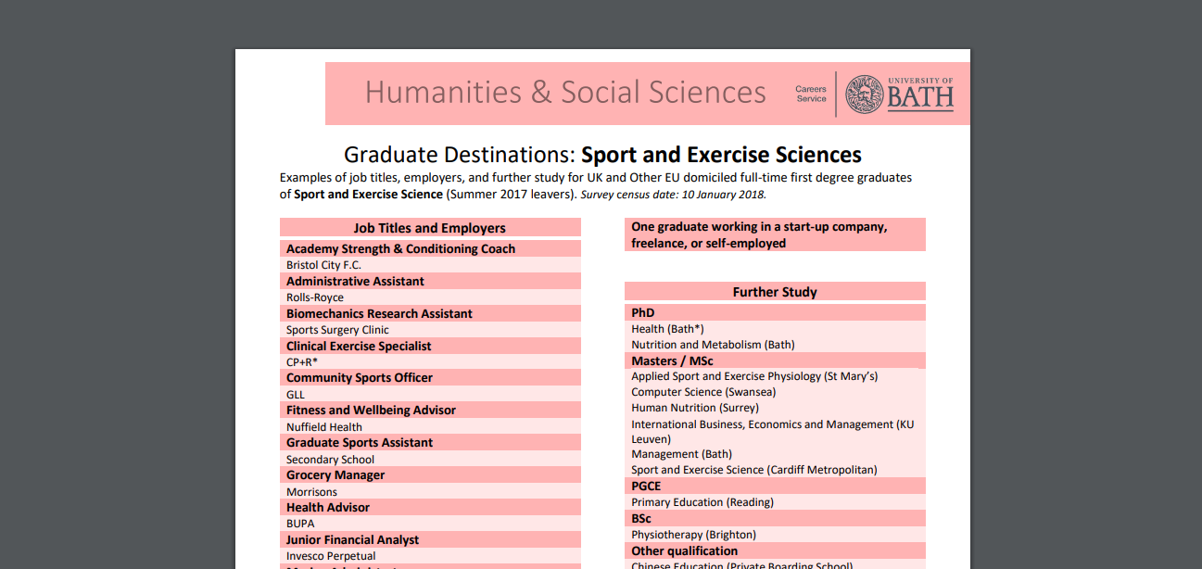

Slide 20
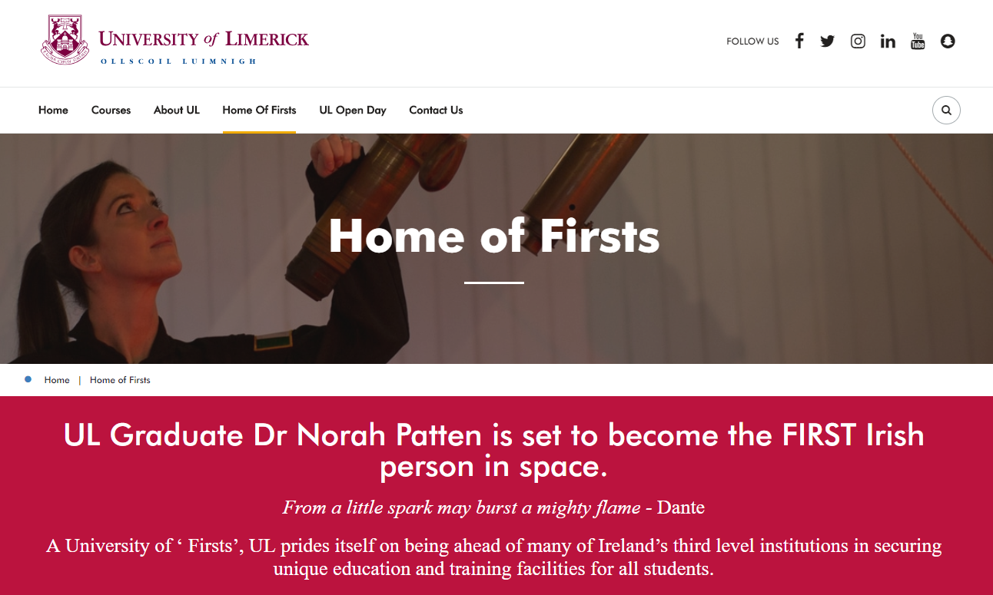

Slide 21
Where to find information about university
Notes:
Talk about key stakeholders that Unis should be sending info to
If a parent is going to discuss university options with their child then they are likely to rely on information from their children’s school, or use google and other internet sites.
For parents - Clarity of message and quality of information and easy of accessibility – how many clicks to find relevant info?
Stakeholders – schools/careers advisers

Slide 22
Key findings
Students are deciding to go to university early
Students feel parents play a significant role in influencing choice of university
Parents themselves are likely to encourage their children to go to university
They do this as they feel it is best for long term career prospects
Majority of parents will leave the final decision to their children
They do this as they want to make sure the course suits them and they enjoy it. The same is for employers/profession
More parents are talking to their children about alternatives to university. Over 20% increase compared to last year.
They rely on information from their children’s school and from searching on Google to have these discussions
Notes:
Students are deciding to go to university early
Students feel parents play a significant role in influencing choice of university
Parents themselves are likely to encourage their children to go to university. Education level of parents doesn’t affect their suggestions
They do this as they feel it is best for long term career prospects. Some parents left comments saying that practically all job descriptions require a bachelors degree of some discipline as a minimum pre-requisite. Others believe university makes people more employable as they are well-balanced and have learned to be independent.
Majority (80%) of parents will leave the final decision to their children. Few parents will make some suggestions but leave the ultimate decision to them as they want them to enjoy it.
They do this as they want to make sure the course suits them and they enjoy it. The same is for employers/profession. This is why careers guidance is so important
Over 70% of parents talk to their children about alternatives to university. Compared to under 50% last year. Apprenticeships and taking a gap year are most popular options discussed.
They rely on information from their children’s school and from searching on Google to have these discussions. Might be worth noting that parents are not confident in their knowledge or understanding the knowledge available about finance options (bursaries and scholarships (INTERESTING), repayment schemes, means testing for grants, various finance options available), alternative options and clearing v. adjustment.
I think stressing that parents have no knowledge of clearing v. adjustment could be an interesting/surprising fact for universities as they run quite pricey campaigns every year for their clearing courses.

Slide 23
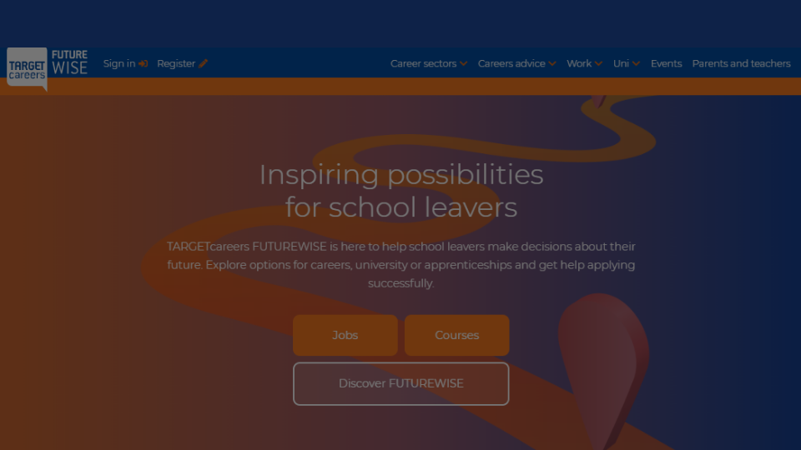
Who are we?

Slide 24
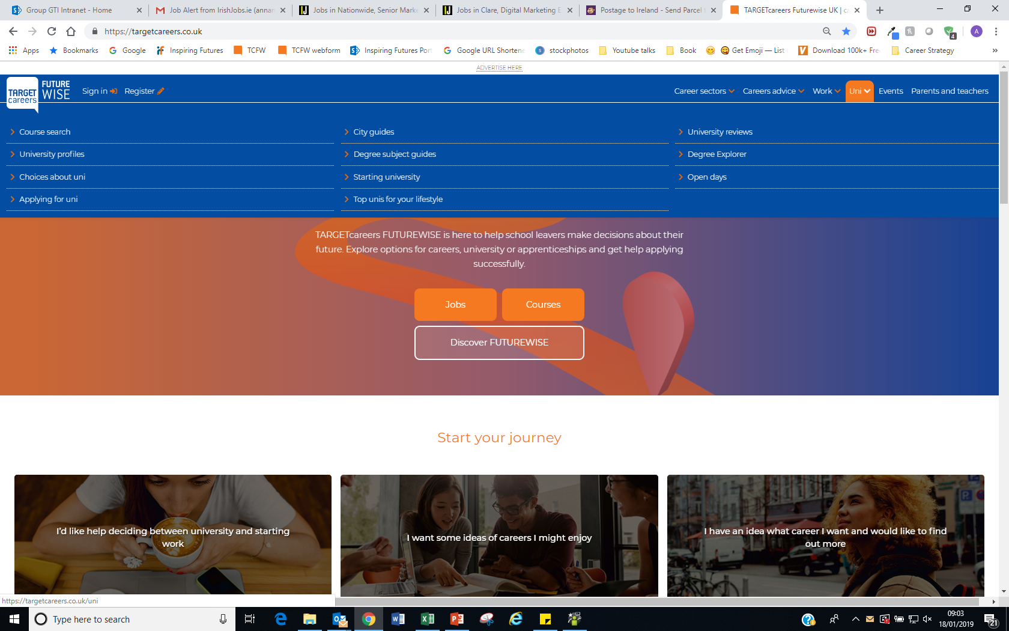

Slide 25
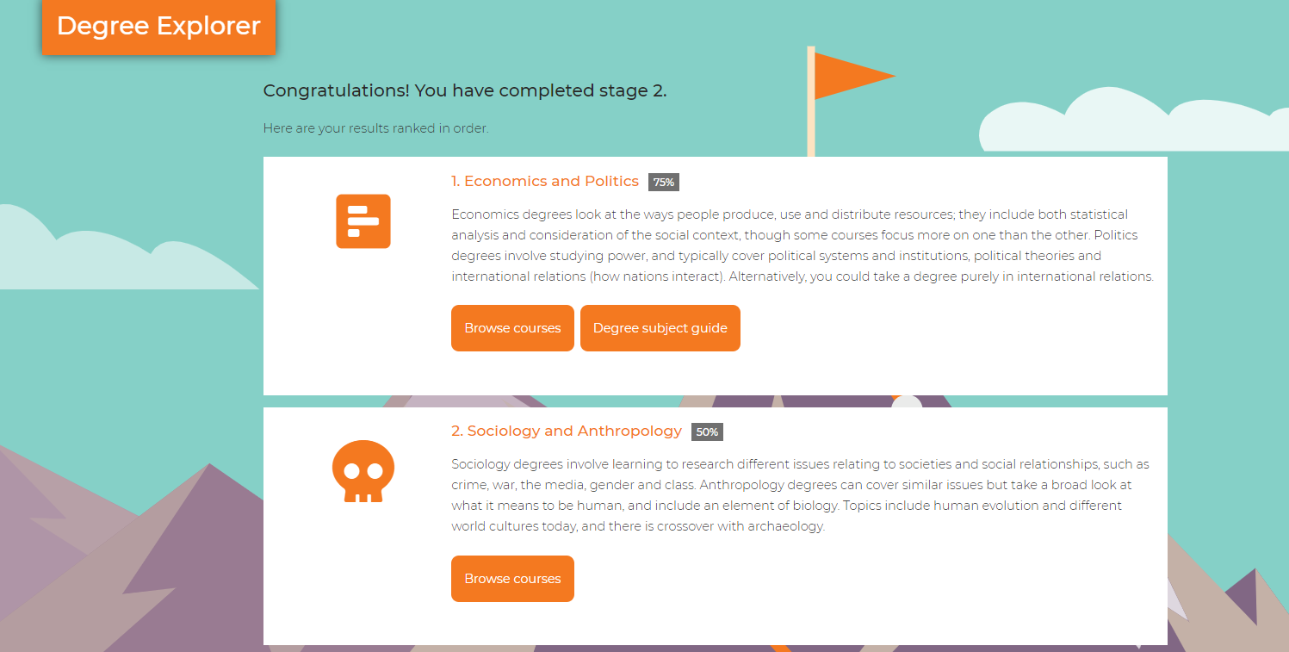
Notes:
The Degree Explorer is a 20-minute questionnaire designed to help students choose the right course by matching their interests to UK university courses. The Degree Explorer and related content helps students to:
Determine what university degree subjects would most suit them
Consider future careers when making degree choices
Prepare for the future: post-16 subject choices, writing personal statements and more!
20 minute two-stage questionnaire In stage 1, students will be asked 95 questions to figure out how interested they are in different subject areas. Students must select between three and five subject areas to take forward to the next stage.
In stage 2, the student will continue the questionnaire focusing on their top five subject areas. The questionnaire will explore these subject areas in more depth.

Slide 26
Working with us to engage parents
Print campaigns
Pathways to Professional Careers – A Parent’s Guide
TARGETcareers FUTUREWISE – Guide to your Future
Digital campaigns
Enhanced University Profile
Featured creative bundle
Content and social marketing
Degree Explorer
Upskill staff
Notes:
Key messages
Visit stand
Get across our products and services to communicate with patents
- presence on TCFW website
help engage with parents via publications – digital newsletter goes to parents, students, schools/ Parents Guide publication
Degree explorer
Upskilling staff – professional training

Slide 27
Thank you

