Slide 1
Student Loans Company
Improving Understanding of Student Finance through Collaborative Working
HELOA National Conference, 25th January 2019
Jon Legg
Funding Information Partners Account Manager, SLC
Jack Clare
Senior Student Recruitment Officer, Solent University
Huw Peters
Student Recruitment & WP Officer (Key Influencers), University of Manchester
www.slc.co.uk

Slide 2
Session Overview
Student Finance Update: England & Wales
Funding Information Services Team & Collaborative Working
Student Finance Working Groups (Jack)
Discussion: Student Finance in Your Institution
University of Manchester Teacher & Adviser Forum (Huw)
Discussion: School & College Engagement
Moving Forward

Slide 3
Student Finance Update: England & Wales

Slide 4
Student Finance Update: England & Wales
Tuition Fees 2019/20
Tuition Fee Loan available for students starting courses in 2019/20.
Maximum full-time fee levels are unchanged: £9000 (Wales) / £9250 (rUK)
Maintenance Support 2019/20
Different packages of support available for English and Welsh students
England: Maintenance Loan only
Amounts vary, determined by household income
Wales: Maintenance Loan & Welsh Government Learning Grant
Balance of ML & WGLG determined by household income
Same level of maintenance support overall

Slide 5
Maintenance Loans 2019/20: England
Household Income | Home (£58,215) | Elsewhere (£62,212) | London (£69,888)
£25,000 & under | £7,529 | £8,944 | £11,672
£30,000 | £6,895 | £8,303 | £11,020
£35,000 | £6,260 | £7,661 | £10,367
£40,000 | £5,626 | £7,019 | £9,714
£45,000 | £4,991 | £6,377 | £9,062
£50,000 | £4,357 | £5,735 | £8,409
£55,000 | £3,722 | £5,093 | £7,756
£60,000 | £3,314 | £4,452 | £7,103
£65,000 | £3,314 | £4,168 | £6,451
£70,000 | £3,314 | £4,168 | £5,812

Slide 6
Maintenance Support 2019/20: Wales
Income | Living with parents |  |  | Living away from home, outside of London |  |  | Living away from home, studying in London
 | Grant | Loan | Total | Grant | Loan | Total | Grant | Loan | Total
£18,370 | £6,885 | £955 | £7,840 | £8,100 | £1,125 | £9,225 | £10,124 | £1,406 | £11,530
£20,000 | £6,651 | £1,189
 |  |  |  | £7,817 | £1,408 |  | £9,760 | £1,770
£25,000 | £5,930 | £1,910 |  | £6,947 | £2,278 |  | £8,643 | £2,887
£30,000 | £5,209 | £2,631 |  | £6,078 | £3,147 |  | £7,526 | £4,004
£35,000 | £4,488 | £3,352 |  | £5,208 | £4.017 |  | £6,408 | £5,122
£40,000 | £3,767 | £4.073 |  | £4,339 | £4,886 |  | £5,291 | £6,239
£45,000 | £3,047 | £4,793 |  | £3,469 | £5,756 |  | £4,174 | £7,356
£50,000 | £2,326 | £5,514 |  | £2,600 | £6,625 |  | £3,056 | £8,474
£55,000 | £1,605 | £6,235 |  | £1,730 | £7,495 |  | £1,939 | £9,591
£59,200 | £1,000 | £6,840 |  | £1,000 | £8,225 |  | £1,000 | £10,530

Slide 7
Other Support 2019/20: England & Wales
Supplementary Support 2019/20
Disabled Student Allowances & Dependants’ Grants
Rates of support for 2019/20 available online
New process for Childcare Grants in 2019/20 (England only)
Full-time Undergraduate Applications for 2019/20
Application launch dates and deadlines TBA (both domiciles)
Postgraduate Support
England: support for students starting courses in 2019/20 announced:
Postgraduate Loan: up to £10,906
Postgraduate Doctoral Loan: up to £25,700
Wales: support packages for 2019/20 TBA

Slide 8
Funding Information Services Team & Collaborative Working

Slide 9
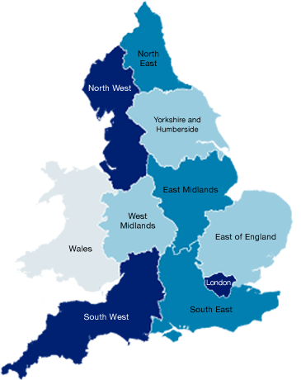
Funding Information Services Team
The Funding Information Services Team works with staff in a range of organisations and partners across England and Wales
North East England, Yorkshire and Humber
Kevin – kevin_mcmullan@slc.co.uk
North West England and Wales
Jon – jon_legg@slc.co.uk
The Midlands
Ahmar – ahmar_ehsan@slc.co.uk
South East England
Charmaine – charmaine_valente@slc.co.uk
London , South West and East of England
Ben – ben_rutter@slc.co.uk

Slide 10
Collaborative Working
Examples of Organisations we work with:
Universities (public and private), FE Colleges, Sixth Form Colleges, Training Providers, Careers advice providers, Local Authorities, Jobcentre Plus, plus many national bodies (e.g. OfS, UCAS, NHS, charities, etc)
Examples of Networks we work with:
HELOA, NASMA, NCOPs, NEON, AoC, local/regional networks....
Examples of teams within universities & colleges we work with:
Marketing, Recruitment, Outreach, Admissions, Finance, Student Money Advisers, Student Welfare staff, Widening Participation staff, Disability support teams, Study Abroad teams, Student Union staff, Tutors...
Challenges we face:
1) Reaching some but not all staff we need to work with
2) Being unaware of staff/teams in organisations (and vice versa)
3) Annual changes & staff knowledge not always fully up to date

Slide 11
Student Finance Working Groups (Jack Clare)

Slide 12
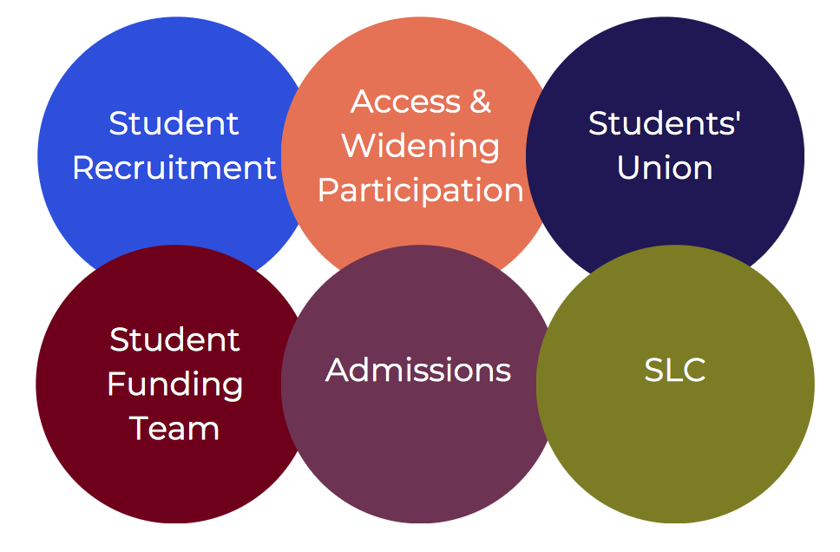
Student Finance Working Groups
ADDITIONAL SUPPORT
Formation of group and its aims
Previous lack of unified working on student finance at Solent University
Brings together key stakeholders within the university and SLC
Keeps all staff up to date including those from SLC, Shares good practice and implements relevant changes

Slide 13
Student Finance Working Groups
ADDITIONAL SUPPORT
‘I have enough meetings, Why should I have a student finance working group?’
Keeps all staff well informed
Get to know your SLC contact
Improves student recruitment and Access and Widening Participation content, resources and activities relating to student finance.
Improves collaborative working between teams on finance within the university
Can contribute towards having a real impact with target groups student recruitment and AWP teams work with

Slide 14
Discussion:
Student Finance in Your Institution

Slide 15
Discussion: Student Finance in Your Institution
Questions to discuss in your groups:
Which team(s) in your organisation deliver(s) student finance information & guidance? Do you work with them?
Do you know if they work with SLC’s FIS Team?
Do you know who produces student finance resources in your organisation? Does your team contribute to them? Do you work collaboratively on these? Or do you just use SLC resources?
Are there different student finance resources produced by different teams? If so, do you think this is an issue?
Is there scope for better collaborative working in this area?
If so, what actions could you take in your institution?

Slide 16
University of Manchester Teacher & Adviser Forum (Huw Peters)

Slide 17
University of Manchester Teacher & Adviser Forum
Group of teachers and careers advisers within travelling distance of The University of Manchester
Meetings include key developments in HE, Information about opportunities and events at Manchester.
Meetings held 4 times per year
Opportunity to get feedback from teachers and careers advisers and allow them to network and share good practice.

Slide 18
Discussion:
School & College Engagement

Slide 19
Discussion: School & College Engagement
Questions to discuss in your groups:
How do you work with school and college staff?
How much knowledge of student finance do you think they have?
Do you take any steps to ensure they have up to date knowledge of student finance?
If so, how do you do this? What resources do you use?

Slide 20
Moving Forward

Slide 21
Moving Forward
Summing up.....
Over to you....
Potential actions to improve collaborative working?

Slide 22
Funding Information Services Team
Partner Services
fundinginformationpartners@slc.co.uk
practitioners.slc.co.uk
Jon Legg – North West England & Wales
jon_legg@slc.co.uk
0777 162 4163

