Slide 1
Extended Project Qualification
Jennifer Obaditch
Head of Curriculum Projects at AQA
HELOA North East, Yorkshire & the Humber
10 December 2018

Slide 2
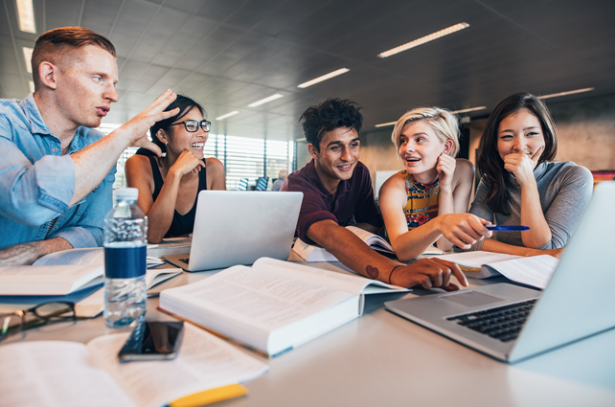
Agenda
Benefits of EPQ and student led projects
EPQ Specification
What makes an EPQ? Taught skills, Production Log, project product and presentation
The role of the EPQ supervisor
Curriculum models of delivery in schools - timelines
EPQ marking information – the assessment objectives for EPQ and how they are evidenced
Notes:
What and How = possibilities
Why = potential
Questions

Slide 3
Student led projects
Undertaking EPQ benefits performance in A level (Jones, 2015)
The odds of being awarded grades A* to B increased by 29% for students entering for EPQ (Jones, 2015)
Students more likely to obtain a first or upper second class degree of they have taken EPQ (Gill, 2017b)
Students with an EPQ were less likely to leave university after the first year (Thompson and Jones, 2016)
Valued by higher education, can reduce entry requirements
Can help address shortcoming in the post 16 curriculum
AOs reflect those expected by university level programmes

Slide 4
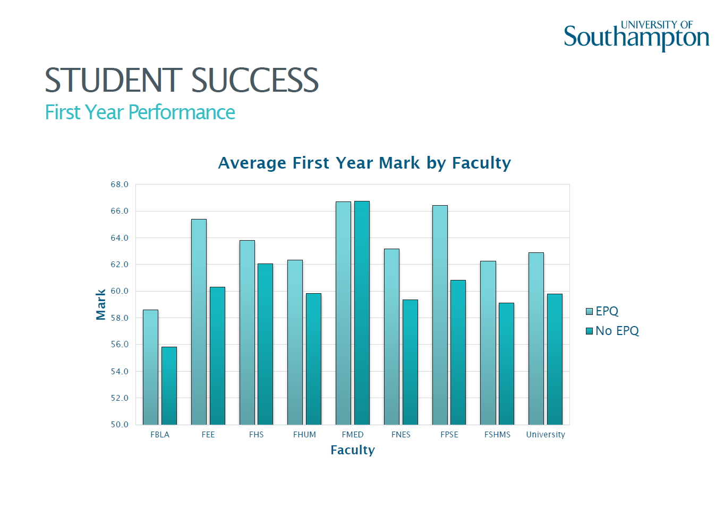
Thompson, 2016

Slide 5
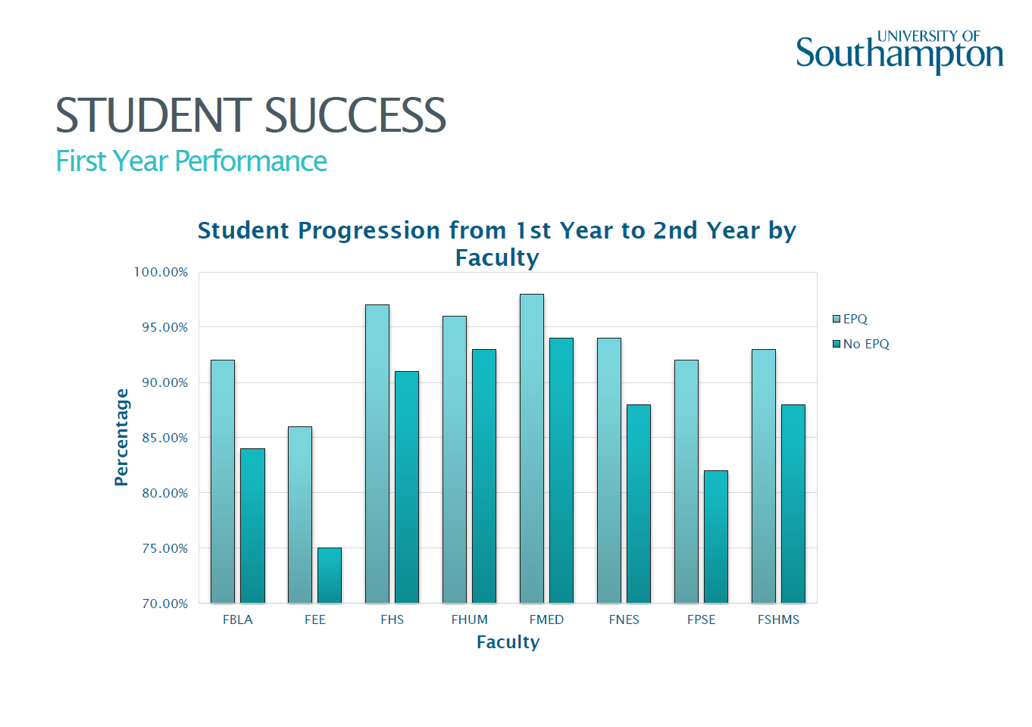
Thompson, 2016

Slide 6
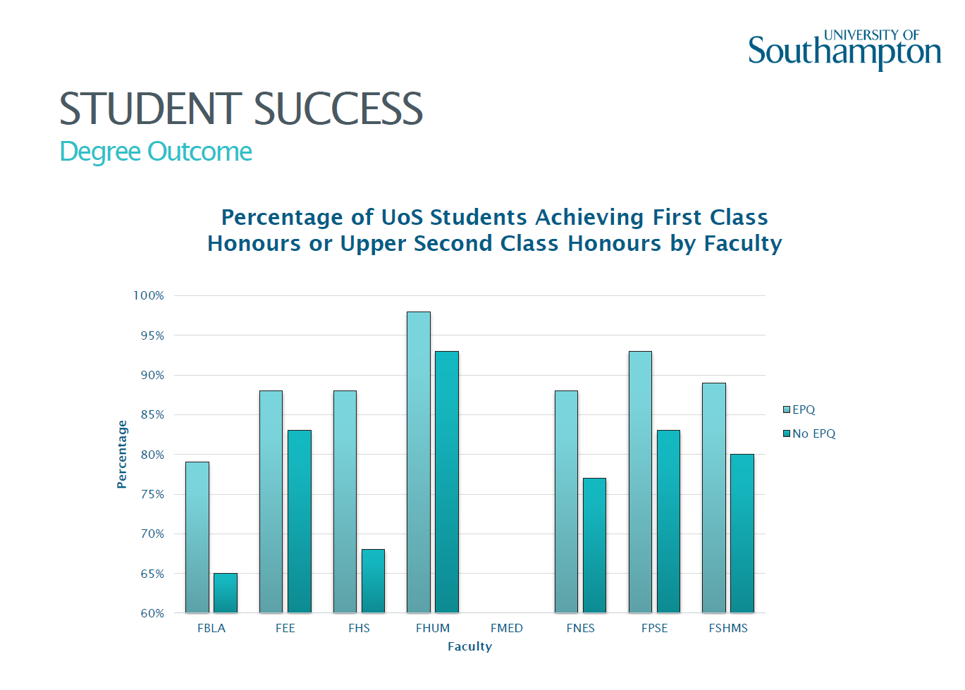
Thompson, 2016

Slide 7
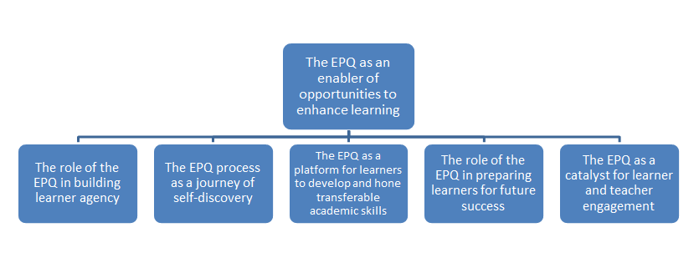
An enabler of opportunities to enhance learning
(Stephenson, 2017)

Slide 8

Specification

Slide 9
What is an EPQ?
Level 3 Qualification
Equal in level to A level
Graded A* to E
Earns half A level UCAS tariff points
Grade | UCAS Tariff Points
A* | 28
A | 24
B | 20
C | 16
D | 12
E | 8

Slide 10
What makes an EPQ?
independent research
production log
presentation
project product
taught skills programme

Slide 11
Taught Skills Programme
30 hours (of a total of 120 hours for EPQ)
Flexible based on the needs of the students
Schools deliver taught skills in a variety of ways:
Traditional classroom lessons
Using librarians and libraries
Using online courses and MOOCs (Future Learn etc.)
Self study guides
Using university outreach programme: visits from universities; visit to universities; online materials

Slide 12
Typical taught skills topics
Understand
the EPQ
Project management
Research methods: facilities
Research methods: critical engagement
Developing titles
questions
proposals
Conducting primary research
Referencing and plagiarism
Report writing
Presentation skills
Reflect and evaluate
Crucial to do well
Students must understand the project process, AOs, paperwork and outcomes
Question words, ambiguity, narrowing focus, suitability for EPQ
Time management, project planning techniques and software, setting aims and objectives
Use of IT, internet, JSTOR etc.,
libraries, museums, galleries, other media
Analysis and evaluation, awareness of bias and reliability, synthesising key information
Research ethics, risk assessment, data collection techniques, qualitative vs quantitative
What is plagiarism? What is referencing? Harvard and other forms of referencing, use of referencing software tools
What to include, presentation media, public speaking skills and practice
Reflective learning, what an evaluation includes
Report structure, developing arguments, using research materials, logical structures, proof reading, editing, conclusions

Slide 13
Independent research
Detailed research
A wide range of relevant resources
Selecting and evaluating resources
Critical analysis of resources
Synthesis of sources creating clear links to theories and concepts

Slide 14
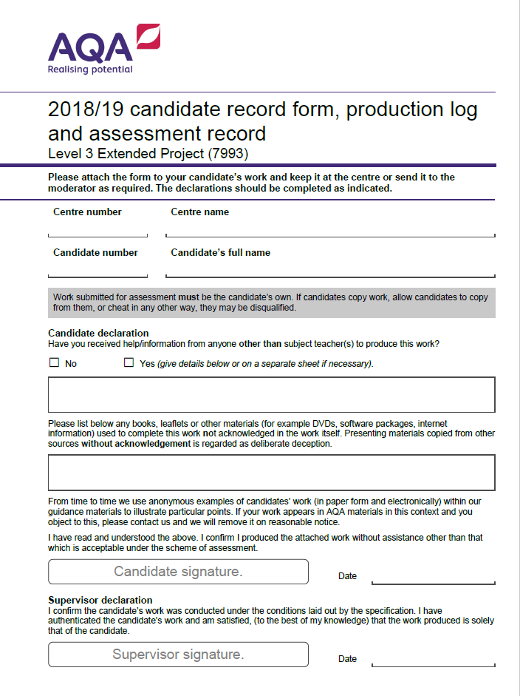
Production Log
The project qualifications are process-based qualifications
Used to record a student’s journey through the project process
Not an admin document
Provides the student with the backbone of their project
It charts the student’s progress from initial ideas, through their research to their final outcome and evaluation

Slide 15
Project Product
The outcome of the research process
5000 word research based written report OR
1000 word research based written report AND artefact as an outcome of the research
An artefact can be a physical outcome such as a book or piece of art work, or it can be a presentation to a specific audience such as a play, fashion show or a musical evening. In fact there is almost no limit to what can constitute an artefact, as long as it has research at its core.

Slide 16
Example projects
Time to look at some projects
artefacts video
See how students and teachers complete the Production Log
What was the initial title of the project?
What is the final title of the project? How did this develop?
At planning review and mid project review, what key ways did the student develop their project?
What did the student learn from taking an EPQ?

Slide 17
Exemplar Project Titles
5000 word reports | Artefacts and 1000 word report
Why has the USA not gone decimal? | Can I paint a picture of my cat?
An evaluation of the economic and ethical issues of ‘tax havens’ | “Cucina Povera” a cookery book based on old economical recipes from the student's Italian family
Why do female domestic violence victims stay with their abusers? | “Branding Hector” Hector was a classic Citroen van owned by the school and converted into a mobile coffee bar. The student took on the task of rebranding the van to try and improve business.
The Government’s decision to increase university fees has not influenced students when they are making choices regarding higher education. Is this true? | Underwater timing display - a visual aid for swimmers
To what extent has migration been responsible for the similarities found in Northern Folk Music? | Recreating an accurate and representative WW1 trench for the set of 'Journey's End'
How has the study of epigenetics changed ideas about the human genome? | To research (historically), plan and produce (own needlework) an eighteenth century ball gown.
The Millennium Bridge – To what extent could it’s closure have been foreseen & prevented? | Directing an informative and entertaining production of Jessica Swale's 'Nell Gwynn' for an adolescent audience
To what extent has mathematicians’ understanding of prime numbers improved throughout history, and how far has this influenced their modern applications? | Construction and testing of a small-scale hybrid rocket motor

Slide 18
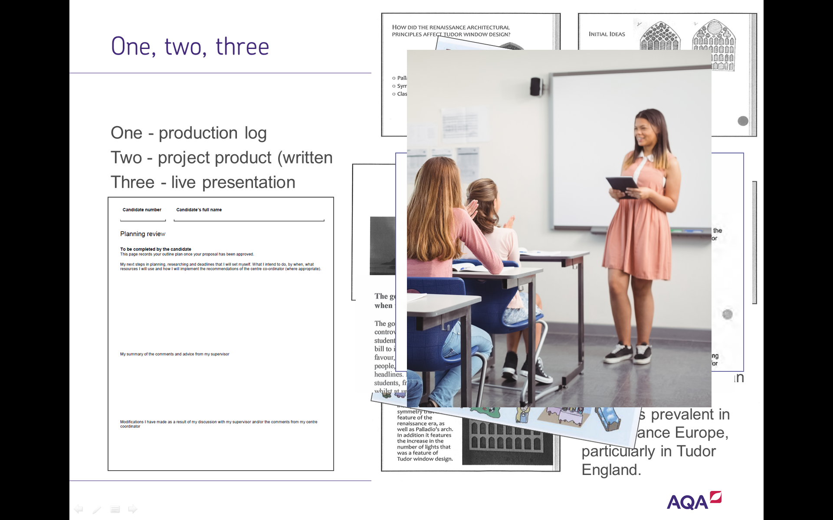
Presentation
Vital for EPQ
No presentation – no EPQ!
Viva, lecture, seminar or market place
what their project is about
the reasoning that underpins their project
their aims and objectives
what research has been undertaken and why
a review of their performance and achievements
lessons they have learnt
how their product might affect their future career/education.

Slide 19
The EPQ supervisor – four responsibilities
Responsibility | Requirement
regularly meet with their student(s) | Field initial ideas offer advice and guidance without directing the course of the project
complete key sections of the AQA production log | Provide evidence that the project process is comprehensive. Authenticate the EPQ
attend each student’s presentation | keep a full record of the nature of the audience, the nature of the presentation, the delivery of the presentation and of the questions asked/responses given
mark the work of their student(s) | follow the system of internal standardisation and moderation

Slide 20
Delivery models
Year 12 models |  |  | Submit
Autumn | Spring | Summer
TS | Research/Realise | Realise | May Year 12
Autumn | Spring | Summer
TS | Research | Realise | Nov Year 13
Year 13 model |  |  |  | Submit
Summer Y12 | Autumn | Spring | Summer
TS | Research | Research/realise | Realise | May Y13
Many schools will deliver EPQ over the two years of Sixth Form
Taught skills in September/January of Year 12
Submitting May Year 13

Slide 21
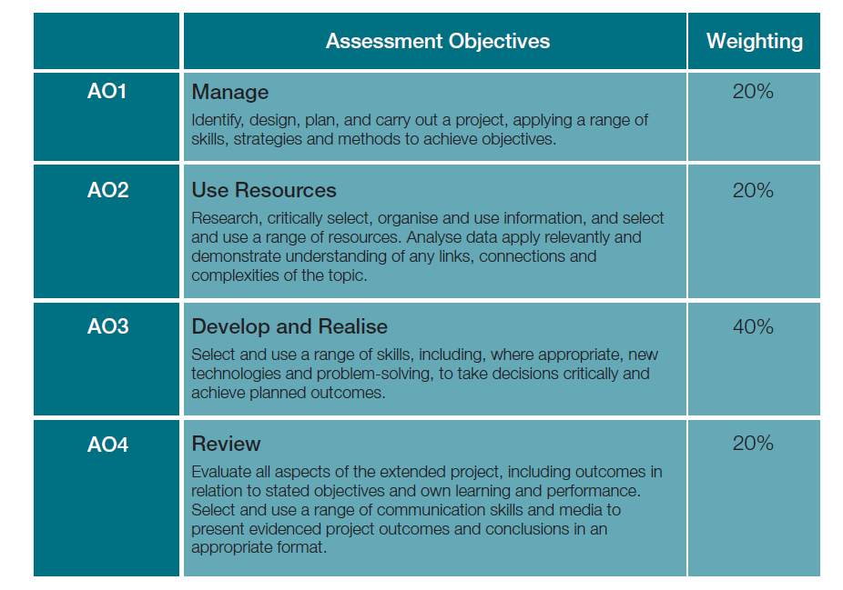
Assessment Objectives (AOs)
EPQ is marked holistically once at the end of the process
The project must be complete before any AOs can be applied
Centre marked AQA moderated

Slide 22
Questions
Jennifer Obaditch
projects@aqa.org.uk
0161 957 3980

Slide 23
References
Gill, T. (2017a). An analysis of the effect of taking the EPQ on performance in other Level 3 qualifications. Research Matters: A Cambridge Assessment publication, 23. Retrieved from: http://www.cambridgeassessment.org.uk/Images/375447-an-analysis-of-the-effect-of-taking-the-epq-on-performance-in-other-level-3-qualifications.pdf
Gill, T. (2017b). Preparing students for university study: a statistical comparison of different post-16 qualifications. Research Papers in Education, 1-19. doi: 10.1080/02671522.2017.1302498
Jones, B. (2015). Does the Extended Project Qualification enhance students’ GCE A level performance? CERP_TR_BEJ_21052015. Manchester, UK: AQA Centre for Education Research and Policy.
Stephenson, C. (2017) “An antidote to A-levels”? Exploring students’ and teachers’ experiences of the Extended Project Qualification Manchester, UK: AQA Centre for Education Research and Policy.
Thompson, E., & Jones, B. (2016, July). The Extended Project Qualification (EPQ): Its influence and impact. Paper session presented at UCAS Annual Competitive Admissions Conference, Warwick.

Slide 24
Potential: learner agency
“perceived by learners and teachers to empower students to take control of their own learning – something many felt was missing from the wider A-level curriculum.” (Stephenson, 2017)
With A-levels, you have essentially a syllabus and it’s restricted and you need to memorise all this information for the exam ... With the EPQ, you can literally do anything you want about any topic. And it’s a different type of learning. It’s not just memorising information and regurgitating it (Dave, student)
There’s a greater sense of ownership, because the student actually gets to choose the curriculum … and actually here the adult world is saying, ‘well, what do you think’, perhaps for the first time (Daniel, teacher)

Slide 25
Potential : self discovery
“students learn about themselves during the EPQ process. Not only do they learn how they learn best, they come to understand what they are capable of achieving independently, developing pride and confidence.” (Stephenson, 2017)
I'm almost shocked by what I see from the beginning of that journey to the end and how much these kids change. Not just the independence, but the whole confidence, the self-esteem, the resilience (Julie, teacher)
Just knowing that I can do such a big piece of work entirely on my own has made me feel a lot more confident in my ability to achieve academically (Lizzie, student)

Slide 26
Potential: transferable academic skills
“a platform for learners to develop and hone transferable academic skills” (Stephenson, 2017)
Doing the EPQ made me evolve in terms of, I learned a lot more about research and I was able to learn the different research skills. I would say I become more time efficient. I was able to develop more of a critical mind (Dave, student)
I think that the skills that the EPQ offers them are pretty much unattainable in the sort of depth that EPQ provides them in any other A-level subject (Clive, teacher)

Slide 27
Potential: preparation for future success
“Teachers and students expressed the importance of the EPQ in preparing learners, not only for university study, but also for the workplace and adult life.” (Stephenson, 2017)
I think some of the key skills that come out of it are really important, regardless of whether they’re going to university or they’re going into a job or an apprenticeship or whatever (Sue, teacher)
I learned probably the most from my seven years at secondary school from the EPQ just because it is the most, it was the biggest sense of what university would be like (Lizzie, student)

Slide 28
Potential: teacher learner engagement
“learners expressed that the EPQ gave them the chance to pursue something they were passionate about and consequently heightened their interest in the subject.”
The enthusiasm and the development of the girls is phenomenal and is really pleasurable to see… you can really feel like you’re making a difference to their future in a different sort of way (Holly, teacher)
Because it was something I was interested in, it didn’t feel boring or taxing or like normal schoolwork because it was me looking into something I was interested in and then reporting my findings to other people (Adam, student)

