Slide 1
Getting the most from your Student Staff.
Caitlin McEllenborough – Education Liaison Officer
Jo McKenna – Student Success Officer

Slide 2
Opening Activity
Do you have opportunities for current students to collaborate on Widening Participation Initiatives?
How do you incentivise your student staff?
What types of work do you advertise to your student staff?
What is the application process like for your student staff?
What process do you use to advertise work?
How regularly do you offer training?
Do you have different levels of student staff? E.g. Senior Ambassadors
Do you have a disciplinary process in place?

Slide 3
Student Staff at Edge Hill

Slide 4
Student Voice
Events in schools & on campus
Types of support our students provide
Social Media
Panel Members
Clearing
Admin Support

Slide 5
What are the Student Advisory Panels?
Student Advisory Panels provide a platform for EH students to offer their feedback, ideas and opinions giving them the opportunity to shape the future of our university services to ensure our university remains inclusive to the needs of everyone.

Slide 6
Who?
11 fixed panels a year which students from intersectional key APP target groups can attend;
Black, Asian, Minority Ethnic students
Disabled students
Students who were previous eligible for Free School Meals
Care Experienced and Estranged students
BTEC students
Mature students
First in family students
Adhoc panels can be call if particular individual groups need to be consulted

Slide 7
Recruitment
Online application form
Why you would like to be a Student Advisory Panel member / outline the skills and attributes needed / why is equality of opportunity and equality, diversity and inclusion are important to you
Interview Process
Mock panel is held to see if students are;
Able to confidently share their views
Be considerate of the views of others
Interested and enthused by EDI work

Slide 8
Recruitment
Training
One 2-hour evening session per year for new and existing members
Updates / changes communicated form evaluation process
Covers; what WP is, aims and rationale of the programme, expectations, logistics, student voice and evaluation
Incentives
Paid opportunity
CV material
Opportunity to make real change
Provide further work opportunities for panel members in marketing campaigns, prospectus and more
Create friendships / improve sense of belonging

Slide 9
Impact and changes made
Developing a Race, Ethnicity and Religion staff training toolkit- with students reviewing the toolkits content and featuring in the training videos discussing their experiences
Took part in a listening workshop with the Pro-Vice Chancellor around the experiences of Care Leaver, Care Experienced and Estranged Students
Supported in the planning and design of WP On-Course / Access Support Programmes
Reviewing Black History Month Celebrations, with panel members volunteering to be advisors to the Black History Month Committee

Slide 10
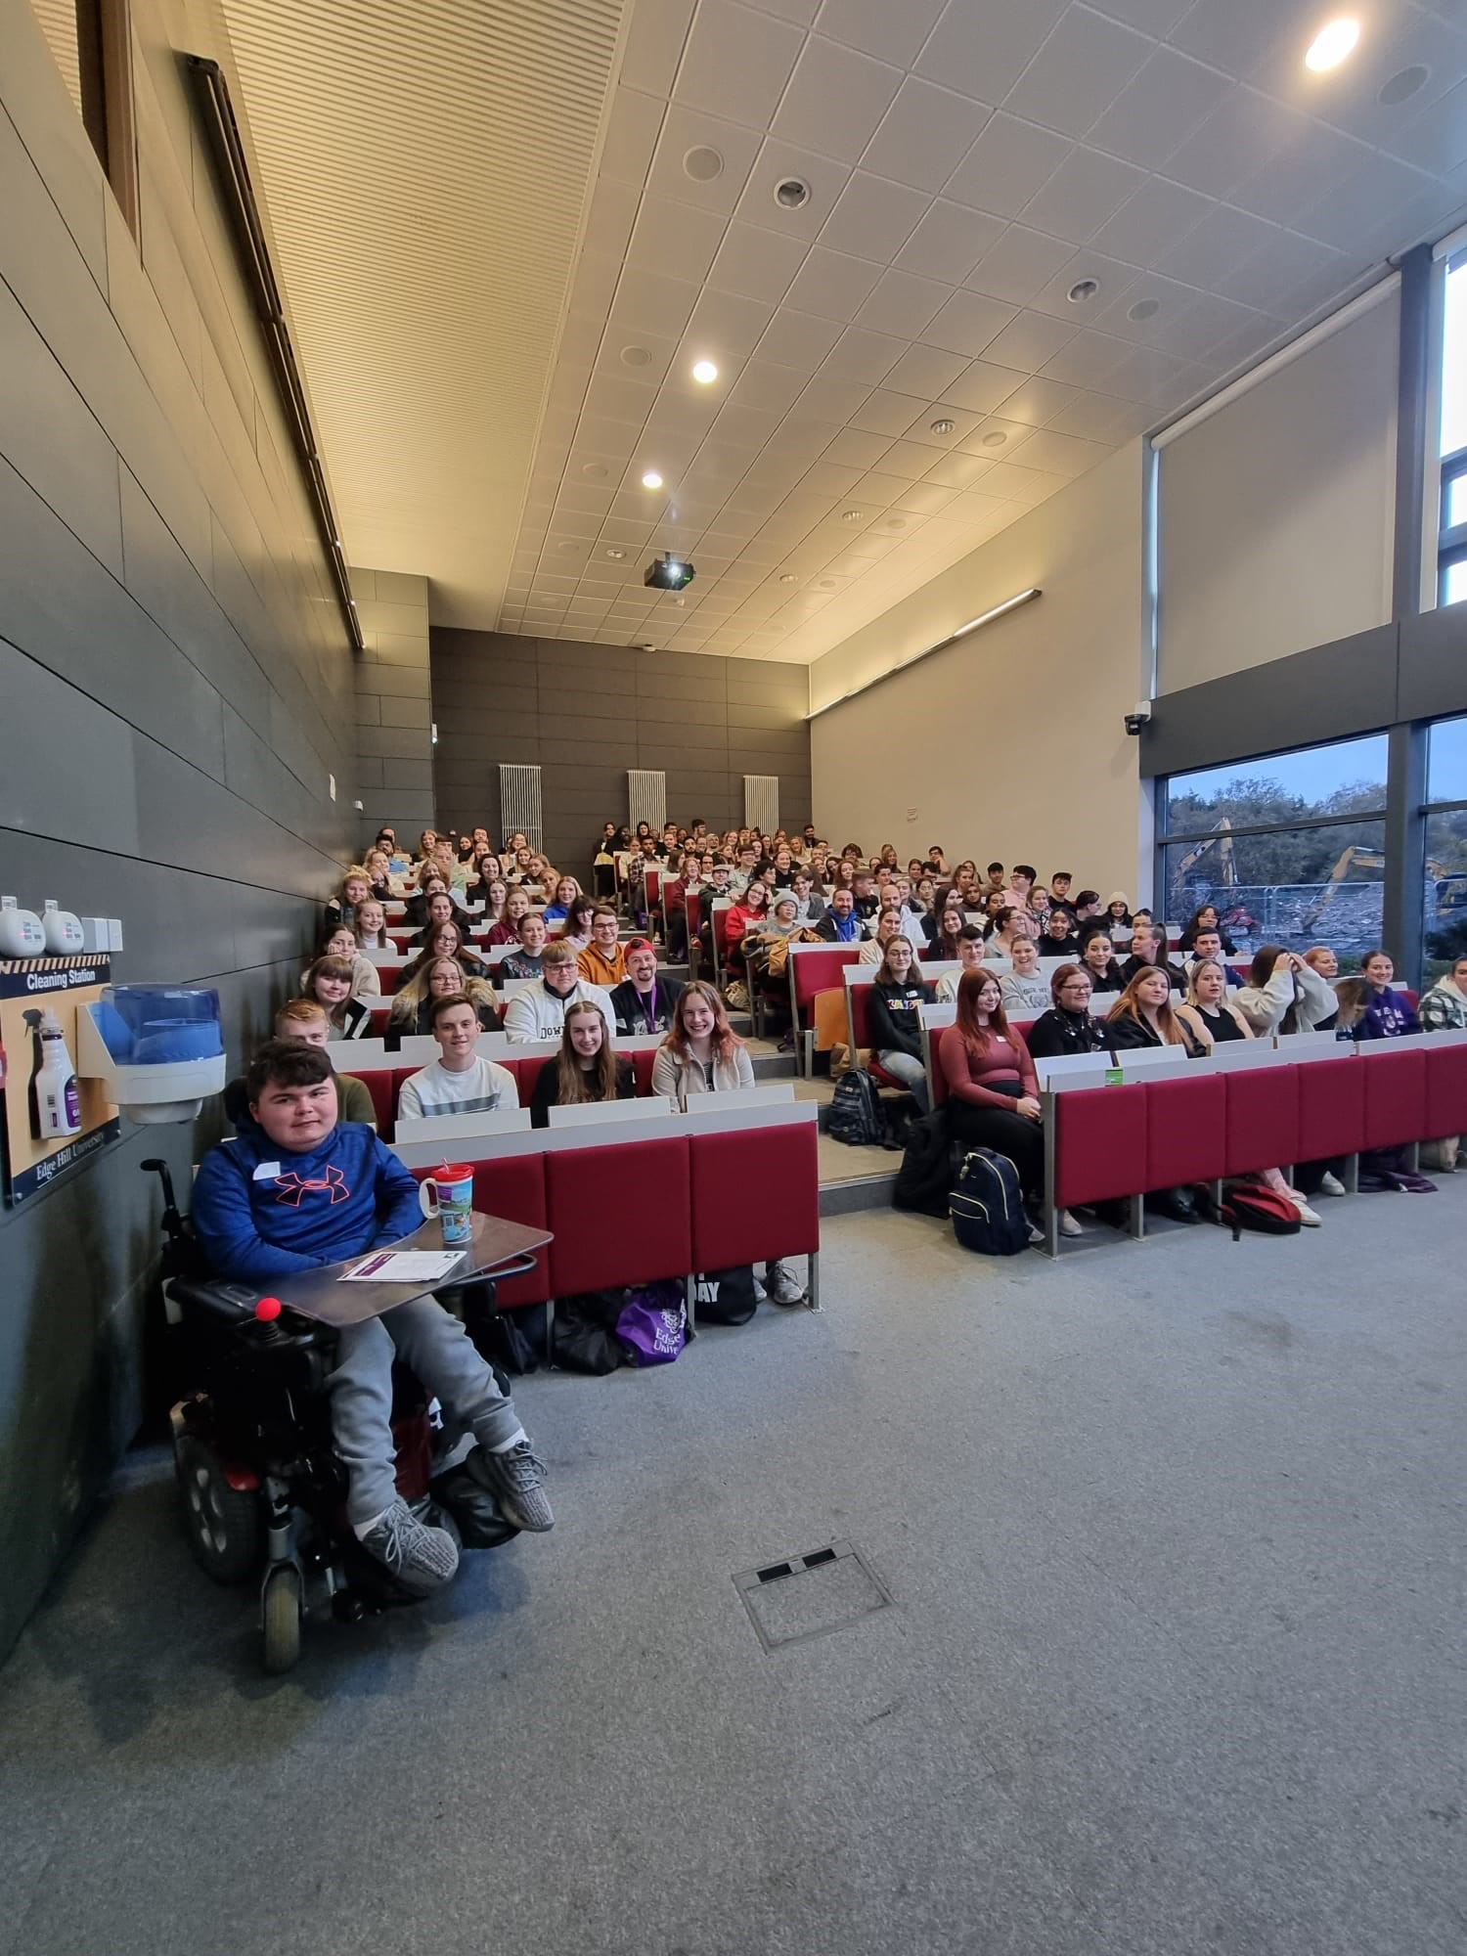
Utilising Students for Recruitment
Recruitment of Student Guides
Training Day
Types of work for Student Guides
Recruitment of Student Ambassadors
Training Evening
Types of work for Student Ambassadors
Incentives
Cross Department Working

Slide 11
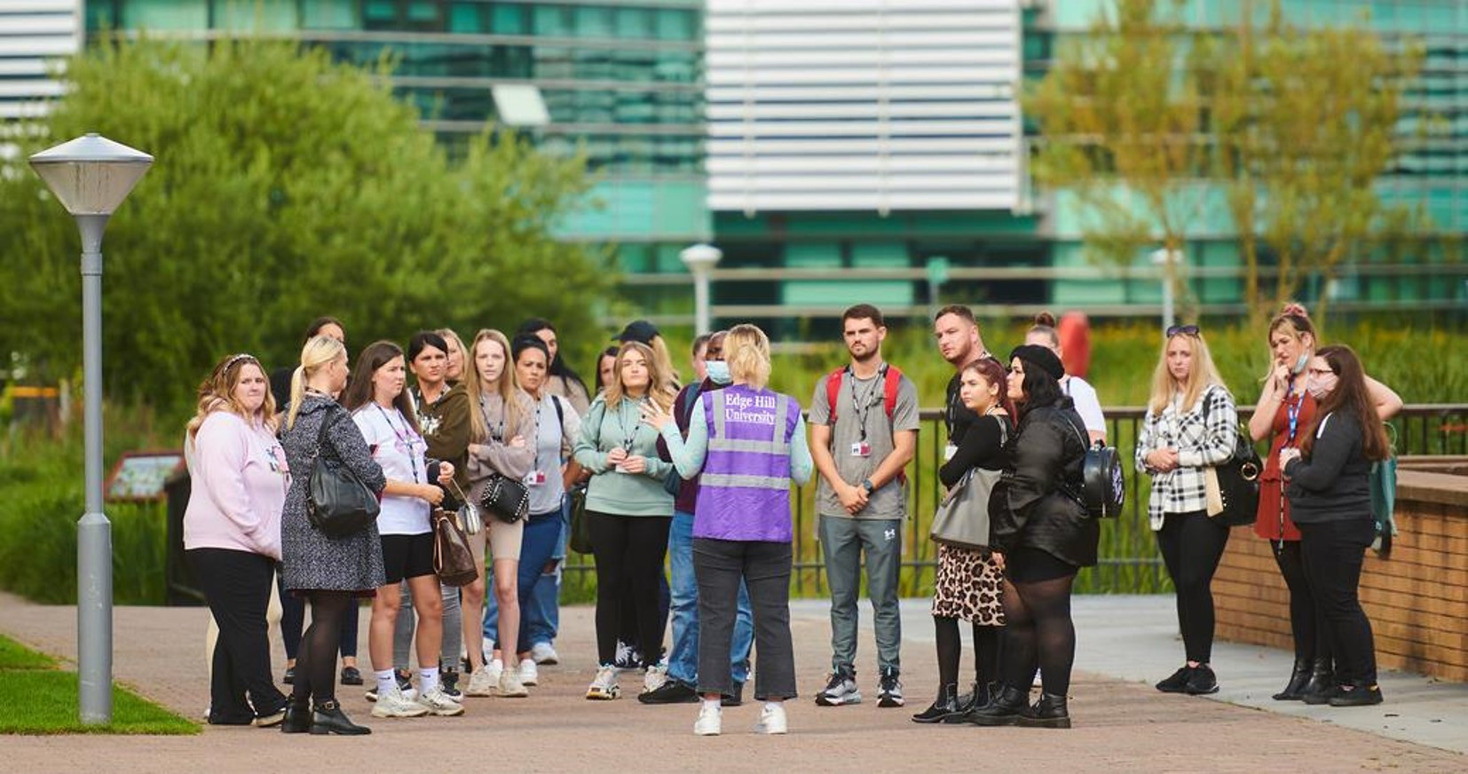
Student Guides
Recruitment of Student Guides
Coordinated by 1 person
Involves an application process & group interview
Training Day
Specific role induction e.g. campus tour training, standards &
working with the audience
Safeguarding
Ice Breakers
Types of work for Student Guides
All work advertised & allocated via HEAT by all team members
Open Days, Bespoke School Visits, Taster Days, Packing Work
All guides are selected and trained to ensure the best experience for all visitors on campus.

Slide 12
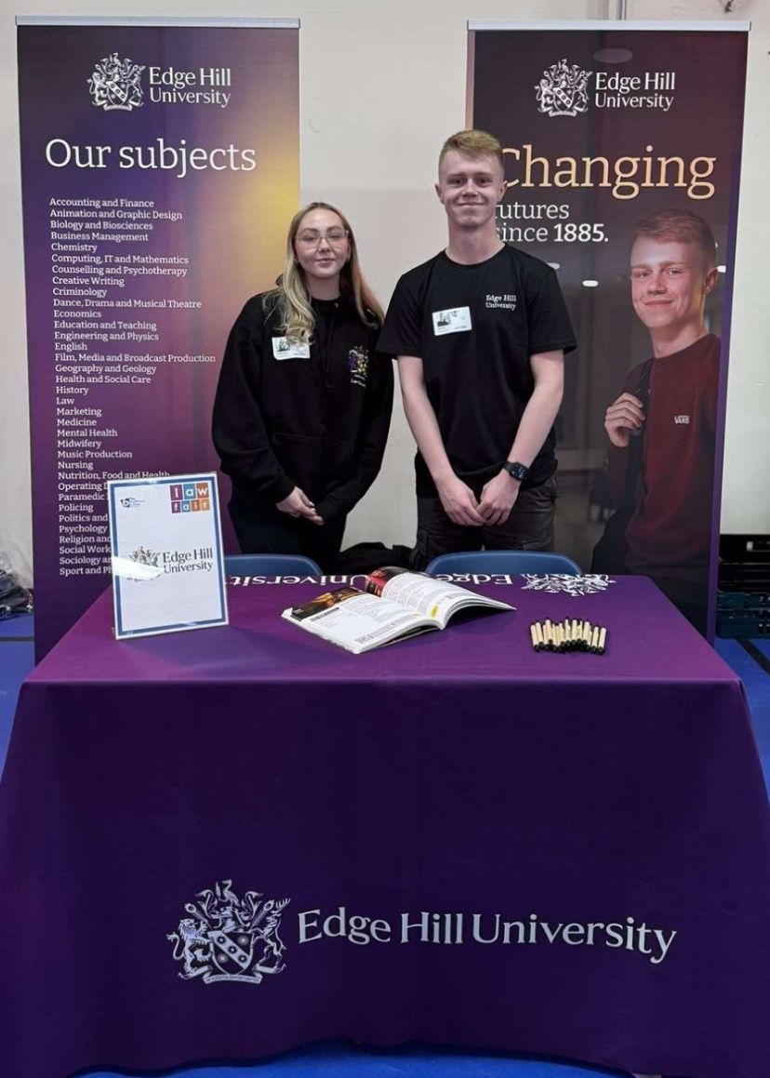
Student Ambassadors
Recruitment of Ambassadors
Coordinated by the Officers within our team
Involves an individual interview – only those trained to be guides can interview
Training Evening
Specific role induction e.g. setting up a stand, understanding the UCAS cycle, standards &
working with the audience
Expenses
Enhancing course knowledge
Types of work for Student Ambassadors
All work advertised & allocated via HEAT by all team members
UCAS & UK Uni Events, Careers Fairs, Mock Interviews, Talks in schools alone.
All Ambassadors are selected and trained to ensure the EHU brand is being represented properly.

Slide 13
Ensuring quality in our Student Guides
Incentives
Students are paid for all work carried out for the department – living wage
In the past for continued hard work we have also thanked them with vouchers
We have held socials around Christmas time – film nights & quiz nights
We regularly update their HEAT profiles with positive feed back
Termly refresher training offered
Graduation gift
Pebble Pad
Starting this year, we will have a monthly newsletter for guides to keep updated, as well as fun features so they can get to know our team.
Disciplinary Procedure
All staff trained to confidently follow the diciplinary procedure if a student's behaviour isn't appropriate – 3 strikes leads to dismissal and all notes of warnings are kept on the student's profile for consistency

Slide 14
Cross Department Working
Working with Careers colleagues to offer support in completing applications, giving feedback for unsuccessful applications
Work with Student Voice colleagues to send over topics students want to be heard on that don’t align with the APP / test student opinion on a bigger scale
Work alongside Marketing and CRM teams – supporting with filming for socials / easing workload for CRM colleagues
Offering work throughout the year – Graduation, Welcome Weekend, Clearing…

Slide 15

Reflection Activity
Using some of the themes from the first activity,
what could you take back to your institution to improve
how you work with student staff?

Slide 16

Sharing best practice
If you're the person in your team who coordinates your student staff scheme, there is a Northwest group for you to gain support from staff at different universities.
Join the group on LinkedIn

