Slide 1
HELOA New Practitioner Conference
2 June 2020
Thankyou for joining. The session will commence at 1:45pm
Please note that this presentation will be emailed to Emma (HELOA Training) and available for circulation to you all after the session. Please feel free to ask any questions in the Chat Box. I will provide responses after the session, so please feel free to type any questions throughout the presentation.
At 1:45pm can I ask that you please MUTE your microphone, this will reduce background noise and distortion so that everyone can hear.
Ahmar Ehsan – Funding Information Services Team

Slide 2
STUDENT FINANCE UPDATE
POLICY CHANGES AND ENHANCEMENTS
2020/21

Slide 3
STUDENT FINANCE 2020/21
AY 2020/21 STUDENT FINANCE ARRANGEMENTS
Key points of note on SFE student finance policy and SLC procedures for
academic year 2020/21 include;
Eligible EU national entitlement to student support confirmed to continue ‘as is’ for the duration of courses started in AY 2020/21
Indefinite Leave to Remain as a result of Domestic Violence (DVILR) and Calais Leave residency criteria introduced for new students
Enhancements to the customer repayment journey
These include a new online portal and improved credit balance refund process for any students who have over-repaid their loan balance
Notes:
https://www.parliament.uk/business/publications/written-questions-answers-statements/written-statement/Commons/2019-07-23/HCWS1793/
Higher education student finance arrangements for the 2020/21 academic year were announced by the Government in a Written Statement in Parliament on 23 July 2019. The HE student finance arrangements for 2020/21 are:
• Maximum fee limits for full-time, full-time accelerated and part-time undergraduate courses in 2020/21 remain at 2019/20 levels.
• An increase in maximum loans for living costs of 2.9% for full-time and part-time undergraduate students for 2020/21.
• An increase in maximum disabled students’ allowances for full-time and part-time undergraduate and postgraduate students with disabilities of 2.9% for 2020/21.
• An increase in maximum dependants grants for full-time undergraduate students with adult and child dependants of 2.9% for 2020/21.
• An increase in maximum loans for new students starting postgraduate master’s and doctoral degree courses of 2.9% for 2020/21.
Maximum tuition fees for the 2020/21 academic year in England will be maintained at the levels that apply in the 2019/20 academic year, the third year in succession that fees have been frozen. This means that the maximum level of tuition fees for a standard full-time course will remain at £9,250 for the 2020/21 academic year.
Maximum undergraduate loans for living costs will be increased by forecast inflation (2.9%) in 2020/21. And the same increase will apply to maximum disabled students’ allowances for students with disabilities undertaking full-time and part-time undergraduate courses in 2020/21.
Maximum grants for students with child or adult dependants who are attending full-time undergraduate courses in 2020/21 will also increase by forecast inflation in 2020/21.
We are also increasing support for students undertaking postgraduate courses in 2020/21. Maximum loans for students starting master’s degree and doctoral degree courses from 1 August 2020 onwards will be increased by forecast inflation (2.9%) in 2020/21. And the same increase will apply to the maximum disabled students’ allowance for postgraduate students with disabilities in 2020/21.
I expect to lay regulations implementing changes to student finance for undergraduates and postgraduates for 2020/21 late in 2019 or early in 2020. These regulations will be subject to Parliamentary scrutiny.
The Government will consider the recommendations of the independent panel to the Review of Post-18 Education and Funding, published on 30 May 2019, and will conclude the review at the Spending Review later this year.
Higher Education Student Finance for 2020/21
1) Fees for full-time and part-time undergraduate students.
Maximum fees for full-time and part-time undergraduate courses will remain at 2019/20 levels in 2020/21.
The maximum fee for standard full-time courses offered by Approved (Fee Cap) Providers with an Access and Participation Plan (APP) and a Teaching Excellence and Student Outcomes Award (TEF) will remain at £9,250 in 2020/21.
The maximum fee for full-time accelerated degree courses offered by Approved (Fee Cap) Providers with an APP and a TEF will remain at £11,100 in 2020/21.
The maximum fee for part-time courses offered by Approved (Fee Cap) Providers with an APP and a TEF will remain at £6,935 in 2020/21.
Lower maximum fees will remain at 2019/20 levels in 2020/21 for (i) courses offered by providers without an APP and/or a TEF and (ii) overseas study years, work placement years and short final years of full-time courses.
Students undertaking courses at Approved (Fee Cap) Providers will be able to apply for up-front tuition fee loans to meet the full costs of their tuition.
Maximum fees for undergraduate courses offered by Approved Providers are not capped. Students undertaking courses at Approved Providers will be able to apply for up-front tuition fee loans towards the costs of their tuition which will remain at 2019/20 levels in 2020/21: up to £6,165 for a standard full-time course; up to £7,400 for a full-time accelerated degree course and up to £4,625 for a part-time course.
2) Living costs support for full-time undergraduate students.
Loans for living costs for new full-time students and continuing full-time students starting their courses on or after 1 August 2016.
Maximum loans for living costs for new full-time students and eligible continuing full-time students starting their courses on or after 1 August 2016 will be increased by forecast inflation (2.9%) in 2020/21.
The maximum loan for living costs for 2020/21 will be £9,203 for students living away from home and studying outside London. The equivalent loan rate for students living away from home and studying in London will be £12,010; for those living in the parental home during their studies, £7,747; and for those studying overseas as part of their UK course, £10,539.
Loans for living costs for new full-time students and continuing full-time students starting their courses on or after 1 August 2016 who are eligible for benefits.
Maximum loans for living costs for new full-time students and eligible continuing full-time students starting their courses on or after 1 August 2016, and who are eligible for benefits, will be increased by forecast inflation (2.9%) in 2020/21.
The maximum loan for living costs for 2020/21 will be £10,490 for students who are eligible for benefits who are living away from home and studying outside London. The equivalent loan rate for students who are eligible for benefits who are living away from home and studying in London will be £13,098; for those living in the parental home during their studies, £9,140; and for those studying overseas as part of their UK course, £11,732.
Loans for living costs for new full-time students and continuing full-time students starting their courses on or after 1 August 2016 who are aged 60 or over on the first day of the first academic year of their course.
The maximum loan for living costs in 2020/21 for new full-time students and eligible continuing full-time students starting their courses on or after 1 August 2016 who are aged 60 or over on the first day of the first academic year of their course, will be increased by forecast inflation (2.9%) to £3,893.
Maintenance grants and special support grants for full-time students who started their courses before 1 August 2016.
The maximum maintenance grant and special support grant for eligible full-time students who started their courses on or after 1 September 2012 but before 1 August 2016, will be increased by forecast inflation (2.9%) to £3,801 in 2020/21.
The maximum maintenance grant and special support grant for eligible full-time students who started their courses before 1 September 2012 will be increased by forecast inflation (2.9%) to £3,489 in 2020/21.
Loans for living costs for full-time students who started their courses before 1 August 2016.
Maximum loans for living costs for eligible students who started their courses on or after 1 September 2012 but before 1 August 2016, will be increased by forecast inflation (2.9%) in 2020/21.
The maximum loan for living costs will be £6,597 for students who are living away from home and studying outside London. The equivalent loan rate for students living away from home and studying in London will be £9,205; for those living in the parental home during their studies, £5,247; and for those studying overseas as part of their UK course, £7,837.
Loans for living costs for eligible students who started their courses before 1 September 2012.
Maximum loans for living costs for eligible students who started their courses before 1 September 2012 will be increased by forecast inflation (2.9%) in 2020/21.
The maximum loan for living costs will be £5,938 for students who are living away from home and studying outside London. The equivalent loan rate for students living away from home and studying in London will be £8,309; for those living in the parental home during their studies, £4,604; and for those studying overseas as part of their UK course, £7,068.
Long Courses Loans.
Maximum long courses (living costs) loans for new and continuing students who are attending full-time courses that are longer than 30 weeks and 3 days during the academic year will be increased by forecast inflation (2.9%) in 2020/21.
3) Targeted support for undergraduate students with dependants and undergraduate students with disabilities.
Dependants’ Grants.
Maximum dependants’ grants (adult dependants’ grant, childcare grant and parents’ learning allowance) will be increased by forecast inflation (2.9%) in 2020/21 for all new and continuing full-time undergraduate students.
The maximum adult dependants’ grant will be increased to £3,094 in 2020/21.
The maximum childcare grant payable in 2020/21, which covers 85% of actual childcare costs up to a specified limit, will be increased to £174.22 per week for one child only and £298.69 per week for two or more children.
The maximum parents’ learning allowance payable in 2020/21 will be increased to £1,766.
Disabled Students’ Allowances.
Maximum grants for undergraduate students with disabilities will be increased by forecast inflation (2.9%) in 2020/21.
For a full-time course: to £23,258 for a non-medical personal helper, £5,849 for major items of specialist equipment and £1,954 for other disability related expenditure.
For a part-time course: to £17,443 for a non-medical personal helper, £5,849 for major items of specialist equipment and £1,465 for other disability related expenditure.
4) Support for part-time undergraduate students.
Fee and course grants for students who started part-time courses before 1 September 2012.
Maximum fee and course grants for students who started part-time courses before 1 September 2012 will be increased by forecast inflation (2.9%) in 2020/21. Maximum fee grants will be increased to £959, £1,150 or £1,442, depending on the intensity of study of the course. The maximum course grant will be increased to £314.
Loans for living costs for new part-time students and continuing part-time students starting degree level courses on or after 1 August 2018.
Maximum loans for living costs for new part-time students and continuing part-time students who started degree level courses on or after 1 August 2018 will be increased by forecast inflation (2.9%) in 2020/21.
The maximum loan for living costs for 2020/21 will be £9,203 for students living away from home and studying outside London. The equivalent loan rate for students living away from home and studying in London will be £12,010; for those living in the parental home during their studies, £7,747; and for those studying overseas as part of their UK course, £10,539.
Part-time students qualify for a proportion of the full-time loan for living costs depending on their intensity of study compared with a full-time course.
5) Support for postgraduate students.
Loans for students undertaking postgraduate master’s degree courses.
Maximum loans for new students starting postgraduate master’s degree courses in 2020/21 will be increased by forecast inflation (2.9%) to £11,222.
Loans for students undertaking postgraduate doctoral degree courses.
Maximum loans for new students starting postgraduate doctoral degree courses in 2020/21 will be increased by forecast inflation (2.9%) to £26,445.
Disabled Students’ Allowance.
The maximum grant for postgraduate students with disabilities will be increased by forecast inflation (2.9%) to £20,580 in 2020/21.
More details of Higher Education student finance arrangements for the 2020/21 academic year will be published on Government websites in due course.

Slide 4
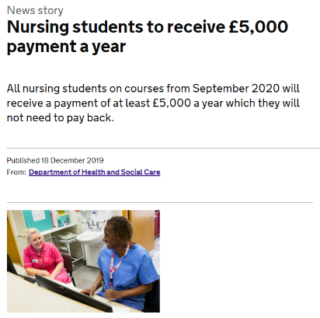
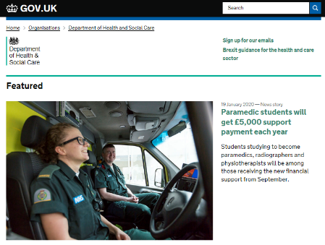
STUDENT FINANCE 2020/21
NHSBSA TRAINING GRANT
i
www.gov.uk/government/news/nursing-students-to-receive-5-000-payment-a-year
www.gov.uk/government/news/paramedic-students-will-get-5000-support-payment-each-year
Notes:
In December 2019, the government announced that new and continuing nursing, midwifery students and many allied health students on pre-registration courses at English universities will receive a £5,000 maintenance grant each year.
The funding will be given to all eligible new and continuing degree-level nursing, midwifery and many allied health students from September 2020.
The government expects the £5,000 maintenance grants to benefit around 100,000 pre-registration nursing, midwifery and allied health degree students every year.
The funding comes as part of the government’s manifesto commitment to increase nurse numbers by 50,000 by 2025.
Students will also be able to continue to access the appropriate funding for tuition and maintenance loans from the Student Loans Company, plus the existing NHSBSA Learning Support Fund.
Students will receive at least £5,000 a year, with up to £3,000 further funding available for eligible students, including for:
specialist disciplines that struggle to recruit, including mental health
an additional childcare allowance, on top of the £1,000 already on offer
areas of the country which have seen a decrease in people accepted on some nursing, midwifery and allied health courses over the past year
This means that some students could be eligible for up to £8,000 per year, with everyone getting at least £5,000.
The funding will not have to be repaid by recipients.
The full list of new and continuing students set to benefit from the funding is as follows:
dietetics
dental hygiene or dental therapy (level 5 courses)
occupational therapy
operating department practitioner (level 5 courses)
orthoptics
orthotics and prosthetics
physiotherapy
podiatry or chiropody
radiography (diagnostic and therapeutic)
speech and language therapy
paramedicine
midwifery
nursing (adult, child, mental health, learning disability, joint nursing/social work)
This is the first time paramedic students will benefit from additional NHS funding while at university.
Extra payments worth up to £3,000 per academic year will be available for eligible students. Each year they could receive:
£1,000 towards childcare costs
£1,000 if studying in a region that is struggling to recruit
£1,000 if they’re a new student studying a shortage specialism important to delivering the NHS Long Term Plan
The shortage specialisms have been confirmed as:
mental health nursing
learning disability nursing
radiography (diagnostic and therapeutic)
prosthetics and orthotics
orthoptics and podiatry The NHS Business Services Authority Student Services department will be responsible for administering this funding on behalf of the Department of Health and Social Care (DHSC). We are working closely with DHSC colleagues to set out the details regarding how and when students will access this additional support. This will include an updated digital application system to make the process as easy as possible for students. NHSBSA will be updating their website and social media channels with information as soon as it becomes available and will be holding some stakeholder events this year to explain the funding in more detail as well as the system and how students can apply Practitioners who would like to receive these updates can sign up to the contact list on our website indicating an interest in the Learning Support Fund to ensure they're on our distribution list.
NHSBSA will also be setting up a separate contact list specifically for students who would like to receive updates.
What is the offer?
Nursing students on courses from September 2020 to receive at least £5,000 a year in additional funding for maintenance and associated study costs.
Up to a further £3,000 additional funding for childcare costs, and students in regions or specialisms struggling to recruit.
This means that some students could benefit from up to £8,000 in total support per year with everyone getting at least £5,000. The funding will not have to be repaid by recipients.
Which parts of the country will get the £1,000 grant?
Although Higher Education Institutes (HEIs) in some regions of the country have been growing their nursing numbers successfully, not all regions have been able to do this. We will undertake further work to support HEIs in the regions of the country that have seen faltering levels of applications.
£1,000 will be available for students in areas of the country which have seen a decrease in people accepted onto some nursing, midwifery and allied health courses over the past year. This funding will be available from 2021/22, with further details on who can access the support by the summer of 2020.
What will the support for students with children be?
New and continuing students with caring responsibilities will also benefit from an additional £1,000 to help them balance their studies with their caring responsibilities, on top of the £1,000 already on offer.
Which groups are included, does this include midwifery and AHP students?
The additional funding will be available to pre-registration undergraduate and postgraduate students starting or continuing nursing and midwifery courses at degree level in the 2020/21 academic year. The same funding is also being made available to support undergraduate and postgraduate students starting or continuing courses in many allied health subjects and dental hygiene and dental therapy in 2020/21
What other funding is available?
The new package will supplement existing support available to nursing students from the Department of Health and Social Care including travel and accommodation costs for clinical placements, funding for students facing financial hardship and childcare support. Students will also be able to continue to access funding for tuition and maintenance loans from the Student Loan Company.
Does it apply to current students?
The package will be available from September 2020 and students studying at that point will be able to apply.
However, students who have completed their studies will not be entitled to this additional funding. Any student who steps off a course in the third year of study now will also not be entitled to this funding if they were to re-join the course.
Will it differ depending on what university students go to?
Every student will receive an annual payment of at least £5,000 in non-repayable funding. Although Higher Education Institutes (HEIs) in some regions of England have been growing their nursing numbers successfully, not all regions have been able to do this, compounded by nursing shortages in the NHS workforce.
£1,000 will be available for students in areas of the country which have seen a decrease in people accepted onto some nursing, midwifery and allied health courses over the past year. This funding will be available from next year, with further details on who can access the support in early 2020.
What if I go to university in Scotland/NI/Wales?
This offer is available to students studying courses in England only. Decisions about the NHS workforce in Northern Ireland, Scotland and Wales, including the funding that they provide for students, are a matter for the Devolved Administrations of those countries.

Slide 5
STUDENT FINANCE 2020/21
NHSBSA TRAINING GRANT – TERMINOLOGY
NHSBSA have provided terminology changes for aspects of the extended
Learning Support Fund:
The Learning Support Fund (LSF) will now be referred to as the NHS Learning Support Fund* (NHS LSF)
The £5,000 grant is to be known as the Training Grant
The Child Dependants Allowance has been renamed Parental Support and is now £2,000 (existing £1,000 funding plus £1,000 new support)
The additional funding for specialist and regional courses are known as ‘specialist subject payments’ and ‘regional incentive’ respectively
i
*Eligibility criteria remains the same with the exception that students
on a paramedic course are now also able to apply
Notes:
As you can imagine, it’s been a busy time for us to ensure students are paid as normal during the COVID-19 outbreak, however we’re pleased to say our team has been working tirelessly to make sure the virus hasn’t affected our go-live plans. We are currently looking at a launch date for the new application system, and therefore open the application window, this summer. We’ll keep you posted on when we’ve got a definite date and will let students know as well. As part of the developments we’re making for the extended Learning Support Fund, there are a few changes you need to know about and these are highlighted below. The Learning Support Fund (LSF) will now be referred to as the NHS Learning Support Fund (NHS LSF). The eligibility criteria remains the same with the exception that students on a paramedic course are now also able to apply.
The £5,000 grant is to be known as the Training Grant.
The Child Dependants Allowance has been renamed Parental Support and is now £2,000.
The additional funding for specialist and regional courses are known as ‘specialist subject payments’ and ‘regional incentive’ respectively.
Students will not need to apply for these, they will be automatically added to their account when they select a qualifying course and university when applying for the Training Grant.
Please note, we are still waiting for clarification on the criteria for the regional uplift payment and will provide further information in due course.

Slide 6
STUDENT FINANCE 2020/21
NHSBSA TRAINING GRANT – ADMINISTRATION
NHSBSA are creating a HEP communications toolkit so practitioners will
have a suite of materials to use to promote the new funding support:
This toolkit will include;
Posters/flyers
A short presentation about the funding and new system plus how it will work with continuing students
Some example text for emails to students
Social media messages for you to use across your channels
The NHS LSF guide for 2020/21 and FAQ document will also be available from: www.nhsbsa.nhs.uk/learning-support-fund/new-student-funding
Notes:
Given the current situation, we have had to change our plans for the stakeholder events slightly and are now looking at holding some virtual sessions to walk you through the new funding and HEI portal later this year. More detail will be provided in due course. We are also in the process of pulling together a HEI comms toolkit so you will have a suite of materials to use. This will include: posters/flyers
a short presentation about the funding and new system plus how it will work with continuing students
some example text for emails to students
social media messages for you to use across your channels.
If there is anything you think would be particularly useful please contact us on nhsbsa.studentservices@nhs.net and use ‘New funding materials’ in the subject heading. The NHS LSF guide for 2020/21 is in the final stages of review, however we’re unfortunately unable to publish this until the Department of Health and Social Care has ratified the policy. We hope this will be soon however given the COVID-19 situation things are taking a bit longer than usual to be signed off. There is an FAQ document available which you may find useful and you will also be able to find on our website shortly.

Slide 7
STUDENT FINANCE UPDATE
LATEST NEWS AND KEY MESSAGES
2020/21

Slide 8
i
STUDENT FINANCE UPDATE
LATEST NEWS AND KEY MESSAGES
Current drivers of frequently asked questions and SFE key messages:
Continue to promote early applications for AY 20/21
Applications should be submitted as soon as possible in the usual way
New HEP Tuition Fee Loan payment structure announced for AY 20/21
TBC mid June launch for SFE Part-Time Undergraduate and Advanced Learner Loan applications
TBC late June launch for SFE Postgraduate Loan products

Slide 9
STUDENT FINANCE UPDATE
SUPPORTING AY 2020/21 APPLICATIONS
Our ‘It’s Time To Apply’ campaign aims to encourage students to make a
right first time application for their SFE funding as soon as possible:
The ‘It’s Time To Apply’ campaign page features;
Essential details on the three steps of the application process
Informative short films and links to the gov.uk application pages
The campaign page also contains information for parents and sponsors:
This includes, how to support a student’s application, SFE evidence requirements and current year income assessments (CYI)
i
https://studentfinance.campaign.gov.uk
Notes:
Get ready to apply for student finance!
If you’re thinking about going to uni or college this year, it’s time to start preparing as student finance applications are expected to open in late February.
There are a few things you’ll need to have ready before you fill out your application.
You’ll need:
your passport and
your National Insurance number.
When the time comes, it’s easy to apply online – it only takes around 30 minutes.
Watch our films which explain what student finance is available, whether you’ll be eligible and when and how to apply.
Share this page with your friends if they also need student finance for uni or college.
And follow us on social media so we can tell you when applications open.
Stay connected!
Facebook
Twitter @SF_England
Twitter #Tagafriend

Slide 10
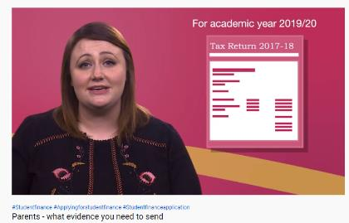
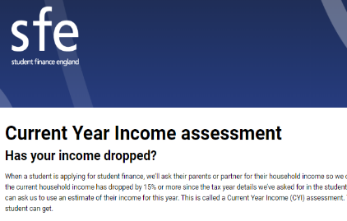
STUDENT FINANCE UPDATE
SUPPORTING AY 2020/21 APPLICATIONS
Our ‘It’s Time To Apply’ campaign page features a range information and
resources for parents and sponsors:
The content is designed to help them understand how to support a student finance application and includes;
Key messages and a YouTube film on how sponsors submit their details as part of the application process
Information, a checklist and YouTube film on evidence requirements
Income assessment and what to do if that income level changes (CYI) including a YouTube film and link to an online CYI guide
i
https://studentfinance.campaign.gov.uk
Notes:
Get ready to apply for student finance!
If you’re thinking about going to uni or college this year, it’s time to start preparing as student finance applications are expected to open in late February.
There are a few things you’ll need to have ready before you fill out your application.
You’ll need:
your passport and
your National Insurance number.
When the time comes, it’s easy to apply online – it only takes around 30 minutes.
Watch our films which explain what student finance is available, whether you’ll be eligible and when and how to apply.
Share this page with your friends if they also need student finance for uni or college.
And follow us on social media so we can tell you when applications open.
Stay connected!
Facebook
Twitter @SF_England
Twitter #Tagafriend

Slide 11
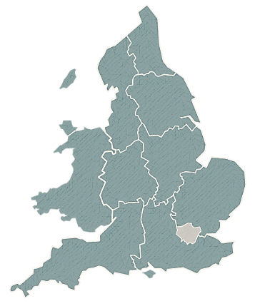
STUDENT FINANCE APPLICATIONS
ON TIME APPLICATIONS NATIONAL AVERAGE
Only 56% of full-time applications in AY 19/20 were received before the May
deadline. Please encourage students to apply as soon as possible!
SCOTLAND 69.3% (+13.5%)
NORTH WEST 61.8% (+3%)
NORTH EAST 58.1% (+2.3%)
WALES 48.9% (-6.9%)
YORKS/HMBR 61.5% (+5.7%)
WEST MIDS 53.1% (-2.7%)
EAST MIDS 65.7% (+9.9%)
SOUTH WEST 61.2% (+5.4%)
EAST ANGLIA 46.2% (-9.6%)
SOUTH EAST 54.8% (-1%)
LONDON 46.3% (-9.5%)

Slide 12
HOW AM I ASSESSED?
SAME FOR FULL TIME AND PART TIME STUDENT ASSESSMENTS
(A) Parent / Step Parents (if you are single and under the age of 25)
Income of the parent(s) you live with – including any new partner that lives with parents (e.g. step-parents) - see link Current Year Income Assessments
(B) Partner / Spouse (if you are married or in a civil partnership, or over 25 and cohabit)
Student is married
Student is over 25 years old and living with partner
(C) Independent Student Status (Partner / spousal income)
Aged 25+, single
Student has a child
Student is care experienced – we can accept emailed evidence and signatures
Student is estranged from parents – we can accept emailed evidence and signatures
Both parents deceased
Parents outside EU and not practical / dangerous to provide financial status

Slide 13
WHAT IS HOUSEHOLD INCOME?
If supporting an application for means tested student finance, SFE need the details
of a student’s parents (including stepparent or cohabiting partner), partner or other
sponsors household (taxable) income and National Insurance numbers:
Taxable earned income includes;
Wages, salaries, tips, and other taxable employee pay
Gross income received as a statutory employee
Earnings from self-employment (after deduction of allowable expenses)
Taxable unearned income includes;
Interest from savings (only the annual summary is required)
Benefits and Pensions
Rent from property or a room
i
The total household income from all taxable sources is considered when
calculating entitlement to support, including taxable benefits
Notes:
TAXABLE INCOME
Interest from a bank, building society or local authority - in some instances this source of income may not reach exceed the applicable tax free interest threshold but it will be included in the assessment ;
Interest from National Savings (other than first £70 of National Savings Ordinary Account interest) and Investments;
Interest distributions from authorised unit trusts and open-ended investment companies;
Dividends from shares, UK authorised unit trusts and open-ended investment companies;
Pensions, i.e. private pensions, state pension, pensions from previous employers, personal pensions, retirement annuities;
Other income and lump sums (for example - pensions lump sums, pension payment or redundancy payments);
Earning from employment;
Earnings from self-employment (after deduction of allowable expenses);
Rent from letting property;
Income from the 'Rent a Room' scheme
Income from trust funds;
Income from taxable benefits in kind;
Chargeable event gains from life insurance policies (only life insurance paid monthly is classed as a taxable benefit);
Income from outside the UK;
Share of joint income;
Foster Care Payments
Additional Voluntary Contributions - extra pension contributions made to top up their occupational pension
Taxable Benefits
Bereavement Allowance – (replaced Widow’s Pension from; 09/04/2001 although Widow's Pension is still paid to Widow’s whose entitlement arose before 09/04/01)
Bereavement Benefit
Care Allowance; (information is available from DWP Carers Allowance, Palatine House, Lancaster Road, Preston ,PR1 1HB,Phone number 0345 608 4321, www.direct.gov.uk/carers - email facility on website
Employment Support Allowance (contributory based only as income based is not taxable)
Income Support when paid to strikers or people involved in a trade dispute
Payments of Incapacity Benefit over 28 weeks
Pensions payable under the Industrial death Benefit Scheme
Jobseeker’s Allowance
Retirement Pension - includes state pension
Statutory Adoption Pay
Statutory Sick Pay
Statutory Maternity Pay
Statutory Paternity Pay
Widowed Parents Allowance

Slide 14
STUDENT FINANCE UPDATE
TUITION FEE PAYMENTS AY 2020/21

Slide 15
STUDENT FINANCE UPDATE
ACADEMIC YEAR 2020/21 TUITION FEE PAYMENTS
SLC are planning to make two fee payments to providers in the first term of AY 2020/21:
The first 25% payment of the Tuition Fee Loan will be made as normal
A second payment of 25% is being made in advance of term two
The third term payment of 50% remains unchanged
This change applies to all UK HEPs, in respect of English, Northern Irish
and Welsh full-time and part-time undergraduate students
SLC have contacted the British Universities Finance Directors Group (BUFDG) to commence formal implementation planning
Notes:
On 4 May 2020, the Education Secretary of the UK Government, Gavin Williamson, made the following statement:
"Changes to tuition fee loan payments – The Student Loans Company will bring forward tuition fee payments of students in the 2020/21 academic year to providers, expected to be worth £2.6bn, to help cash flow. This will not affect the loan liability, amount of interest charged to students or the timing of their maintenance loan payments.”
Therefore, we are planning to make two fee payments in the first term of AY 2020/21.
The first payment of 25% of the Tuition Fee Loan is being made as normal. A second payment of 25% is being made in advance of term 2. The third term payment of 50% remains unchanged.
This change applies to all UK higher education providers, in respect of English, Welsh and Northern Irish full-time and part-time undergraduate students.
We have contacted the British Universities Finance Directors Group (BUFDG) to commence formal implementation planning.

Slide 16
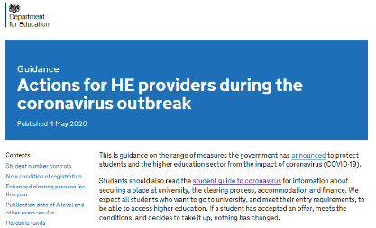
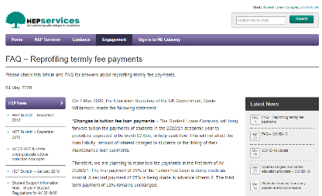
STUDENT FINANCE UPDATE
ACADEMIC YEAR 2020/21 TUITION FEE PAYMENTS
Full details of the government statement, supporting guidance to HEPs and an SLC FAQ on the new payment profile are available online:
www.gov.uk/government/publications/actions-for-he-providers-during-the-coronavirus-outbreak
www.heinfo.slc.co.uk/engagement/hep-news/faq-reprofiling-termly-fee-payments
Notes:
On 4 May 2020, the Education Secretary of the UK Government, Gavin Williamson, made the following statement:
"Changes to tuition fee loan payments – The Student Loans Company will bring forward tuition fee payments of students in the 2020/21 academic year to providers, expected to be worth £2.6bn, to help cash flow. This will not affect the loan liability, amount of interest charged to students or the timing of their maintenance loan payments.”
Therefore, we are planning to make two fee payments in the first term of AY 2020/21.
The first payment of 25% of the Tuition Fee Loan is being made as normal. A second payment of 25% is being made in advance of term 2. The third term payment of 50% remains unchanged.
This change applies to all UK higher education providers, in respect of English, Welsh and Northern Irish full-time and part-time undergraduate students.
We have contacted the British Universities Finance Directors Group (BUFDG) to commence formal implementation planning.

Slide 17
STUDENT FINANCE UPDATE
COVID-19: STUDENT INFORMATION

Slide 18
STUDENT FINANCE UPDATE
SUPPORTING AY 2020/21 APPLICATIONS – FORMS AND EVIDENCE
Due to the COVID-19 situation, students applying for estrangement status or
financial hardship can submit forms and evidence by email:
Standard email attachments, scanned copies and clear photographs of the forms and evidence can be accepted
Hardship Forms and evidence to: financial_hardship@slc.co.uk
Practitioners can submit completed student Estrangement Forms to:
estranged@slc.co.uk
Estrangement Forms need to come from an @ac.uk email address
Notes:
Financial Hardship Team - Sending Forms and Evidence During COVID-19 Due to the current circumstances, students applying for financial hardship now have the option to send forms and evidence to the Financial Hardship Team by email.
Advisors should make students aware that OneDrive or GoogleDrive attachments cannot be accepted.
However, standard attachments, scanned copies and clear photographs of forms and evidence can be accepted.
Emails should be sent to financial_hardship@slc.co.uk.

Slide 19
STUDENT FINANCE UPDATE
CORONAVIRUS GUIDANCE – DSA APPLICATION SECTION 5
Certain students applying for DSAs will need to have Section 5 of a full DSA
application form completed by their HEP to confirm certain course details;
During this time we understand that it is unlikely for students to get this section of their application completed by a HEP
We will therefore be able to accept an email from a student’s HEP (from a university email address: ac.uk) in lieu of a signed and stamped Section 5
Disabled Student Allowance Specific FAQ – available here
Notes:
Can SLC make any adjustments for those students who cannot get section 5 of the full DSA application completed by their HEP?
Yes. We understand that it is unlikely to be possible for our customers to get this section of their application completed by their HEP during this time.
We will therefore be able to accept an email from a student’s HEP (from a university email address) in lieu of a signed and stamped section 5.
The email must confirm the following; Academic Year, Course Name, Course Start Date, Course End Date, Year of Study e.g. Year 2 of 3, Mode of Study e.g. FT or PT, Intensity of study i.e. 50% of full time equivalent –
We must have this information for part-time students and Level of Study e.g. Undergraduate or Postgraduate.
Please note section 5 information is only a requirement for students who are applying for DSA only on an undergraduate course and those applying for a part-time or postgraduate courses.

Slide 20
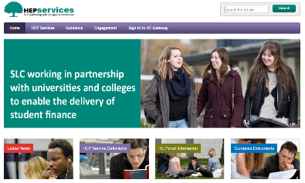
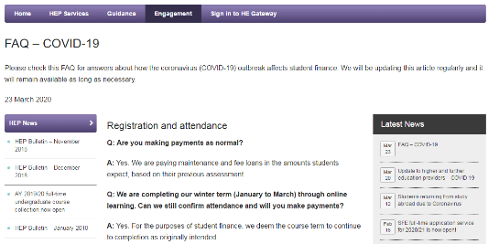
STUDENT FINANCE UPDATE
SLC CORONAVIRUS GUIDANCE
FAQ sections have been added to our websites and will be updated with the latest news, development and answers to questions received:
www.heinfo.slc.co.uk/engagement/hep-news/faq-covid-19
Notes:
Update to Higher and Further Education providers – COVID-19
SLC is providing advice to Further and Higher Education providers following yesterday's update from the UK Government on its strategy to delay the spread of Coronavirus.
We are working closely with education departments across the UK Government to ensure we can provide a continuous level of service across our core functions. The situation is being closely monitored and we have contingency measures in place to ensure that our systems and processes are resilient.
As part of our business continuity preparedness, and in line with updates to Government guidance, we will take additional practical steps to safeguard the welfare of our colleagues and protect against any potential disruption to our business. This may include delivering services from alternative sites across the SLC estate, maximise colleagues’ ability to work remotely, and additional requirements for planning direct engagement between SLC Account Managers and education providers.
We will continue to keep you informed as the situation develops and should you have any questions please do contact us at Partner_Services@slc.co.uk
_____________________________________________________________________________________________________
2. Completion of Spring Term through virtual learning environments Update on completion of Spring Term
Where the HEP completes the Spring term through virtual/online learning, we are deeming this as a continuation of their existing mode of study, and of the level of intensity, that the course was intended to deliver. We would not expect a mode of study or fee change CoC just because of the greater degree of online learning.
______________________________________________________________________________________________________
3. Statement on Student Finance embedded into a wider letter to heads of HEPs - For Info only, please do not share until Paul Smith has confirmed its cleared.
I would like to assure you that the Student Loans Company (SLC) is planning to make Term 3 (Summer term) tuition fee payments as scheduled and that students will continue to receive maintenance payments on the scheduled dates, whether or not campuses are closed or whether learning has been moved on line. In order for this to happen, HE Providers must confirm in the normal way that students are in attendance, but should contact the Student Loans Company if that proves impossible as a result of wide-spread staff absence. HE Providers should also confirm in the usual way registration of any new starters in the latter part of AY19/20, so that SLC can make their maintenance payments

Slide 21
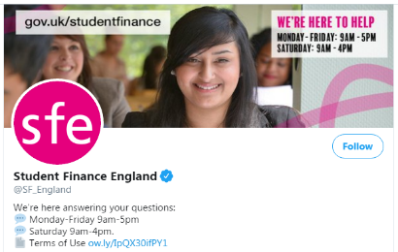
STUDENT FINANCE UPDATE
CORONAVIRUS GUIDANCE – STUDENT INFORMATION
We are working to fully restore our contact services as soon as we can and
have enabled many of our customer service colleagues to work safely:
Our social media team are available to answer general student questions about funding, but cannot answer application specific queries
twitter.com/SF_England
facebook.com/SFEngland
Notes:
We are working to restore our customer contact services as soon as we can by enabling more of our customer service colleagues to work safely. However, as a predominately office based organisation this is taking some time.
Our @SF_England social media team are starting to answer questions about your funding.
Our @SLC_Repayment social media team will be starting to answer questions in the coming days.
We plan to restore customer contact services asap, and we will provide further information here and on our social media channels.

Slide 22
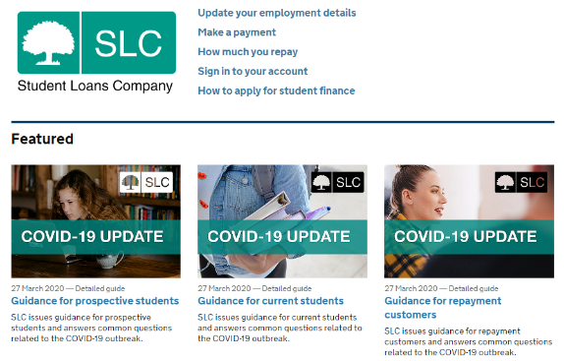
STUDENT FINANCE UPDATE
CORONAVIRUS GUIDANCE – STUDENT INFORMATION
Updated information will be provided online through appropriate channels:
www.gov.uk/government/organisations/student-loans-company

Slide 23
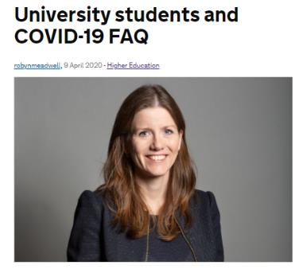
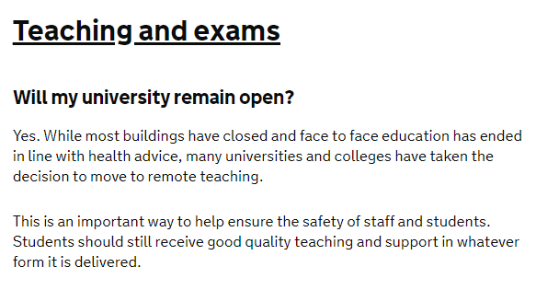
STUDENT FINANCE UPDATE
CORONAVIRUS GUIDANCE – STUDENT INFORMATION
DfE have introduced a COVID-19 FAQ information blog for students:
https://dfemedia.blog.gov.uk/2020/04/09/university-students-covid19-faq/

Slide 24
STUDENT FINANCE UPDATE
REPAYMENT SERVICE IMPROVEMENTS

Slide 25
STUDENT LOAN REPAYMENT
ENHANCED REPAYMENT PORTAL
Key features of the enhanced online repayment service will include;
Shared login from the GOV.UK Apply portal to improve access
Ability to easily update personal details
Plan type, balance, repayment and interest details clearly displayed
Ability to make a one off repayment or set up monthly repayments
Ability to tell SLC they’re going overseas or returning to the UK
Viewing and accessing all correspondence
i
An email and SMS campaign will inform all (4.5 million) repayment customers about the service once it is available (summer 2020 TBC)
Notes:
An investment is being made in a new online repayment service, delivering an upgrade to the existing repayment portal.
The service will allow customers to manage their loan and will provide a platform for future planned features that will enhance self service capability.
The service will largely replace the existing paper statements, though customers can continue to access these from their online account and opt in to continue to receive paper copies if required.
More Frequent Data Sharing (MFDS) has enabled us to provide customers with an up to date view of their balance, repayments made and interest accrued.
Go live is expected in Spring 2020.
SLC will be launching an email and SMS campaign to inform all repayment customers about the service (c4.5m) once it is available.
Key features of the service include:
Shared login from Apply portal
Update personal details
Balance, repayments and interest
Make a one off repayment
Set up a monthly repayment
Tell SLC you’re going overseas/returning to the UK
View correspondence
View active plan type

Slide 26
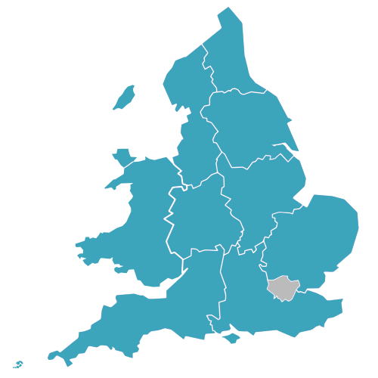
SFE PRACTITIONER RESOURCES
FUNDING INFORMATION PARTNERS ACCOUNT MANAGERS
Stephen Jones
NORTH WEST ENGLAND
NORTH WALES
stephen_jones@slc.co.uk
Kevin McMullan
NORTH EAST ENGLAND
YORKSHIRE & HUMBERSIDE
kevin_mcmullan@slc.co.uk
Phil Lynes
WELSH SCHOOLS & WP
phillip_lynes@slc.co.uk
Ahmar Ehsan
THE MIDLANDS
ahmar_ehsan@slc.co.uk
Stacey-May Fox
SOUTH WEST ENGLAND
& SOUTH WALES
stacey-may_fox@slc.co.uk
Ben Rutter
LONDON
& EAST ANGLIA
ben_rutter@slc.co.uk
Lesley McDowell
FI SERVICES MANAGER
& NATIONAL PARTNERS
lesley_mcdowell@slc.co.uk
Charmaine Valente
SOUTH EAST ENGLAND
& SOUTH LONDON
charmaine_valente@slc.co.uk

Slide 27
For further information on student finance,
applications and repayment
www.gov.uk/studentfinance
For a range of helpful tools and guidance,
visit student finance zone
www.thestudentroom.co.uk/studentfinance

