Slide 1

HELOA North West & Northern Ireland
Lifelong Learning Entitlement
Briefing Session
12th September 2024

Slide 2
The LLE: OVERVIEW MESSAGES
The Lifelong Learning Entitlement (LLE) will transform the post-18 undergraduate student finance system in England:
The LLE will create a single funding system to help people pay for college or university courses, and train, retrain and upskill over their working lives a time that is right for them
LLE will provide new eligible learners with a Tuition Fee Loan entitlement to the equivalent of four years post-18 education funding to use up to the age of 60
This entitlement would equate to £37,000 in today’s fees
From September 2025 (TBC), learners will be able to apply for LLE funding for the first time for courses and
modules starting from January 2026:
This could be through a full-time degree, individual modules, or other courses such as Higher Technical Qualifications (HTQs)

Slide 3
THE LLE: A PHASED INTRODUCTION IMPACTS
The Lifelong Learning Entitlement
General Funding Entitlement
Notes:
The Lifelong Learning Entitlement (LLE) will transform the post-18 student finance system in England.
From September 2025, learners will be able to apply for LLE funding for the first time for courses and modules commencing from January 2026 onwards.
When fully rolled out, the LLE will create a single funding system to help people pay for college or university courses, and train, retrain and upskill flexibly over their working lives.
The LLE will allow people to develop new skills and gain new qualifications at a time that is right for them.
This could be through a full-time degree, or individual modules, or other courses such as higher technical qualifications (HTQs).
From its launch, the LLE loan will be available for:
full courses at level 4 to 6, such as a degrees, technical qualifications, and designated distance-learning and online courses
modules of high-value technical courses at level 4 to 5

Slide 4
THE LLE: FUNDING ENTITLEMENT
Funding entitlement under the LLE:
Individuals will have access to a loan entitlement worth the equivalent of four years of post-18 education funding (£37,000 in today’s fees)
The government will be offering this four-year entitlement to both new, and returning students
Returning students will have access to a residual entitlement
An additional entitlement, above the core four-year entitlement, will be made available for some priority subjects and longer courses such as medicine
Eligibility criteria for the LLE will track existing HE student finance nationality and residency rules
LLE Tuition Fee Loans will be available to eligible students up to the age of 60
Students over 60 may still qualify for maintenance support, but not a Tuition Fee Loan
Notes:
The Lifelong Learning Entitlement (LLE) will transform the post-18 student finance system in England.
From September 2025, learners will be able to apply for LLE funding for the first time for courses and modules commencing from January 2026 onwards.
When fully rolled out, the LLE will create a single funding system to help people pay for college or university courses, and train, retrain and upskill flexibly over their working lives.
The LLE will allow people to develop new skills and gain new qualifications at a time that is right for them.
This could be through a full-time degree, or individual modules, or other courses such as higher technical qualifications (HTQs).
From its launch, the LLE loan will be available for:
full courses at level 4 to 6, such as a degrees, technical qualifications, and designated distance-learning and online courses
modules of high-value technical courses at level 4 to 5

Slide 5
THE LLE: TUITION FEES AND FEE LOAN
New students (those who have not yet received government support to undertake higher-level learning) will
be able to access:
A full entitlement equal to 4 years of full-time tuition
This is currently equal to £37,000 across four years based on today’s fee limit of £9,250 per year
This means a student could use their £37,000 to pay for more than 480 credits of learning
Under the LLE, tuition fee limits will be based on credits instead of being based on the number of academic
years in the course, as is the case under the existing system:
There will be a maximum financial amount per credit and a maximum number of credits which can be charged for in each course year
DFE have published the list of standard numbers of credits for every course type, as well as the maximum or
default numbers that can be charged for in any one course year:
www.gov.uk/government/publications/lifelong-learning-entitlement-tuition-fee-limits
Notes:
The Lifelong Learning Entitlement (LLE) will transform the post-18 student finance system in England.
From September 2025, learners will be able to apply for LLE funding for the first time for courses and modules commencing from January 2026 onwards.
When fully rolled out, the LLE will create a single funding system to help people pay for college or university courses, and train, retrain and upskill flexibly over their working lives.
The LLE will allow people to develop new skills and gain new qualifications at a time that is right for them.
This could be through a full-time degree, or individual modules, or other courses such as higher technical qualifications (HTQs).
From its launch, the LLE loan will be available for:
full courses at level 4 to 6, such as a degrees, technical qualifications, and designated distance-learning and online courses
modules of high-value technical courses at level 4 to 5

Slide 6
THE LLE: MAINTENANCE SUPPORT
For the first time, under the LLE, maintenance support will be available to eligible students across all eligible
Level 4 to 6 technical and part-time courses:
This will place such courses on a par with traditional full-time study
Maintenance Loan and targeted grant support, such as Disabled Students’ Allowance (DSA) and Childcare
Grant will be made available for all designated courses and modules that require in-person attendance:
The maximum amount of Maintenance Loan available will be based on a student’s course, location and personal criteria such as household income
This will broadly remain the same as the current criteria
A Reduced-Rate Maintenance Loan will continue to be available for eligible students aged over 60
LLE Tuition Fee Loan and DSA will be available for eligible online and distance learning courses
Notes:
The Lifelong Learning Entitlement (LLE) will transform the post-18 student finance system in England.
From September 2025, learners will be able to apply for LLE funding for the first time for courses and modules commencing from January 2026 onwards.
When fully rolled out, the LLE will create a single funding system to help people pay for college or university courses, and train, retrain and upskill flexibly over their working lives.
The LLE will allow people to develop new skills and gain new qualifications at a time that is right for them.
This could be through a full-time degree, or individual modules, or other courses such as higher technical qualifications (HTQs).
From its launch, the LLE loan will be available for:
full courses at level 4 to 6, such as a degrees, technical qualifications, and designated distance-learning and online courses
modules of high-value technical courses at level 4 to 5

Slide 7
THE LLE: REPAYMENT - GENERAL TERMS
Repayment of loans taken under the LLE will follow the Plan 5 student loan terms and conditions:
This means that repayments will only start once a borrower earns more than £25,000* a year before tax
This is equal to £2,083 a month or £480 per week
The amount repaid is 9%, or 9p for every £1, of an individual’s gross salary over the repayment threshold
Those with an existing undergraduate student loan who then choose to use the residual support
entitlement they have left under the LLE:
Borrowers will continue to make a single repayment of 9% of their gross salary above the repayment threshold
*£25,000 is the initial threshold for Plan 5 loans and subject to change from April 2027
Notes:
The Lifelong Learning Entitlement (LLE) will transform the post-18 student finance system in England.
From September 2025, learners will be able to apply for LLE funding for the first time for courses and modules commencing from January 2026 onwards.
When fully rolled out, the LLE will create a single funding system to help people pay for college or university courses, and train, retrain and upskill flexibly over their working lives.
The LLE will allow people to develop new skills and gain new qualifications at a time that is right for them.
This could be through a full-time degree, or individual modules, or other courses such as higher technical qualifications (HTQs).
From its launch, the LLE loan will be available for:
full courses at level 4 to 6, such as a degrees, technical qualifications, and designated distance-learning and online courses
modules of high-value technical courses at level 4 to 5

Slide 8
ALTERNATIVE STUDENT FIANCE
All student loans currently charge interest:
This means some people feel unable to access existing student loans for university or college due to their
faith or conscience, most common among some Muslims whose faith prohibits engagement with interest:
The government has committed to introducing an Alternative Student Finance (ASF) product with an alternative to interest payments as part of the wider LLE programme (date TBC)
Students will apply for an alternative payment for both their tuition fee and living cost support
Students will apply for ASF support in the same way as a conventional loan, via Student Finance England
After they leave their studies, students will repay contributions the same way as for conventional student loans, those contributions are then ‘ring-fenced’ to help future students access loans
This new student finance product will be Sharia-compliant and compatible with Islamic finance principles
www.gov.uk/government/publications/alternative-student-finance/alternative-student-finance
Notes:
The Lifelong Learning Entitlement (LLE) will transform the post-18 student finance system in England.
From September 2025, learners will be able to apply for LLE funding for the first time for courses and modules commencing from January 2026 onwards.
When fully rolled out, the LLE will create a single funding system to help people pay for college or university courses, and train, retrain and upskill flexibly over their working lives.
The LLE will allow people to develop new skills and gain new qualifications at a time that is right for them.
This could be through a full-time degree, or individual modules, or other courses such as higher technical qualifications (HTQs).
From its launch, the LLE loan will be available for:
full courses at level 4 to 6, such as a degrees, technical qualifications, and designated distance-learning and online courses
modules of high-value technical courses at level 4 to 5

Slide 9
THE LLE: REMOVING RESTRICTIONS
Eligible students will be able to use their Lifelong Learning Entitlement (LLE) funding for a variety of higher
education courses, both full and modular:
This includes courses that are at the same or a lower level as those they have already undertaken
Under the proposed LLE eligibility policies, ‘unnecessary barriers to learning’ will be removed:
This will include the Equivalent Level Qualification (ELQ) restrictions
This revised policy rule under LLE means that:
Returning students can train, retrain, and upskill based on their remaining LLE balance, rather than being assessed against prior qualifications achieved
However, where they have previously accessed government-backed student support:
This can impact the amount of LLE funding available to the student
Notes:
The Lifelong Learning Entitlement (LLE) will transform the post-18 student finance system in England.
From September 2025, learners will be able to apply for LLE funding for the first time for courses and modules commencing from January 2026 onwards.
When fully rolled out, the LLE will create a single funding system to help people pay for college or university courses, and train, retrain and upskill flexibly over their working lives.
The LLE will allow people to develop new skills and gain new qualifications at a time that is right for them.
This could be through a full-time degree, or individual modules, or other courses such as higher technical qualifications (HTQs).
From its launch, the LLE loan will be available for:
full courses at level 4 to 6, such as a degrees, technical qualifications, and designated distance-learning and online courses
modules of high-value technical courses at level 4 to 5

Slide 10
THE LLE: RESIDUAL ENTILEMENT
Learners who have already received government support for tuition fees may have a residual entitlement to
LLE funding:
This means their initial Tuition Fee Loan entitlement would also be £37,000, based on current fee levels
However, deductions will be applied to their actual LLE funding entitlement
The applied deduction will depend on how much government support the learner had received for their previous courses
Eligible learners with little or no remaining entitlement after all appropriate deductions are made:
Such learners may still receive additional entitlement for government priority subjects or certain longer courses
More details on residual entitlement are available at:
www.gov.uk/government/publications/how-much-lifelong-learning-entitlement-you-could-get
Notes:
The Lifelong Learning Entitlement (LLE) will transform the post-18 student finance system in England.
From September 2025, learners will be able to apply for LLE funding for the first time for courses and modules commencing from January 2026 onwards.
When fully rolled out, the LLE will create a single funding system to help people pay for college or university courses, and train, retrain and upskill flexibly over their working lives.
The LLE will allow people to develop new skills and gain new qualifications at a time that is right for them.
This could be through a full-time degree, or individual modules, or other courses such as higher technical qualifications (HTQs).
From its launch, the LLE loan will be available for:
full courses at level 4 to 6, such as a degrees, technical qualifications, and designated distance-learning and online courses
modules of high-value technical courses at level 4 to 5

Slide 11
THE LLE: DUDUCTIONS – COURSES FROM 2012
For learners that used student loans for courses that began on or after 1st September 2012 any deductions
from their LLE balance will be based on:
Funding to be reduced by the actual amount of Tuition Fee Loan or Grant
This includes study across the UK
The calculation excludes any Maintenance Loans or Grants
The deductions made will be exactly what learners have already drawn down in government support:
This is regardless of which course it was or how they studied
Deductions will not include any years recorded as impacted by Compelling Personal Reasons (CPR):
Compelling Personal Reasons that can be considered include serious illness and bereavement
Notes:
The Lifelong Learning Entitlement (LLE) will transform the post-18 student finance system in England.
From September 2025, learners will be able to apply for LLE funding for the first time for courses and modules commencing from January 2026 onwards.
When fully rolled out, the LLE will create a single funding system to help people pay for college or university courses, and train, retrain and upskill flexibly over their working lives.
The LLE will allow people to develop new skills and gain new qualifications at a time that is right for them.
This could be through a full-time degree, or individual modules, or other courses such as higher technical qualifications (HTQs).
From its launch, the LLE loan will be available for:
full courses at level 4 to 6, such as a degrees, technical qualifications, and designated distance-learning and online courses
modules of high-value technical courses at level 4 to 5

Slide 12
THE LLE: ENTITLEMENT DUDUCTIONS EXAPMLE 1
Deductions from a learner’s LLE balance
For learners that used student loans for courses that began on or after 1st September 2012:
Example: A learner fully funded by student finance
Learner A studied a 3-year degree beginning in September 2012
The university charged £9,000 per year for tuition
This was £27,000 in total and the learner paid for the course with student loan support
When they apply for LLE after 2025, their £37,000 entitlement will be reduced by £27,000
This means the learner will have £10,000 of LLE funding remaining
Notes:
The Lifelong Learning Entitlement (LLE) will transform the post-18 student finance system in England.
From September 2025, learners will be able to apply for LLE funding for the first time for courses and modules commencing from January 2026 onwards.
When fully rolled out, the LLE will create a single funding system to help people pay for college or university courses, and train, retrain and upskill flexibly over their working lives.
The LLE will allow people to develop new skills and gain new qualifications at a time that is right for them.
This could be through a full-time degree, or individual modules, or other courses such as higher technical qualifications (HTQs).
From its launch, the LLE loan will be available for:
full courses at level 4 to 6, such as a degrees, technical qualifications, and designated distance-learning and online courses
modules of high-value technical courses at level 4 to 5

Slide 13
THE LLE: ENTITLEMENT DUDUCTIONS EXAPMLE 2
Deductions from a learner’s LLE balance
For learners that used student loans for courses that began on or after 1st September 2012:
Example: A learner not funded by student finance
Learner B studied a degree part-time over 6 years, beginning in 2017
The university charged £6,000 per year
Student C paid for it without using student loans
When they apply for LLE after 2025, no deductions will be applied to their entitlement for this study
This means the learner will have £37,000 of LLE funding remaining
Notes:
The Lifelong Learning Entitlement (LLE) will transform the post-18 student finance system in England.
From September 2025, learners will be able to apply for LLE funding for the first time for courses and modules commencing from January 2026 onwards.
When fully rolled out, the LLE will create a single funding system to help people pay for college or university courses, and train, retrain and upskill flexibly over their working lives.
The LLE will allow people to develop new skills and gain new qualifications at a time that is right for them.
This could be through a full-time degree, or individual modules, or other courses such as higher technical qualifications (HTQs).
From its launch, the LLE loan will be available for:
full courses at level 4 to 6, such as a degrees, technical qualifications, and designated distance-learning and online courses
modules of high-value technical courses at level 4 to 5

Slide 14
THE LLE: DEDUCTIONS – COURSES BEFORE 2012
For learners who accessed student finance for level 4 to 6 courses, as well as some level 7 courses such as
PGCEs before 1st September 2012:
Deductions will be made from LLE entitlement depending on how many years the learner studied
This only includes study at UK providers
The specific treatment for this cohort reflects the fact that tuition fees were very different before 2012 to how
they have operated since:
Fees were much smaller (and before 1998 they didn’t exist)
This means that the government paid most of the cost of a student’s tuition
The deductions to be applied are broadly in line with modern-day tuition fees
Notes:
The Lifelong Learning Entitlement (LLE) will transform the post-18 student finance system in England.
From September 2025, learners will be able to apply for LLE funding for the first time for courses and modules commencing from January 2026 onwards.
When fully rolled out, the LLE will create a single funding system to help people pay for college or university courses, and train, retrain and upskill flexibly over their working lives.
The LLE will allow people to develop new skills and gain new qualifications at a time that is right for them.
This could be through a full-time degree, or individual modules, or other courses such as higher technical qualifications (HTQs).
From its launch, the LLE loan will be available for:
full courses at level 4 to 6, such as a degrees, technical qualifications, and designated distance-learning and online courses
modules of high-value technical courses at level 4 to 5

Slide 15
THE LLE: ENTITLEMENT DUDUCTIONS EXAPMLE 3
Deductions from a learner’s LLE balance
For learners who accessed student finance before 1st September 2012:
Example: Full-time study
Learner C studied a full-time degree for 4 years, beginning in 2002
One of those years was a sandwich year of work placement
When applying for LLE after 2025, the learner will have:
1 deduction of £1,850, and
3 deductions of £9,250
This means the learner will have £7,400 of LLE remaining
Notes:
The Lifelong Learning Entitlement (LLE) will transform the post-18 student finance system in England.
From September 2025, learners will be able to apply for LLE funding for the first time for courses and modules commencing from January 2026 onwards.
When fully rolled out, the LLE will create a single funding system to help people pay for college or university courses, and train, retrain and upskill flexibly over their working lives.
The LLE will allow people to develop new skills and gain new qualifications at a time that is right for them.
This could be through a full-time degree, or individual modules, or other courses such as higher technical qualifications (HTQs).
From its launch, the LLE loan will be available for:
full courses at level 4 to 6, such as a degrees, technical qualifications, and designated distance-learning and online courses
modules of high-value technical courses at level 4 to 5

Slide 16

Example
Learner
Journey
Current Funding System
LLE Funding
Everyone Beth talks to recommends a degree
She decides to take a 3-year geography degree and applies to SFE for Tuition Fee Loan support
When discussing her future, Beth is given a range of advice on potential study options
A tutor suggests modular study as a way she can gain further experience of computer science
Beth starts the course and enjoys it, but still isn’t sure and is not clear on her employment options
She feels committed, so completes the course
Beth creates her online personal account to find
an LLE fee loan entitlement of £37,000
(4 years of post-18 education funding at today's level)
She wants to see if computer science is right for her, so uses some of her LLE to fund an initial single module at a local university
After graduating, Beth struggles to find work linked to her degree and gets a job in recruitment
Beth is a college student interested in geography and computer science.
She’s unsure about studying a computer science degree but is confident she’d enjoy geography.
i
After several years, Beth is not satisfied with her job but is unsure if she can afford to retrain
Beth enjoys the module and decides to continue, using her LLE funding to undertake a full 1-year Higher Technical Qualification (HTQ)
Under the pre-LLE rules, Beth’s funding options for further HE level study would have been limited
The relaxation of ELQ and previous study rules under LLE mean that Beth would have a residual entitlement available to fund further approved
Level 4 to 6 courses or modules
i
After studying, Beth gets a job in the digital sector
Beth is confident in the knowledge that she can use her LLE funding again if she ever wants to
or needs to upskill or retrain
i
Caveat: Funding and course eligibility rules are subject to final LLE policy!

Slide 17
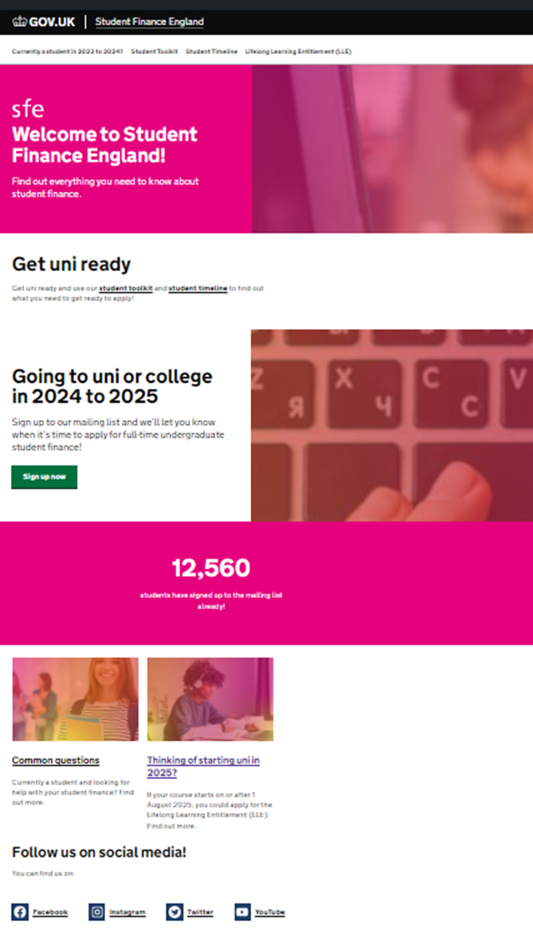
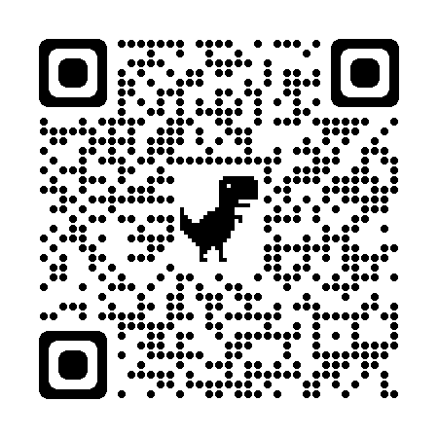
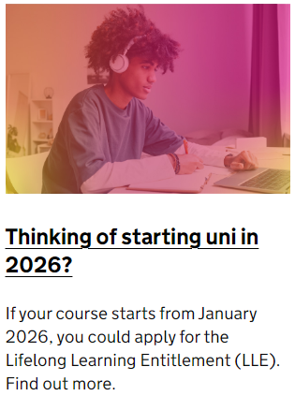

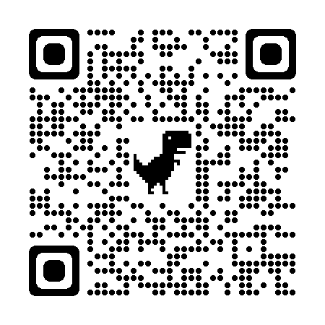
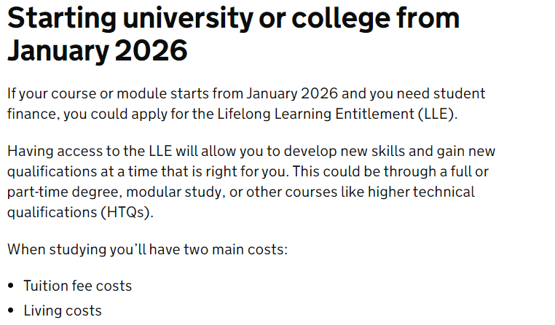
THE LLE: LEARNER INFORMATION AND GUIDANCE
The first phase of customer-facing information for prospective learners starting a course or approved module
under the LLE is now available from the SFE campaign page:
The campaign page will feature information for those starting a course in academic year 2024/25 covering the existing undergraduate student finance package
studentfinance.campaign.gov.uk
A dedicated LLE section has been added for those interested in starting a course from January 2026
studentfinance.campaign.gov.uk/lifelong-learning-entitlement
Notes:
https://studentfinance.campaign.gov.uk/
https://studentfinance.campaign.gov.uk/lifelong-learning-entitlement/

Slide 18
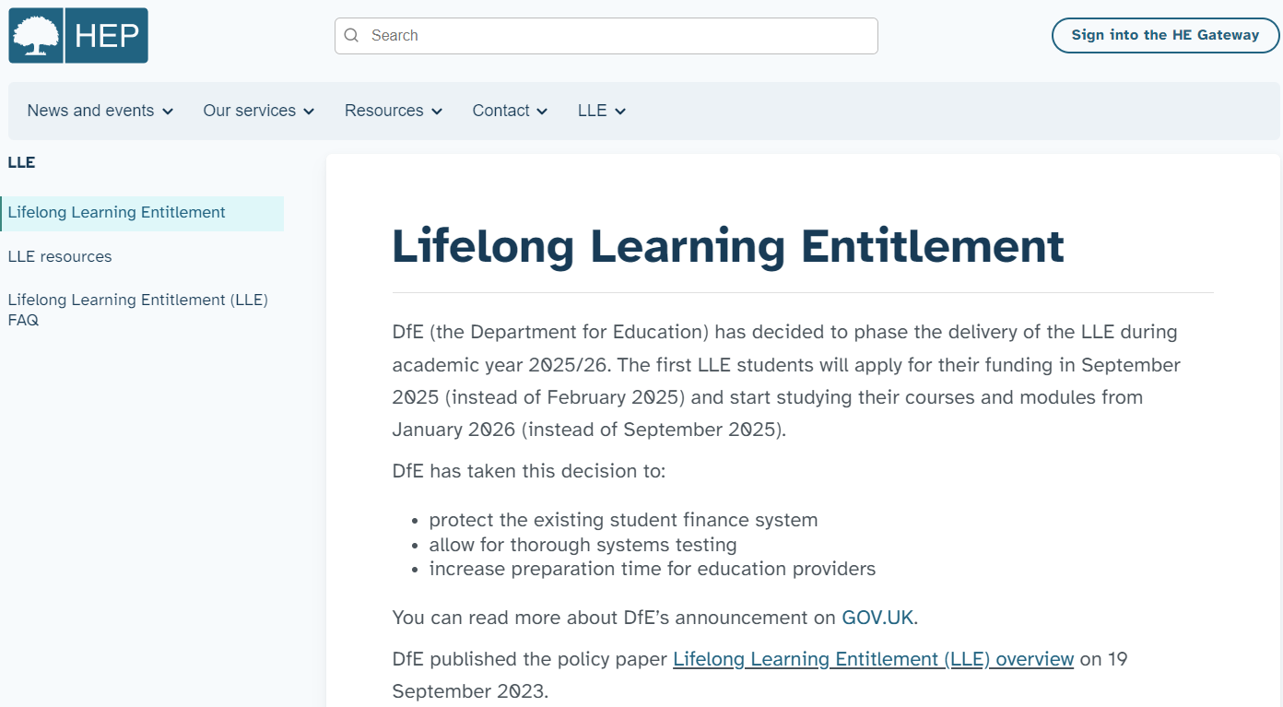
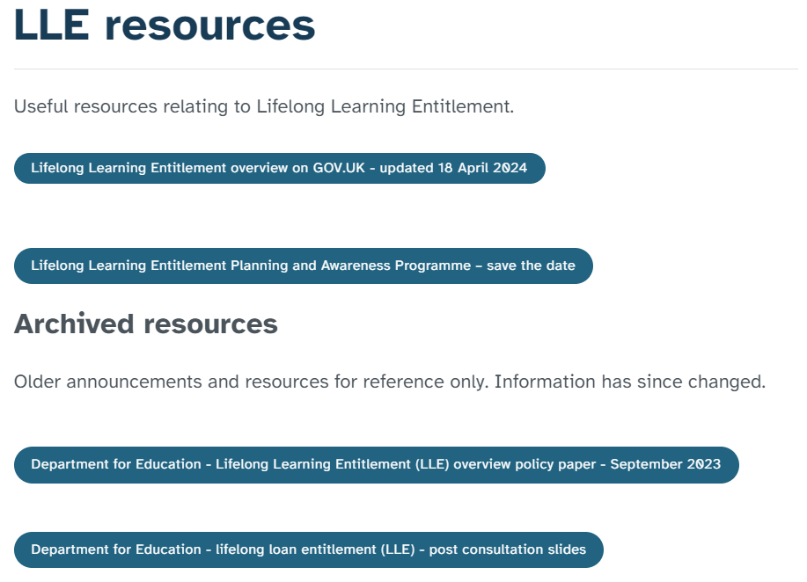
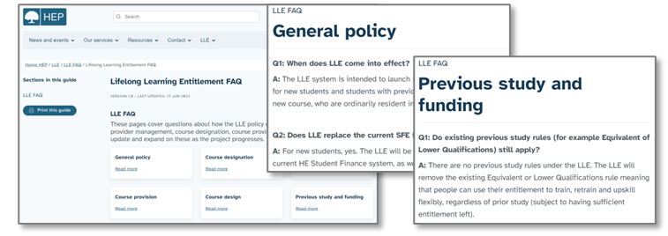
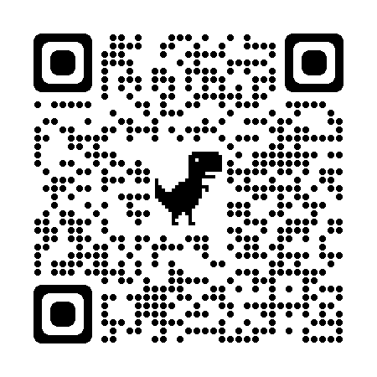
THE LLE: SLC RESOURCES AND INFORMATION
Dedicated information sections have been added to the SLC HEP Services website and will host the latest LLE
updates and resources: www.heinfo.slc.co.uk/lle/lifelong-learning-entitlement
Page content includes:
An introduction to the LLE
LLE resources, and
An LLE frequently asked questions (FAQ) section, covering topics such as general policy, course designation and previous study
The FAQ section is being frequently updated when additional policy information and clarification is received

Slide 19


Slide 20
Many thanks for attending.
If you want to discuss any Student Finance issues, ask questions or arrange a visit, please don’t hesitate to contact me using the details below.
Stephen Jones
Account Manager – Northwest England & North Wales
stephen_jones@slc.co.uk

