Slide 1
Effective Governors,
Excellent Schools
Notes:
From Governors for Schools, Eoghan Kelly, Partnership Manager in the South East

Slide 2
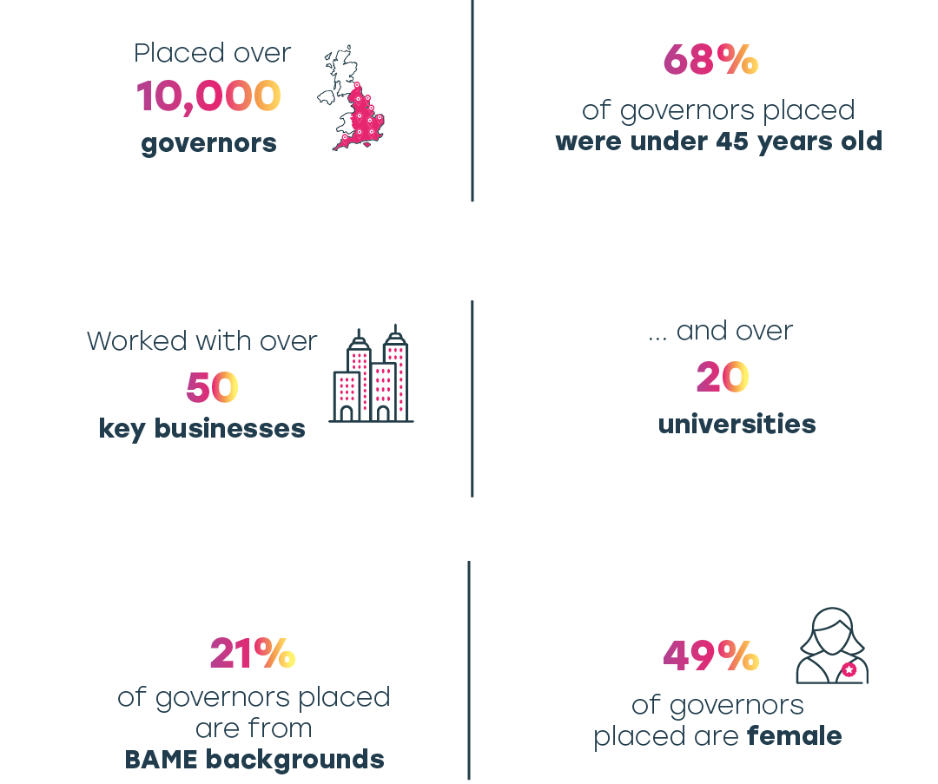
Who are Governors for Schools?
Note: Data from the last 5 years
Notes:
Governors for Schools is an education charity which exists to improve educational standards so that children and young people have the chance to realise their full potential.
We believe the key to improving school performance is effective governance. By finding, nurturing, and supporting a talented network of governors we help to drive systematic change in how schools operate.
Since 1999 we’ve been connecting schools across England with skilled and committed volunteers, supported by our wide pool of business and university partnerships, for example Lloyds Banking Group, PWC, KPMG, Allen & Overy, Pearson, and Manchester University.
What we do is to match the skills that schools want on their governing bodies with those that volunteers offer.
We have helped to place over 10,000 governors in the last 5 years.
We are proud that we bring diversity to the governing boards – both in terms of youth and ethnic background; also from a gender perspective we place 49% women.

Slide 3
Role of the School Governor or Trustee
Strategy
Creating robust
accountability
Financial
management
Notes:
Ensure clarity of vision, ethos and strategic direction
Work collaboratively with the school’s senior leadership team to set the school’s aims and objectives, formulate policies and agree targets.
Hold senior leaders to account for the educational performance of the school and the outcomes of its pupils
Support and challenge the school’s senior leadership to ensure the schools aims and objectives are achieved and the standards of educational provision is high aiding the progress of all pupils.
Financial Accountability
Oversee the financial management of the school and ensure its money is well spent and appropriately accounted for.
Differences in governance responsibilities between MATs and maintained schools, and if this is somethingyou’re interested in, I’d be happy to provide more detail.

Slide 4
How do school governors and trustees benefit?
Gain board experience
“It has given me board experience, experience of setting strategy and opened up a lot of new networks which will benefit my career.” Anne
Develop transferable skills
“This experience has enabled me to become more informed about all the different aspects involved in running a complex organisation and this has had a positive impact on my perceptions of my own place of work.” Jacqui
Improve educational standards
“Helped implement a reward system for attendance, generated prizes for pupils using external contacts. Attendance has improved from 92% to 96% over last 18 months as a result.” Rachael

Slide 5
Commitment
Time per month
Term of Office
Travel
Liability

Slide 6
The impact of school governors
Impact animation
Notes:
This brief animation shows the results of our impact survey.

Slide 7
What do we do
Recruit volunteers to become school governors or trustees
Match based on skills and preferences
Make introductions and support through the process
Provide ongoing support
Notes:
Our service is free to maintained and academy schools. They tell us what skills they need on their Board and we match them with a suitable volunteer.
When a volunteer applied they can tell us about their skills and their preferences, including phase of education and how far they’d like to travel.
Each volunteer will have a regional Partnership Manager who will support them through the matching and placement process.
We provide ongoing free support in the form of e-learning and webinars.

Slide 8
Why do we partner with universities?
Breadth of skills
Commitment to professional development
Commitment to social responsibility
Flexible working – supportive of volunteering
Reach – local and national
Notes:
Our aim is to improve educational standards through effective schools governance. The priority in establishing an effective governing board is to have the right people around the table.
Universities provide staff with a huge breadth of skills and a passion for education. So alongside educationalists we have facilities managers, accountants, HR experts, research fellows that cover such a huge range of areas of study.
Skills offered by alumni can be even wider.
Universities are positive about developing the skills of staff and can understand the Continuous Professional Development Opportunity that being a school governor provides.
Universities are committed to supporting the local community through a range of initiatives of which school governance can be one.
Many universities already have policies to support time off for volunteering, or at least for public duties. Fleixible working means that volunteers are able to support schools effectively as occasional day time visits will be needed in order to be effective and build links with the school.
University employees often commute a significant distance, meaning that staff are able to support schools in a wider geographical area that the university may traditionally reach. Alumni can reach even further.
By engaging alumni who were originally attracted to the university through widening participation activity, they can then support their local communities and continue the cycle of raising aspirations.

Slide 9
Why do universities partner with us?
Identify/make links with school
Better understanding of schools
Target particular areas where the University can have most impact
Staff development – Professional Development opportunity
Alumni engagement – valuable volunteering opportunity
Social impact and improving educational standards
Notes:
There are two parts to developing a governor network; you can approach either area first and we can help with both. Engaging existing governors, and recruiting more governors.
By engaging existing governors, you can ensure that Boards are taking advantage of their strategic links to HE - If we consider the Gatsby benchmarks, and look at number 7 - Encounters with further and higher education – we know how important it is for schools to be making these links with higher education and providing opportunities to children and young people. Having a governor linked to the university can be a massive step forward in building these.
Raises aspirations
Engages schools in other university activities and initiatives
Employee satisfaction and become employer of choice
Volunteering is good for staff:
Neighbourly survey November 2017
The survey, carried out by an independent research company with 2,000 people across the UK, found that employees who have volunteered with their company are
13% happier than those who have not.
100% of employees said volunteering made them feel proud to work for their company
employees who volunteer are 15% more satisfied with their lives
and 15% more likely to recommend the company they work for, helping to support the recruitment of top talent.
85% of businesses find volunteering advances talent as part of the learning and development strategy.
Supporting governors leads to better school governance which raises educational standards. – that’s why we all work in education.
When developing a governor network and considering recruitment, you may find that it sits within a number of teams, for example, Widening Participation/Recruitment and alumni engagement. That’s because it offers a number of opportunities.
In terms of recruitment and outreach, you can talk to us about any particular areas that you want to target, and we can also tell you which areas have the most need. Some schools are particularly looking for university representation on their Boards so we can identify that.
We know that school governors increase their skills through the role and bring those skills back to the workplace. By recruiting more staff to the role, the number of staff who are developing in this way increases, upskilling the workforce and increasing the effectiveness of the university.
By promoting the opportunity to alumni, you not only keep them engaged but contribute to continuing their development.
Your university can have a huge impact on the educational outcomes of thousands of school pupils, whether they attend the university or not.

Slide 10
Who do we already partner with?
Notes:
These are just some of our partners.
Work with uni’s in different ways – internal comms/presentations/events
Target staff/alumni. We can guide through the process, but we’re alos flexible to how your university works.

Slide 11
How to develop a governor initiative
Engaging and support existing governors
Recruiting new governors
Notes:
Engaging and supporting existing governors
Survey staff to identify
Provide access to free online training through ourselves
Provide support to their Board through ourselves – recruitment
Arrange informal buddying/networking
Provide online space to share knowledge
Annual conference – we can suggest speakers and content
Recruiting new governors
Internal communications
Presentation/webinar from Governors for Schools
Networking/lunch and learn event
Alumni communications
Existing volunteering platform/Fairs
Target mature students/Post graduate students
Specific appeals for specific school vacancies

Slide 12
Reporting
Measure engagement with volunteer initiatives
Measure impact on the community
Identify school links
Notes:
Share sample University report
When vols identify the university as an employer or place of study they give permission for us to share details
Measure the number of volunteers, gain an outline of who the volunteers are
Measure the number of schools and the financial equivalent of the volunteer hours
Identify schools with a governor link – provide the benefits of a strategic and operational link to them e.g. raising aspirations through involving them in widening participation activites.

Slide 13
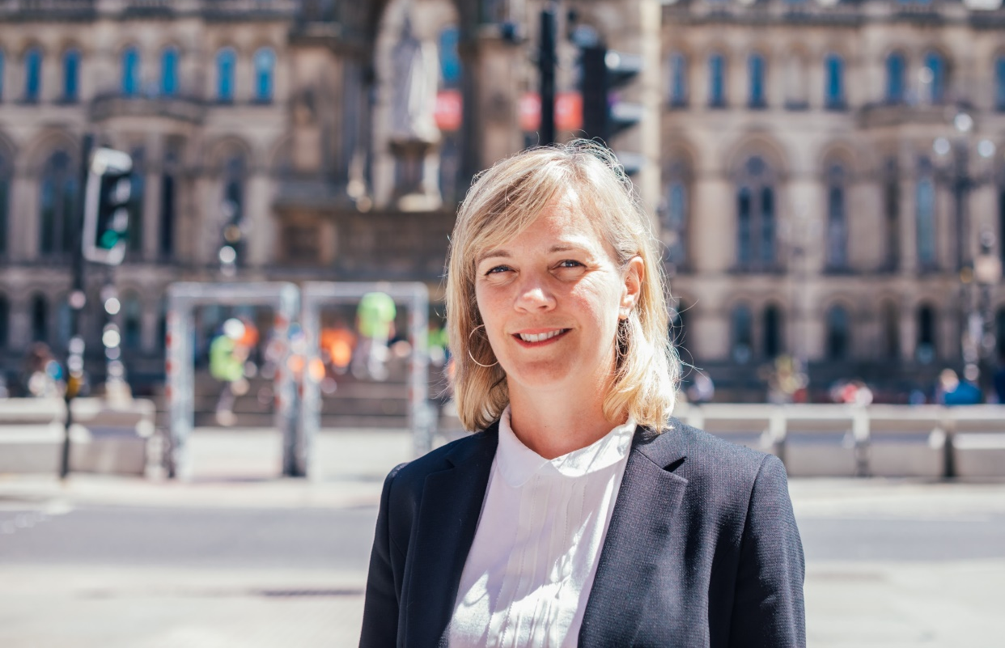
Meet our Volunteers
“I think we have an obligation to the communities we
live and work in to provide
opportunities for young
people.”
Jessica, Manchester
Governor Stories
Notes:
We have a real focus on developing our university relationships in order to maximise the skills of staff and alumni, and support the next generation.
I hope we’ll be able to help you with this and would be happy to discuss with anyone.
Just to finish off, here’s a short video, hearing from some of our volunteers across the country.

Slide 14
Effective Governors, Excellent Schools
www.governorsforschools.org.uk/support-us
governorsforschools
@GovernorsforSchools
@SchoolGovNet
@SchoolGovNet
Notes:
When you have been successfully placed as a governor, please consider making a donation to Governors for Schools. We are an independent education charity and rely on donations to sustain our operations.

