Slide 1
ENGAGING WHITE WORKING-CLASS MALES
Alex Blower, University of Southampton
Alexander.blower@wlv.ac.uk
Twitter @EduDetective
Notes:
Example title slide without image.
We recommend your presentation title is the cover of your UG prospectus eg. ENGINEER A NEW WORLD

Slide 2

Today’s Session
Context
White working-class males in educational research
The role of raising aspiration
Case studies
Considerations for practice

Slide 3

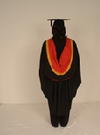
A Man of Two Robes
Staff Member
PhD Student
University of Southampton
University of Wolverhamtpon

Slide 4
Research Questions
How do teaching staff at the school understand the expectations of white working-class male students for their future in education?
How are the expectations of a white working-class male student about the future shaped by the experiences of their social networks?
How do white working class males negotiate expectations regarding their educational future within the institution of the school?

Slide 5
The Study
Participant Observation with 3 students
(4 months)
Semi structured interviews with staff, students and members of their social network
(19 participants)
Notes:
Initial participant observation with white working-class male students currently in year 10 at West Midlands Academy. Aims to build rapport and trust amongst students and teachers. Also provide rich contextual information to inform interviews
Semi structured interviews with teachers, students and social networks with a relationship to West Midlands Academy

Slide 6
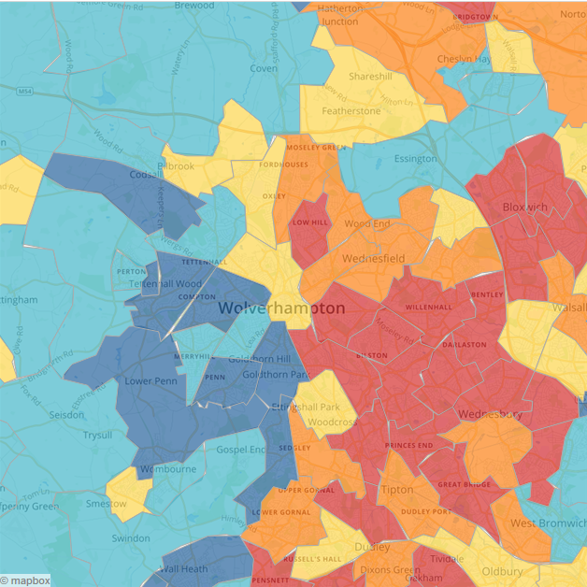
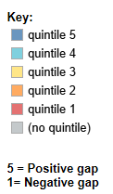
West Midlands Village
http://www.hefce.ac.uk/analysis/yp/gaps/

Slide 7
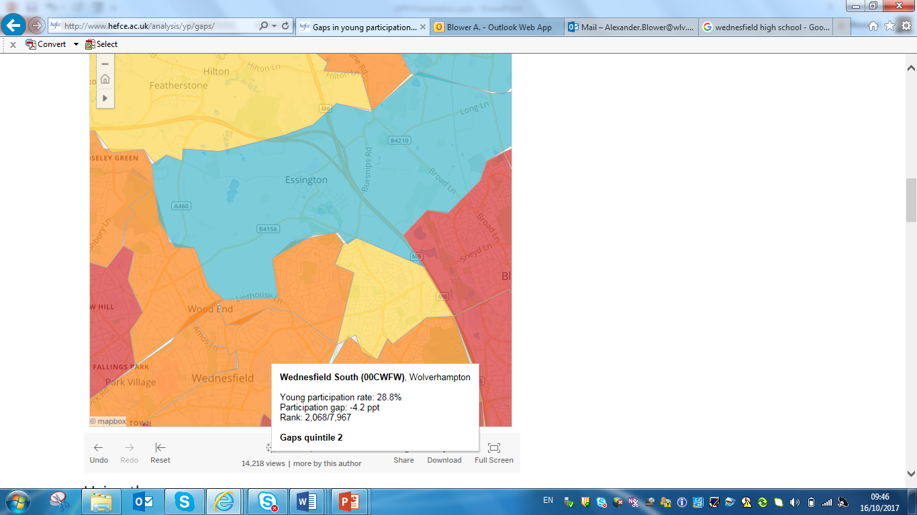
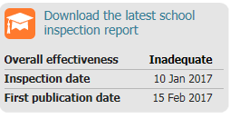
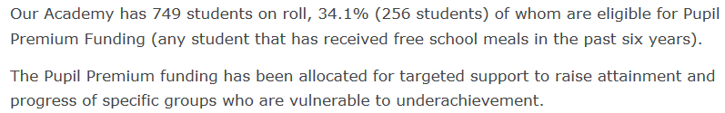
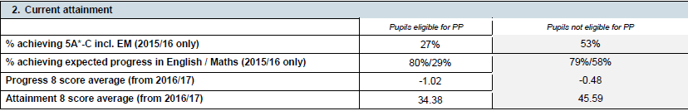
West Midlands High

Slide 8

What are the characteristics of a white working-class male?

Slide 9
What does research say about white working-class males?

Slide 10
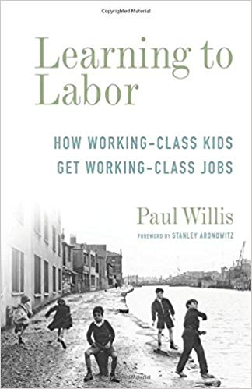
Willis’s Lads
Working-class male as breadwinner
Anti-school subculture
Gained status by disrupting lessons, not doing homework and messing around
Argued lads he observed were deliberately failing themselves in recognition of the menial work that awaited them
Positioned other behaviours a effeminate and undesirable

Slide 11
Student videos
Video 1
Video 2
Video 3

Slide 12
Are new ways of being a white working-class male emerging?
‘we can note that some working class young men discursively construct and imagine lives that are indicative of a sociohistorical moment characterised by inclusive masculinity, with aspects of femininity that once presented a threat to masculine ideals appearing to hold less cultural sway’
Roberts, S. (2013). Boys Will Be Boys … Won’t They? Change and Continuities in Contemporary Young Working-class Masculinities. Sociology, 47(4), 671–686

Slide 13
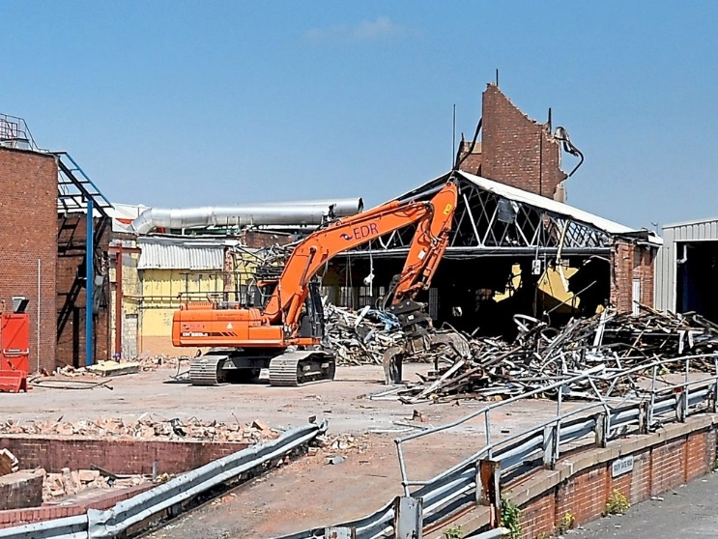
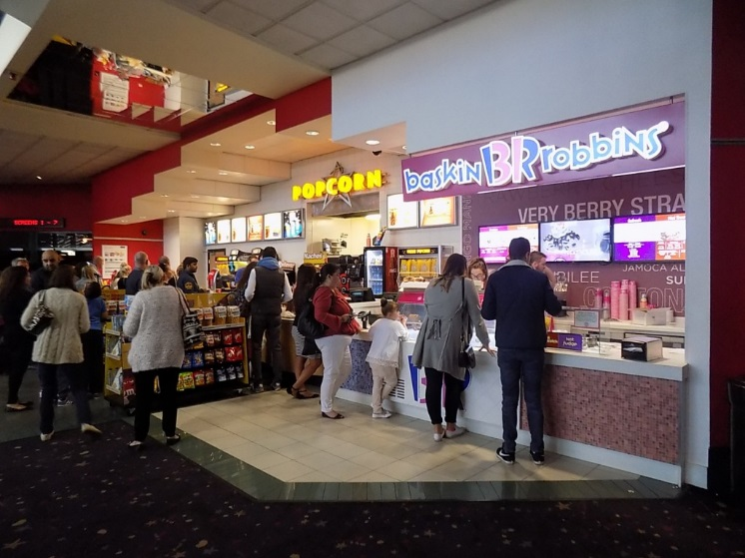

Slide 14

How do we think about class?

Slide 15
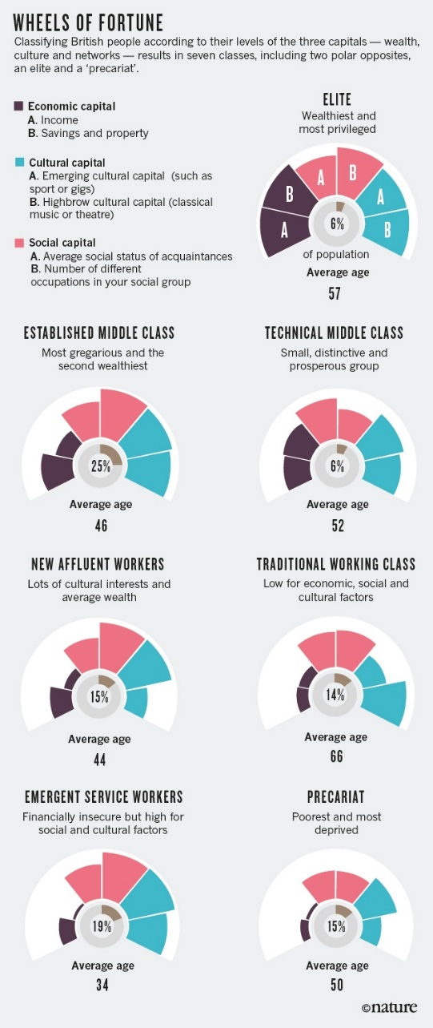
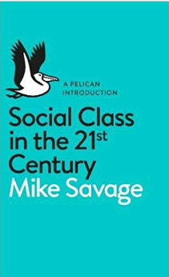
How do we think about class?
The Great British Class Calculator

Slide 16
Social
Resource
Cultural
Economic

Slide 17
Which group are the white working-class males in?

Slide 18
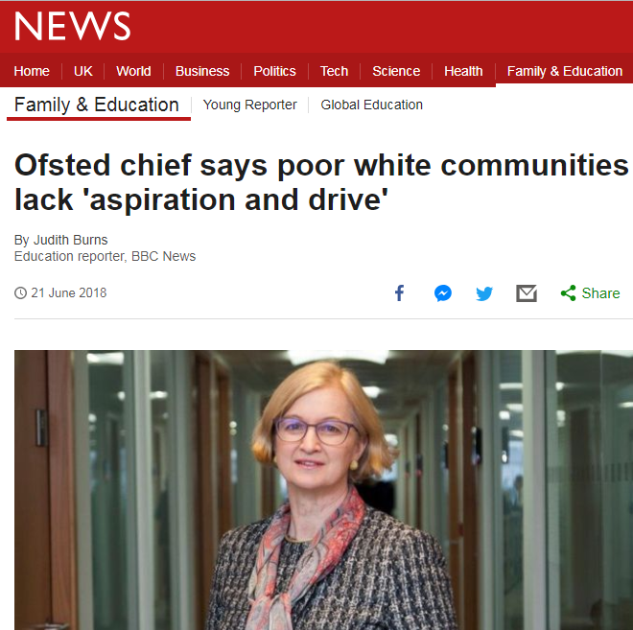

Slide 19
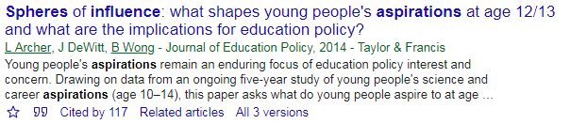
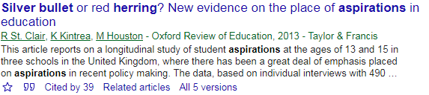
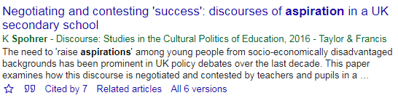
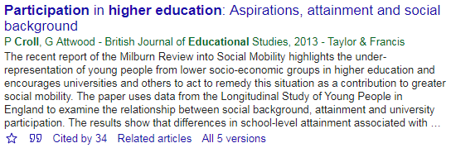
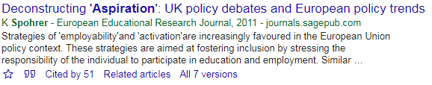
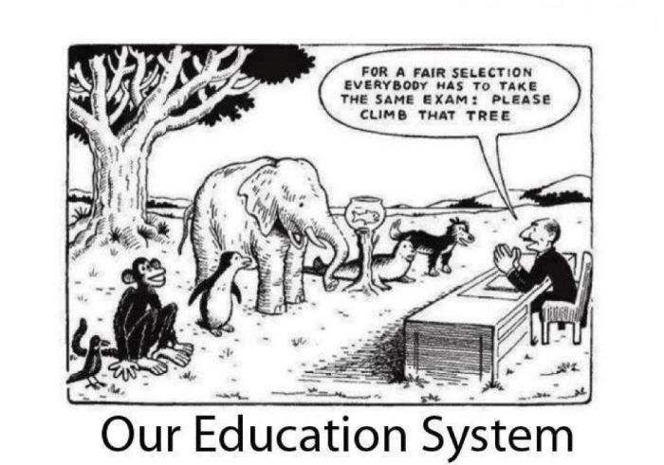
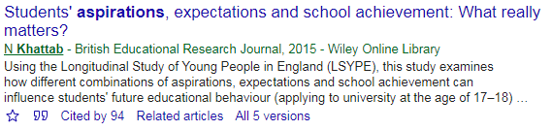
Raise Aspirations?

Slide 20
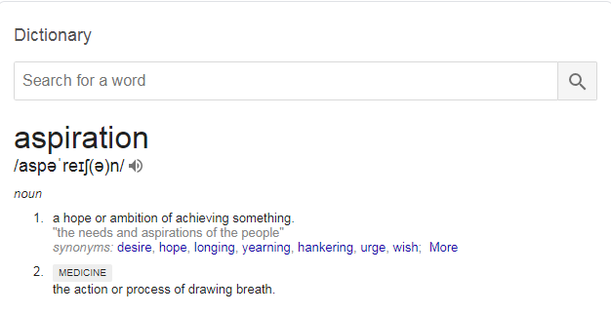
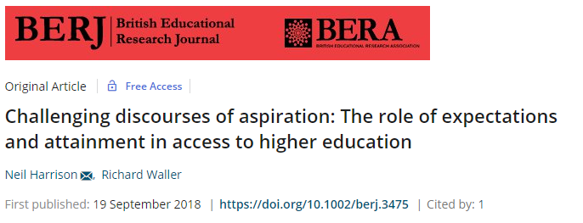
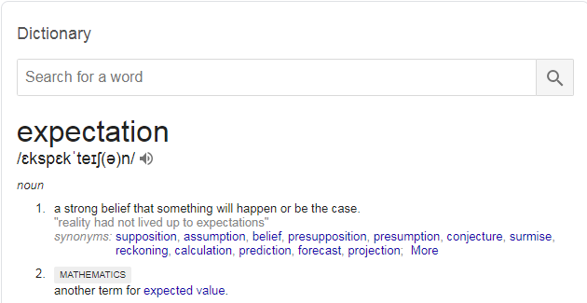
Raise Aspirations?

Slide 21
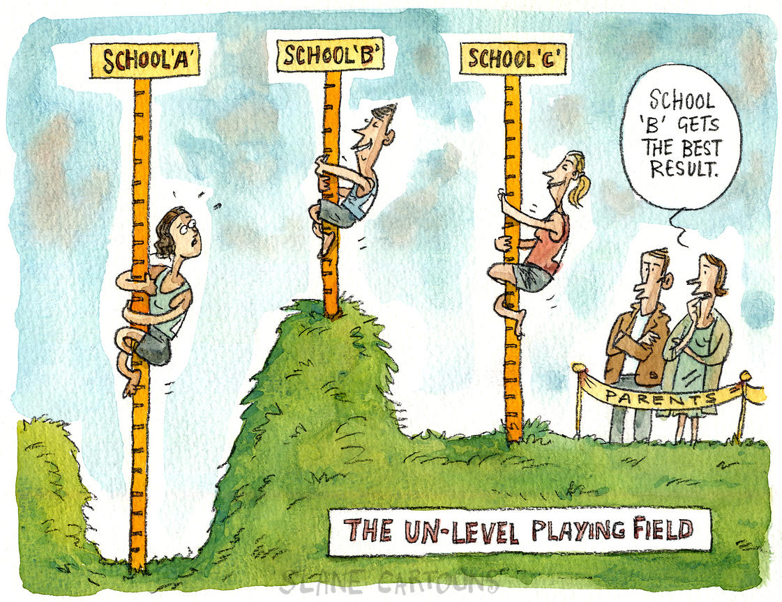
What does this mean for our work with white working-class males?
Providing resource for development of future expectations
Social
Cultural
Economic

Slide 22
The Race for $100

Slide 23
Examples from practice

Slide 24

Case Studies
15 week mentoring programme with white working-class males currently in year 8 at 2 Hampshire schools
6 undergraduate student mentors
18 mentees
All mentors have been in receipt of a contextual offer to the University of Southampton
Flexibility of content allowing for student and mentor to collaboratively develop direction of activity

Slide 25
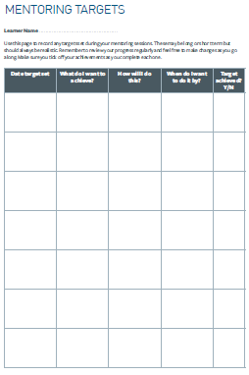
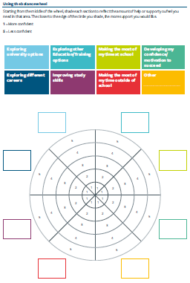
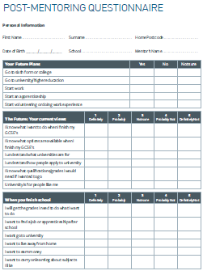

Slide 26
PRO’s
One to one working allows sessions to be tailored for the individual needs of the student
Sustained engagement means longer term targets can be set
‘Hot knowledge’ about HE can be delivered in a more informal manner
Peer to peer nature means undergraduates can be tangible role models
CON’s
Significant cost implications
A lot of work to ensure mentors are prepared to work with learners independently
Limited numbers of students that can be involved
Locating appropriate role models

Slide 27
Through the Eyes of Boys
Shaping Futures NCOP
Chris Bayes
c.bayes@lancaster.ac.uk

Slide 28
Through the Eyes of Boys
Shaping Futures NCOP
Phase 1
Pilot phase launched with Liverpool schools - May 2017 with 67 students
Phase 2
‘Knowsley arm’ – launched January 2018 with 66 students

Slide 29
Through the Eyes of Boys
  “Knowsley arm” of the project
  https://www.theguardian.com/education/2017/jan/29/knowsley-education-catastrophe-a-levels-merseyside
  https://www.theguardian.com/commentisfree/2017/jun/01/knowsley-country-safest-labour-seat-cuts
  https://www.theguardian.com/education/2016/nov/13/education-schools-liverpool-knowsley

Slide 30
Through the Eyes of Boys
Genuine co-production model, Headteacher/SMT buy-in, developed the project with people who knew “the lads”
Developed a programme which went beyond usual HE “aspiration raising”
Took lessons from the pilot and applied them to create something fit for purpose

Slide 31
Through the Eyes of Boys
Cohort 2 (Knowsley) launched January 2018
Programme of events
  Late Jan – Introductory visit – Held at school, invited parents and carers
  February – Go karting, University visit day –’Building Bridges’ and collaborative visit to LIPA, LJMU and City of Liverpool College
  March/April – St Modwen (“The Townie” - local employability), Sports Science session (Liverpool Hope) and ‘Football Industries’ day at Goodison Park via Everton in the community
  May/June – Jaguar Land Rover (Apprenticeships), MALIT
  July – Residential – Keele University
  September – London visit – George Howard MP

Slide 32
PRO’s
‘We were torn to shreds by the Head Teacher before we even started’ made it more meaningful
Senior level buy in from participating schools
Head Teacher and Assistant Head went to the school as students
Partnership with Higher Horizons +
Project stimulated by ‘Knowsley better together’ council led activity. Brought together community steakholders
CON’s
Had to ‘navigate’ some red tape
Workload meant that project was passed on to colleagues who inhabited different positions within the community – lived experience was a big initial driver
No ready made pool of immediate role models

Slide 33
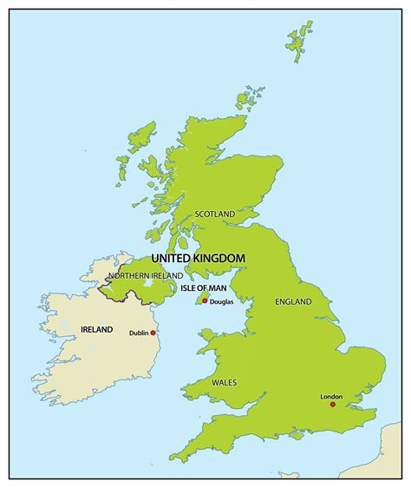
The importance of locality
Newcastle
Devonshire
Bedfordshire
London
Cultural
Resources
Social
Economic

Slide 34
Considerations for practice
What’s the aim of your work? Is the target your working towards measurable and achievable?
Do you know what the group that you’re working with wants/needs access to? If not how can you find out?
How does locality affect students access to resources/opportunities?
What makes it a success?
Cultural
Resource
Social
Economic

Slide 35
Notes:
We recommend including the presenters contact details for further questions.

