Slide 1
International University Applications
David Hawkins

Slide 2
Background
2007-2014: Taunton School, Somerset, UK
History Teacher
Boarding Tutor
Head of Careers
2014-2016: International School of Brussels, Belgium
Head of College and Careers Counselling
Professional Memberships:
International Association for College Admissions Counseling
Council of International Schools, Affiliated Consultant

Slide 3
I work as an independent advisor. I am contracted by families in the UK and internationally to add bespoke, individual and comprehensive guidance and support with university applications to the help students receive from their schools, for applications to:
The UK
The USA
Canada
Europe

Slide 4
http://tiny.cc/uniguypod

Slide 5
A selection of places our students gained offers
Harvard
CEU San Pablo
Yale
Stanford
Macalester College
University of Akron
Amsterdam University College
Bishop’s University Canada
IE University Spain
Universita Bocconi, Italy
The American University of Paris
University of Colorado Boulder
Syracuse University
King’s College London
Hong Kong University
Northeastern University
University of Pennsylvania
University of Southern California
University of Toronto
University of Virginia
Drexel University

Slide 6
Why might students use an independent counsellor?
We make the process of applying to university less stressful by providing clear targets, an overarching strategy, honesty about likely outcomes, and by ensuring students know exactly what needs to be done and when;
We are accredited by outside organisations with codes of practice and do not take commission from universities for placing students; we advise on the ‘whole market’.
We have strong relationships with university admissions officers at a wide range of universities, making the process as smooth as possible;
We understand that students will be applying to universities while doing other things as well, and will help them balance all of their commitments;
We can assist with applications to many different parts of the world in addition to Europe, such as the U.S., U.K., and Canada.

Slide 7
CIS Affiliated Consultants
CIS knows that sometimes families need outside help when considering post-secondary education opportunities, and that finding the right resources can be a daunting and time consuming task. CIS has established a network of consultants to help families at CIS schools find high quality consultants who have experience supporting students around the world. Independent University Consultants (IUCs) are professionals who provide guidance to students and families in the university research and planning process, and they can help to guide the student through the university application process
The counsellors that are part of the CIS Affiliated Consultant network have been evaluated by CIS to ensure they meet standards for quality service according to stringent application requirements. CIS provides the referral to consultants. Students and families then contact the counsellors directly to engage their services

Slide 8
Why Study Abroad?

Slide 9
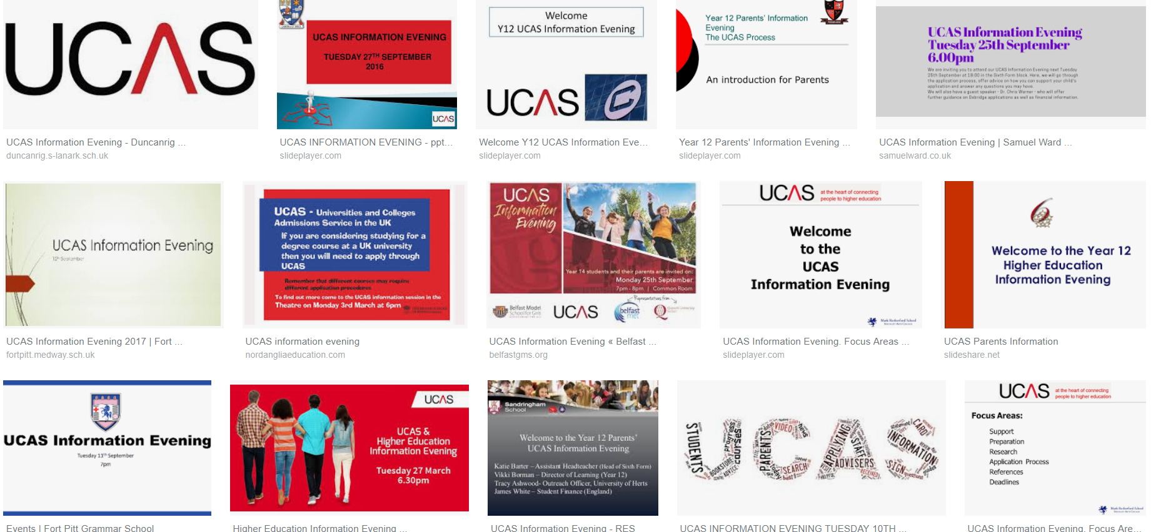
“In this talk, we are going to hear about how to apply to university.”
“In this talk, we are going to hear about how to apply to university in the UK.”

Slide 10
Forget the UK model

Slide 11
Why the UK is different….
You have to decide what you want to study at university before you apply
University is typically mostly about lectures and exams
My predicted grades will determine where I can apply
Universities don’t place much emphasis on anything except school work when deciding who to admit
I need to go to a university people have heard of in order to get a good job

Slide 12
For example, the USA as a different model:
What do you apply for?
Role of the Liberal Arts
College vs University
Major and Minor
Cumulative assessment
Ability to change paths
Integration of extra-curricular options

Slide 13
The Liberal Arts model explained…
UK degree
Set menu & final assessment
Liberal Arts degree
Buffet style & continuous assessment

Slide 14
A different way of applying: the USA
Standardised Testing
Finding your list
Application essays (see example)
Different application portals
Regular vs Early Decision vs Early Action vs Rolling
Demonstrated Interest and Legacy

Slide 15
MIT
For the Bachelor of Science degree, students must complete a core requirement that is equally divided between science and mathematics, and the humanities, arts, and social sciences.
The science/mathematics requirement includes chemistry, biology, physics, and calculus, as well as laboratory and science electives.
The humanities, arts, and social sciences requirement must be fulfilled by taking one course each in the humanities, arts, and social sciences, along with a three-subject concentration. Students must also complete a four-subject communications requirement.

Slide 16
Brown
Unlike other American colleges and universities, Brown has no required core curriculum or distribution requirements that students must complete in order to graduate. Students at Brown have unparalleled freedom to shape their own education and to make their college curricula a more thorough reflection of their own interests and aspirations.
The only specific curricular requirements at Brown are that all students must successfully complete at least 30 courses in eight semesters, that every undergraduate must complete at least one concentration program (often called a “major” at other colleges), and that students must be able to demonstrate excellent skill in written English before they graduate.

Slide 17
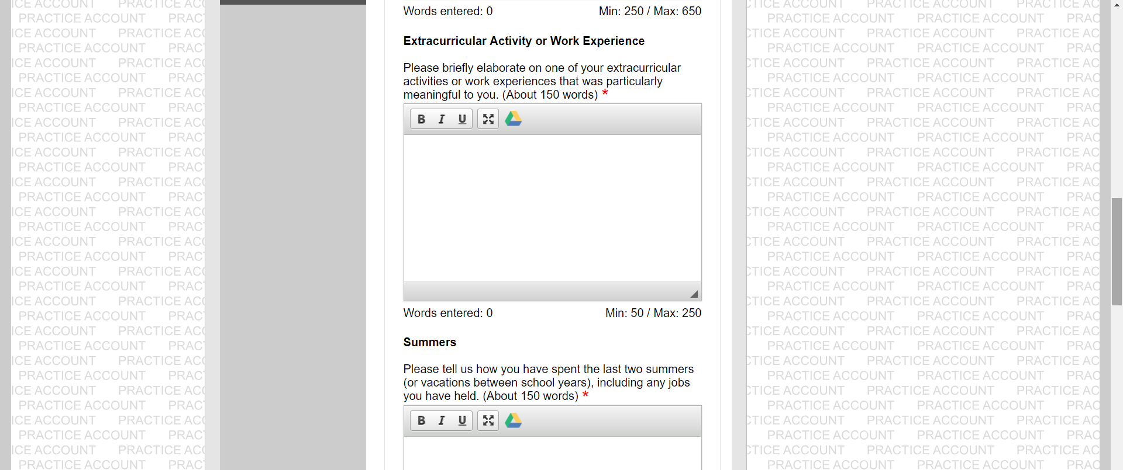

Slide 18
The College Essay: The General Essay
1. Some students have a background, identity, interest, or talent that is so meaningful they believe their application would be incomplete without it. If this sounds like you, then please share your story. 2. The lessons we take from obstacles we encounter can be fundamental to later success. Recount a time when you faced a challenge, setback, or failure. How did it affect you, and what did you learn from the experience? 3. Reflect on a time when you questioned or challenged a belief or idea. What prompted your thinking? What was the outcome?

Slide 19
College Specific Essays…
Imagine you’ve struck a deal with the Dean of Admissions himself, Dean Nondorf. It goes as follows: you’re guaranteed admission to the University of Chicago regardless of any circumstances that arise.
This bond is grounded on the condition that you’ll obtain a blank, 8.5 x 11 piece of paper, and draw, write, sketch, shade, stencil, paint etc., anything and everything you want on it; your only limitations will be the boundaries of both sides on the single page.
Now the catch… your submission, for the rest of your life, will always be the first thing anyone you meet for the first time will see. Whether it’s at a job interview, a blind date, arrival at your first Humanities class, before you even say, “hey,” they’ll already have seen your page, and formulated that first impression.
Show us your page. What’s on it, and why? If your piece is largely or exclusively visual, please make sure to share a creator's accompanying statement of at least 300 words, which we will happily allow to be on its own, separate page.

Slide 20
Lack of centralised systems
USA: Common App, Coalition App, UC App, Direct Apps
Netherlands: Studielink, first or last?
Canada
Others

Slide 21
Entry requirements….

Slide 22
Leiden

Slide 23
McGill

Slide 24
Where in the world?

Slide 25
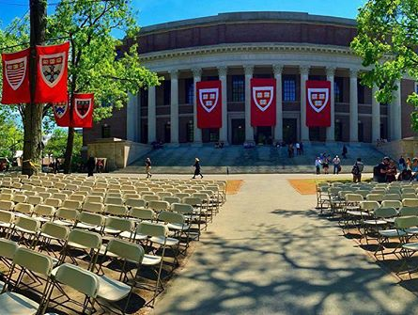
More ‘top’ options

Slide 26
A different concept of teaching and learning

Slide 27
A different curriculum model

Slide 28
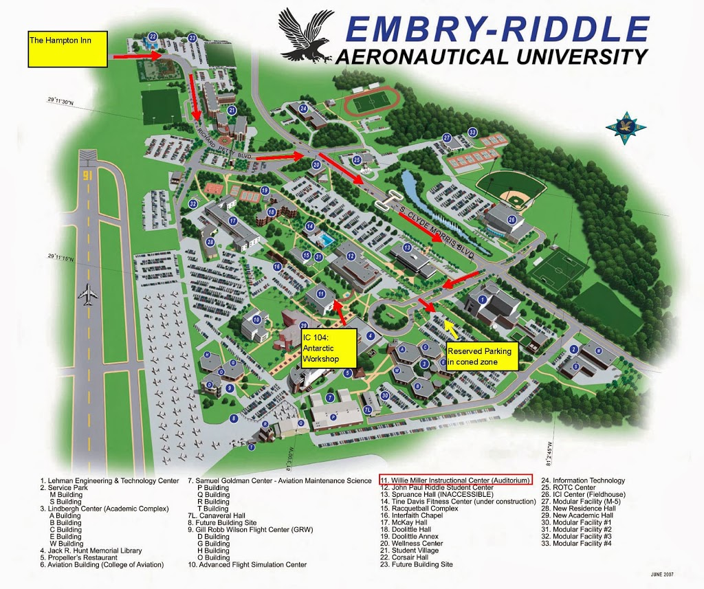
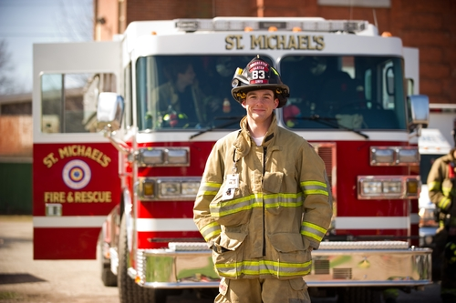
Extra-curriculars and academics:

Slide 29
Great uni,
low entry requirements

Slide 30
Hidden gems

Slide 31
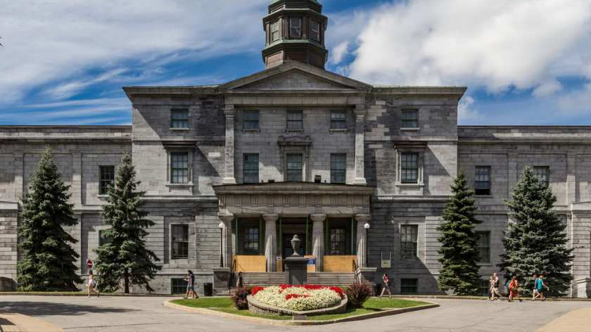
Onward pathways

Slide 32
And I haven’t even discussed
Ireland
Eastern Europe
Africa
Australia & New Zealand
Scandinavia
Hong Kong
Singapore
China
Japan….

Slide 33
Request more information
david@hawkinsglobaleducation.co.uk
07392 846307
www.hawkinsglobaleducation.com

