Slide 1
A lesson in careers guidance
HELOA Conference January 2019
Sarah Frend and Jonathan Hardwick

Slide 2
What and who? 1
Dare to Excel
Excellence through endeavour
Creativity through collaboration
We are ambitious, caring, resilient
Be inspired
Aiming high to achieve excellence for all
Broadening Horizons

Slide 3
What and who? 2
I hate homework
I hate everything about school
The worst part is that my school always give us very HARD exams
My teacher is MEAN. She's rude and sometimes a big bully
It's boring
It's useless
It's a time waster
Whenever I get a bad grade, they call my parents and say that I am doing terrible
My school lunch is disgusting EVERY SINGLE DAY

Slide 4
School experience
The school experience
Notes:
We ask students about their experiences at school and many say that they feel they are on a conveyor belt – focus on examinations and then higher education
Students sometimes to tell peers, school and/or parents that they do not want to go to university/college
Many find it easier to go with the flow
There are alternatives

Slide 7
A good job?
What criteria?
High pay and lots of benefits
Rapid promotion and development
Lots of training
Great colleagues
Innovation and challenge
Diversity – activity, place, people
Good work life balance
Activity – pay and free time

Slide 8
A good job?
High pay
Much free time
Little free time
Low pay
Notes:
List of jobs – individually, in pairs or in small groups, write in where you think the sit on the grid
Are there clusters and reasons for clusters

Slide 9
What’s the difference?
Is there a difference?
Notes:
Ask students’ views

Slide 10
????????????

Slide 12
Effective CEIAG has four essential and interlinked principles
Careers education - a planned programme in the curriculum that gives young people the knowledge and skills for planning and managing their careers
Careers information - including learning options, skills, occupations, labour market information and progression routes to further learning, training and employment
Careers advice and guidance - personalised help from qualified careers advisers to identify goals and plan steps to attain them - these advisers to be appropriately qualified and receive ongoing professional training
Work related learning - experiences within and outside of the curriculum which help students learn about employability skills, careers, enterprise, economic well-being, wealth creation and employment

Slide 13
Why effective CEIAG is important:
Increasing complexity of learning opportunities
Increasing curriculum flexibility
Greater diversity in progression routes into careers
Changing career opportunities, especially the emergence of new career areas

Slide 15
Effective CEIAG benefits the individual
Increased self-awareness and understanding of what influences their decision-making
Increased understanding of opportunities and career options
Less chance of making ill informed decisions
Raised aspirations – higher education and professional careers
Higher attainment

Slide 16
Effective CEIAG benefits schools
Better motivated and more self-aware students
Stronger cross-curricular links
Higher student retention
Greater parental satisfaction
Enhanced reputation

Slide 17
Effective CEIAG benefits universities
Converts interest into applications
Realistic, researched applications
Informed and aware applicants
Motivated, ‘university ready’ students
Happier students
Improved retention
Academic success

Slide 18
Effective CEIAG benefits employers
More chance of recruiting individuals with the right skill set and work ethos
Employees who have an understanding of the employability needs of organizations
Employees that are more interested and ambitious in the sector
Less money spent re-advertising and on retraining staff
Greater employee motivation and productivity

Slide 19
Effective CEIAG benefits society
A workforce with a stronger occupational knowledge and employability skill set
A more skilled, adaptable and flexible workforce which can cope with the challenges and change in an increasingly global labour market
Higher employment, earnings and wealth creation leading to increased economic prosperity
A more fulfilled, happier population

Slide 20
G
A
I
GUIDANCE
Guidance from an IAG specialist providing support through in-depth one-to-one or small group sessions. Guidance is best conducted face-to-face, but can be or by Skype, telephone or email.
ADVICE
Advice can be delivered by a wide range of practitioners including tutors, teachers and mentors through one-to-one sessions, discussion groups, workshops, fairs, parents’ evenings, parent involvement, themed events, formal and informal one-to-one work and presentations by specialist services.
INFORMATION
Impartial, accurate and current information about learning, training or employment, derived from reliable and quality assured organisations, publications and websites.
Careers education

Slide 21
Researching HE options
Many (too many?) sources of information

Slide 22
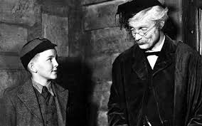
Advice and guidance

Slide 23
How to incorporate advice and guidance into your work

Slide 24
Advice and guidance skills
Explore
Where are you now?
Where do you want to go?
How are you going to get there?
Understand
Action

Slide 25
Advice and guidance skills
Core
Contracting
Active listening
Questioning
Target setting
Specific
Reflecting back
Paraphrasing
Summarising
Being specific
Focusing
Clarifying
Challenging

Slide 26
Active listening
A fundamental skill in guidance which requires concentration & focus
Have an open mind
Use appropriate non verbal language
Allow silences
Resist distractions
Clarify understanding
Summarise
Do not talk too much!

Slide 27
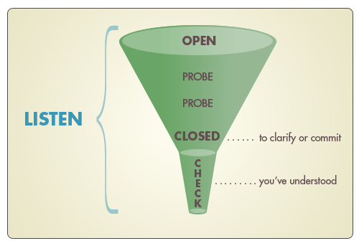
Questioning
Open
Focussing
Clarifying
Hypothetical
Challenging
Reflecting
Summarising

Slide 28
Work in threes – work with people you do not know (well)
Choose a student storey
One be the student
One be the adviser – use key listening & questioning skills
One be the observer – listen & feedback
Choose a second student story - swop roles
Choose a third student story - swap roles

Slide 29
How we support young people, their parents and schools
Career choice, sector choice, employer choice or postgraduate study
Higher education
The Degree Explorer
First job
Alternative pathways
Apprenticeships
School leaver programmes
Employment
Post-school choices
16-18 year olds
Futurewise Curriculum
TARGETcareers website
Helpline
Group work
One to one guidance discussions
Staff, student and parent events
Pre-A level choice
14-16 year olds
Careers with a degree or alternative routes into professional careers
Futurewise Curriculum
TARGETcareers links with employers and universities
Pre-GCSE
13-14 year olds
Raising aspirations
Career Investigator
Futurewise Curriculum

Slide 33
Notes:
https://targetcareers.co.uk/careers-advice/job-market-guide

Slide 35
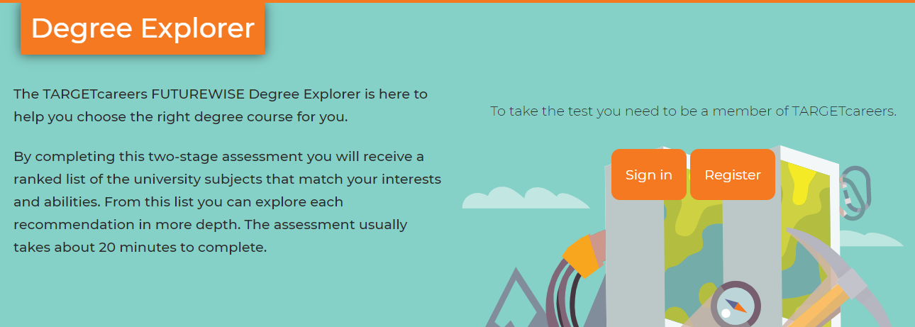
https://targetcareers.co.uk/degree-explorer

Slide 36
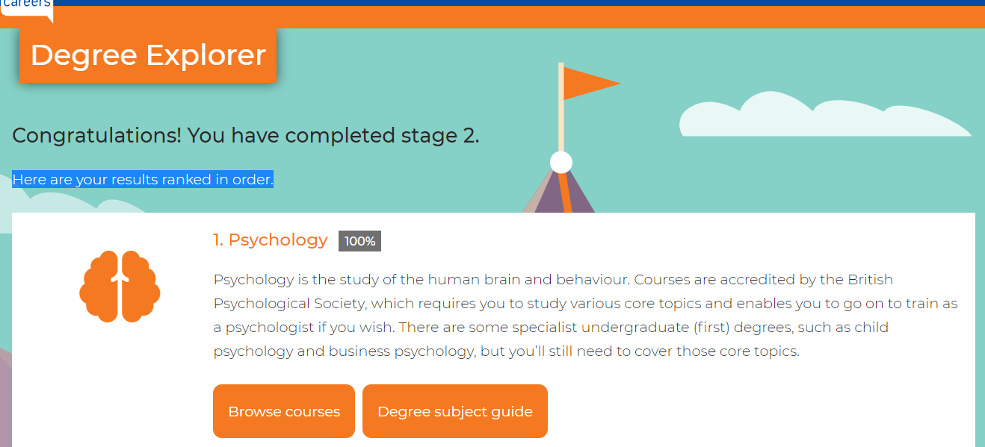

Slide 37
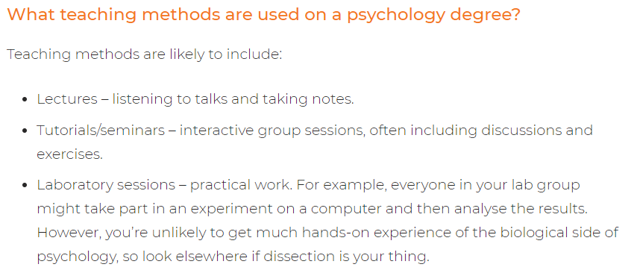
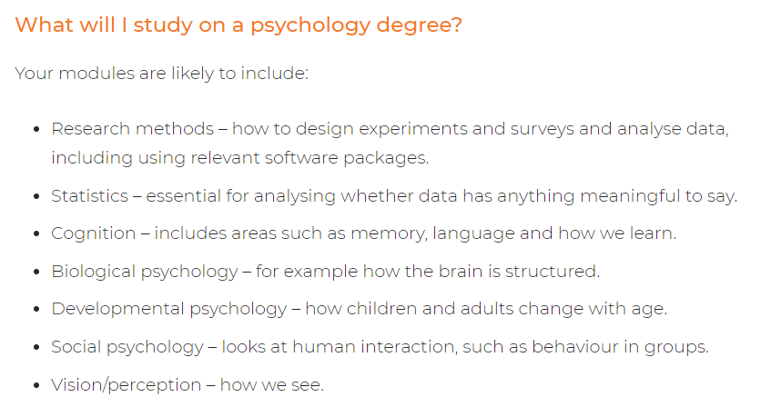

Slide 39
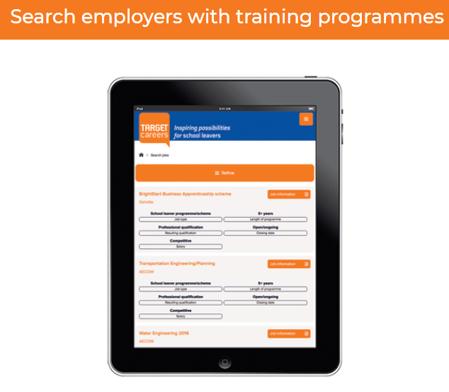

Slide 40
Notes:
https://targetcareers.co.uk/parents-and-teachers

Slide 41
Notes:
https://targetcareers.co.uk/parents-and-teachers

Slide 42
©Inspiring Futures 2019 www.inspiringfutures.org.uk

