Slide 1
_{SFE/HELOA}
_{STUDENT} _{FINANCE}
_{2018/19}
INFORMATION
FOR
STUDENTS
Notes:
The following slides cover the fundamental details of undergraduate student finance for academic year 2018/19, including the
financial support available to students and key messages on applications and repayments:

Slide 2
i
SFE/HELOA PRESENTATION CONTENT
SECTION 1 – INTRODUCTION TO SFE
The following slides cover the fundamental details of undergraduate student finance
for academic year 2018/19:
It is not expected that all slides can/will be delivered but a few are ‘essential’.
There are a range of optional slides covering general eligibility and entitlement for student finance, a breakdown of Maintenance Loan by category if required and added detail on DSA, Dependants Grants and for students studying overseas or on placements etc..
In each section you will see alternative versions of similar slides such as the intro
to SFE, interest and final key messages. These can be used depending on time and personal tastes.

Slide 3
i
SESSION CONTENTS
Introduction to Student Finance England
Section 1 – What support can you get?
Section 2 – How do you get it?
Section 3 – When & how do you repay it?
Section 4 - Managing your money

Slide 4
i
STUDENT FINANCE ENGLAND
AN INTRODUCTION
Student Finance England provide financial support on behalf of the UK government
to students from England entering higher education in the UK:
The two main expenses students have while studying are?
T------ F---?
Tuition Fees
#1
Living Costs
L----- C----?
#2
i
Depending on your circumstances, course and where you study, you may
be able to apply for a range of financial support from SFE

Slide 5
i
STUDENT FINANCE ENGLAND
AN INTRODUCTION
Student Finance England provide financial support on behalf of the UK government
to eligible students from England entering higher education in the UK:
The two main costs you will have while studying are tuition fees and living costs
SFE make finance available to help students with both*
You may be able to get a range of financial help and support, depending on;
Your course and where you live and study
Your household income
Your personal circumstances
i
*Full-time students. Part-time students starting in 2018/19 can also get Tuition Fee Loan, Maintenance Loan and DSA support from SFE

Slide 6
i
STUDENT FINANCE ENGLAND
GENERAL ELIGIBILITY
Students need to meet certain residency criteria in order to be eligible for financial
support from SFE:
Have settled status – Can live in the UK without any Home Office restriction
Be ordinarily resident in England on the first day of the first academic year of
their course
Been living in the UK for the three years immediately prior to this date
Support available to you might vary if you are an EU or international student
or hold a status such as refugee or EEA migrant worker
You can call SFE on 0300 100 0607 if you are unsure
Notes:
Exceptions
If the student, their spouse, civil partner, parent/stepparent are recognised by the Government as a refugee and lived in this country since this status was awarded.
If the student, their spouse, civil partner, parent/stepparent, have been granted Humanitarian Protection to stay in the UK by the Home Office, resulting from a failed asylum application.
If student is the child of a Swiss national or Turkish worker, and been ordinarily resident in the EEA and Switzerland/Turkey for the three year period immediately before the first day of the first academic year of their course
Long Residency Rule
The long residency regulation extends eligibility for student finance out to students who qualify under and can evidence one of the following criteria:
Applicants aged under 18 years of age are required to have lived in the UK for at least 7 years
Applicants aged 18 years and above are required to have either spent at least half their life in the UK or at least 20 years in the UK
This needs to include three years’ lawful ordinary residence before the first day of the first academic year of the course for all such applicants

Slide 7
i
STUDENT FINANCE ENGLAND
ENTITLEMENT AND PREVIOUS STUDY
Generally, a Tuition Fee Loan is available for your first full undergraduate course,
plus one additional year should you need it:
This extra year could be used if you take a qualification like a foundation degree and then want to ‘top-up’ to a full honours or even if you have to re-take a year
You might not get full support if you have to repeat more than one year or have any previous HE study, but personal circumstances can be taken into account
+
=
Extra
Year
4 years support
18/19
19/20
20/21
Example based on standard 3 year F/T Course
Notes:
Full Time Students
If you have previously studied and gained a Equivalent or Lower Qualification (ELQ), you will be unable to get full support, irrespective of whether you received funding from SLC or not. You will not be eligible for Maintenance Loans, Tuition Fee support or Maintenance Grants but will be eligible to receive Grants for Dependants' and DSA support. A few things to remember:-
If you study a higher level qualification, you will be eligible to apply for full funding.
Previous study that did not lead to a qualification will not be counted if entirely self funded at a private institution.*
If you have not received funding from student finance but did get NHS funding (e.g. NHS Bursary), this will be counted when calculating your entitlement.
*Any other previous study will be counted and taken into consideration when calculating any funding for your new course.
If you have not attained a ELQ then you may still be eligible for a non-means tested ML. Please see article 1544.
Part Time Students
Part time students are eligible to receive up to 16 years worth of finance from Student Finance England. Students who previously studied part time and did not receive funding from Student Finance England (self funded) will still have this counted as previous study - providing the previous course was an eligible course.

Slide 8
SECTION 1
WHAT SUPPORT CAN YOU GET?
FEES, LOANS & EXTRA HELP*

Slide 9
TUITION FEE Loan
Extra support
SECTION 3
SECTION TITLE IN HERE
SUBHEADER IN HERE
What support can you get?
Maintenance
Loan

Slide 10
HOW MUCH DO YOU KNOW?
TUITION FEES
Q
What’s the maximum tuition fee universities or colleges can currently charge new students*?
A
£9,250
Q
How much of this would you need to pay up front before going to uni or college*?
A
£0
*Eligible students, living in England and studying at a publicly-funded university or college.

Slide 11
TUITION FEES AND LOANS
AN OVERVIEW
With tuition fees of up to £9,250, how can you afford to go to uni?
Eligible students won’t have to pay any tuition fees up front.
A Tuition Fee Loan is available to cover the fee charged by your university
or college.*
A Tuition Fee Loan doesn’t depend on household income.
SFE pay the Tuition Fee Loan directly to your university or college.
Tuition Fee Loans have to be repaid but only when you’ve finished or left your course and your income is over the repayment threshold.
i
*Up to £9,250 for full-time courses at a publicly-funded uni or college
or up to £6,165 for approved courses at private providers.

Slide 12
Tuition Fee Loan
Extra support
SECTION 3
SECTION TITLE IN HERE
SUBHEADER IN HERE
What support can you get?
MAINTENANCE
Loan

Slide 13
MAINTENANCE LOAN
AN OVERVIEW
A Maintenance Loan is available to help with your living costs while at uni or
college.
All eligible students can get some maintenance support.
The amount you can get depends on where you live and study.
You can also apply for more based on your household income.
The Maintenance Loan is paid directly into your bank account each term.
Maintenance Loans have to be repaid but not until you’ve finished or left your course and your income is over the repayment threshold.
Notes:
The basic rate of Maintenance Loan doesn’t depend on household income but students can apply for more that does.

Slide 14
MAINTENANCE LOAN
MAXIMUM LEVELS FOR 2018/19
£
£7,324
Parental Home Rate:
Live at home while they study
£
£8,700
Elsewhere Rate:
Live and study away from home outside London
£
£11,354
London Rate:
Live and study away from home in London
i
If studying overseas as part of a UK course, Maintenance Loan support is still available, up to £9,963 for 2018/19.
Notes:
Household Income Assessment
The income assessment for full year and final year rates of loans for living costs is calculated as follows:
Parental Home Rate: £1 reduction in loan for every complete £8.10 increase in income above £25,000.
London Rate: £1 reduction in loan for every complete £7.87 increase in income above £25,000.
Elsewhere Rate: £1 reduction in loan for every complete £8.01 increase in income above £25,000.
Overseas Rate: £1 reduction in loan for every complete £7.93 increase in income above £25,000.
The income threshold for the minimum non-income assessed full rate of overseas loan is: £65,816.
The income thresholds for the minimum non-income assessed final year rates of loans are: £56,833 (Home), £67,239 (London), £60,717 (Elsewhere), and £62,533(Overseas).

Slide 15
MAINTENANCE SUPPORT
MAINTENANCE LOAN – MEANS TESTING
New 2018/19 full-time students, not eligible for benefits or aged over 60:
Different amounts are available to students who are eligible for benefits while
they study, aged over 60 or in the final year of their course
Full Year Student | Maximum Loan (100%) | Non-Income Assessed %
Parental Home | £7,324 | £3,224
Elsewhere | £8,700 | £4,054
London | £11,354 | £5,654
Overseas | £9,963 | £4,816

Slide 16
MAINTENANCE SUPPORT
MAINTENANCE LOAN – INDEPENDENT STUDENTS
For the higher rate of Maintenance Loan you will need to give SFE details of your
household income, unless you can be viewed as independent, this can be if you:
Have care of a person under the age of 18
• Are 25 or over on the first day of the academic year
Have supported yourself financially for 3 years before starting in HE
Are permanently estranged from your parents
Are leaving the care of a local authority (see propel.org.uk for more info)
Household income is the income of any parents, stepparent, parent’s partner, wife,
husband, civil partner or guardian you usually live with
Notes:
A student is considered independent if:
They’ve been married or formed a civil partnership before the start of the academic year even if that marriage or civil partnership has ended
• They have no living parents
• They’ve supported themselves for at least three years before the start of their course
They’ve not communicated with their parents for one year before the beginning of the academic year for which they are applying for support, or can demonstrate a permanent estrangement from their parents
Their parents cannot be traced or it is not practical or possible to contact them
Their parents live outside of the EC and an income assessment would put them in jeopardy, or if not reasonably practicable for them to send funds to the UK if a contribution were assessed
• Subject to certain exceptions, they were looked after by a local authority throughout any three month period ending on or after the date on which they turned 16 and before the first day of the first academic year of their course
NNECL - The National Network for the Education of Care Leavers (NNECL) was established in June 2013 by higher education institutions and national
organisations committed to the progression and support of Care Leavers in higher education.
Propel is brought to you by The Who Cares? Trust, a voice for children in care. Everything we do is designed to improve the day-to-day experience of
children and young people in care - and their future lives.

Slide 17
MAINTENANCE SUPPORT
MAINTENANCE LOAN ENTITLEMENT
New 2018/19 full-time students, not eligible for benefits or aged over 60:
You can get an estimate of your student finance entitlement using the calculator
on: www.gov.uk/studentfinance
Household Income | Home | Elsewhere | London
£25,000 & Under | £7,324 | £8,700 | £11,354
£30,000 | £6,707 | £8,076 | £10,719
£40,000 | £5,473 | £6,828 | £9,449
£45,000 | £4,855 | £6,204 | £8,813
£50,000 | £4,238 | £5,579 | £8,178
£60,000 | £3,224 | £4,331 | £6,907
Notes:
Household Income Assessment
The income assessment for full year and final year rates of loans for living costs is calculated as follows:
Parental Home Rate: £1 reduction in loan for every complete £8.10 increase in income above £25,000.
London Rate: £1 reduction in loan for every complete £7.87 increase in income above £25,000.
Elsewhere Rate: £1 reduction in loan for every complete £8.01 increase in income above £25,000.
Overseas Rate: £1 reduction in loan for every complete £7.93 increase in income above £25,000.
The income threshold for the minimum non-income assessed full rate of overseas loan is: £65,816.
The income thresholds for the minimum non-income assessed final year rates of loans are: £56,833 (Home), £67,239 (London), £60,717 (Elsewhere), and £62,533(Overseas).

Slide 18
MAINTENANCE SUPPORT
MAINTENANCE LOAN ENTITLEMENT – AT HOME RATE
New 2018/19 full-time students, not eligible for benefits or aged over 60:
You can get an estimate of your student finance entitlement using the calculator
on: www.gov.uk/studentfinance
Household Income | Total Loan
£25,000 & under | £7,324
£30,000 | £6,707
£35,000 | £6,090
£40,000 | £5,473
£45,000 | £4,855
£50,000 | £4,238
£58,215 & over | £3,224
Notes:
Household Income Assessment
The income assessment for full year and final year rates of loans for living costs is calculated as follows:
Parental Home Rate: £1 reduction in loan for every complete £8.10 increase in income above £25,000.
London Rate: £1 reduction in loan for every complete £7.87 increase in income above £25,000.
Elsewhere Rate: £1 reduction in loan for every complete £8.01 increase in income above £25,000.
Overseas Rate: £1 reduction in loan for every complete £7.93 increase in income above £25,000.
The income threshold for the minimum non-income assessed full rate of overseas loan is: £65,816.
The income thresholds for the minimum non-income assessed final year rates of loans are: £56,833 (Home), £67,239 (London), £60,717 (Elsewhere), and £62,533(Overseas).

Slide 19
MAINTENANCE SUPPORT
MAINTENANCE LOAN ENTITLEMENT – ELSEWHERE RATE
New 2018/19 full-time students, not eligible for benefits or aged over 60:
You can get an estimate of your student finance entitlement using the calculator
on: www.gov.uk/studentfinance
Household Income | Total Loan
£25,000 & under | £8,700
£30,000 | £8,076
£35,000 | £7,452
£40,000 | £6,828
£45,000 | £6,204
£50,000 | £5,579
£62,215 & over | £4,054
Notes:
Household Income Assessment
The income assessment for full year and final year rates of loans for living costs is calculated as follows:
Parental Home Rate: £1 reduction in loan for every complete £8.10 increase in income above £25,000.
London Rate: £1 reduction in loan for every complete £7.87 increase in income above £25,000.
Elsewhere Rate: £1 reduction in loan for every complete £8.01 increase in income above £25,000.
Overseas Rate: £1 reduction in loan for every complete £7.93 increase in income above £25,000.
The income threshold for the minimum non-income assessed full rate of overseas loan is: £65,816.
The income thresholds for the minimum non-income assessed final year rates of loans are: £56,833 (Home), £67,239 (London), £60,717 (Elsewhere), and £62,533(Overseas).

Slide 20
MAINTENANCE SUPPORT
MAINTENANCE LOAN ENTITLEMENT – LONDON RATE
New 2018/19 full-time students, not eligible for benefits or aged over 60:
You can get an estimate of your student finance entitlement using the calculator
on: www.gov.uk/studentfinance
Household Income | Total Loan
£25,000 & under | £11,354
£30,000 | £10,719
£35,000 | £10,084
£40,000 | £9,449
£50,000 | £8,178
£60,000 | £6,907
£69,860 & over | £5,654
Notes:
Household Income Assessment
The income assessment for full year and final year rates of loans for living costs is calculated as follows:
Parental Home Rate: £1 reduction in loan for every complete £8.10 increase in income above £25,000.
London Rate: £1 reduction in loan for every complete £7.87 increase in income above £25,000.
Elsewhere Rate: £1 reduction in loan for every complete £8.01 increase in income above £25,000.
Overseas Rate: £1 reduction in loan for every complete £7.93 increase in income above £25,000.
The income threshold for the minimum non-income assessed full rate of overseas loan is: £65,816.
The income thresholds for the minimum non-income assessed final year rates of loans are: £56,833 (Home), £67,239 (London), £60,717 (Elsewhere), and £62,533(Overseas).

Slide 21
Tuition Fee Loan
EXTRA support
SECTION 3
SECTION TITLE IN HERE
SUBHEADER IN HERE
What support can you get?
Maintenance
Loan

Slide 22
ADDITIONAL SUPPORT
EXTRA SUPPORT
SOURCES OF EXTRA HELP FOR STUDENTS
There may also be extra help available for students who;
Have a disability, long-term health condition, mental-health condition or
specific learning difficulty
Have children or adult dependants
Study overseas as part of their UK based course
For details of all these forms of support see: www.gov.uk/studentfinance
Many universities and colleges also offer students bursaries and scholarships:
These depend on things like your academic results, the course you choose, household income, or even if you are good at sport, art or music etc..
Notes:
Childcare Grant
Helps with childcare costs for dependent children aged under 15 at the beginning of the academic year (or under 17 if they have special educational needs) in registered or approved childcare. For more details on what childcare qualifies, visit www.gov.uk/studentfinance
Depending on their household income, the student can apply for 85% of their actual childcare costs up to £164.70 a week for one child or £282.36 a week for two or more children. They can get this money for term times and holidays. Students won’t qualify for this grant if they, or their husband, wife or partner get the childcare part of the Working Tax Credit or childcare element of Universal Credit from HM Revenue & Customs.
Parents’ Learning Allowance
This allowance can help with course-related costs for students with dependent children.
If they qualify, students can get up to £1,669 a year. The amount they can get depends on their household income; that is the income of the student’s husband, wife or partner (if they have one) and that of any dependants.
In the case of a couple who are both eligible students, they can each get up to £1,669 a year.
Adult Dependants’ Grant
The grant can help if a student has an adult who depends on them financially. This can’t be the student’s grown-up child or other adult who gets student finance.
There are some exceptions to eligible ‘other adult dependants’; students can’t claim for a spouse, civil partner or co-habiting partner who is also a student receiving a statutory award.
The Adult Dependants’ Grant can be up to £2,925 a year. The amount the student can get depends on the income
of their husband, wife or partner (if they have one) and that of any dependants.
Disabled Students’ Allowances (DSAs) help pay for extra costs a student might have as a direct result of their disability, long-term health condition, mental-health condition or specific learning difficulty such as dyslexia or dyspraxia. DSAs are additional support available to students who may otherwise be prevented from attending a higher-education course because of a disability.
Key facts about DSAs:
• Available to undergraduates and postgraduates studying full-time or part-time (their part-time course must be at least 25% intensity of the full-time equivalent course)
• Doesn’t have to be repaid
• Doesn’t depend on household income: the amount students can get relates to their needs up to specified maximum amounts
• Doesn’t affect benefit entitlement. For example, other help students might get, like Disability Living Allowance, won’t be affected by DSAs
• Isn’t affected by a student’s age
• Isn’t affected by previous study
• Is paid directly to the supplier of the service or (in some circumstances) into the student’s bank account
Who can get DSAs?
DSAs are available to those who have:
• a mental-health condition, such as anxiety or depression;
• a specific learning difficulty, such as dyslexia or dyspraxia;
• a developmental disorder, such as autism or ADHD/ADD;
• a progressive medical condition such as Multiple Sclerosis, cancer or HIV;
• a sensory impairment which could affect the ability to see or hear;
• another physical or medical condition; or
• a long-term health condition.
Other conditions not mentioned on this list may be covered by DSAs
The applications for dependants grants and DSA can be triggered through the main student finance application process!!

Slide 23
EXTRA SUPPORT
DISABLED STUDENTS’ ALLOWNACES (DSAs)
Disabled Students’ Allowances provide help towards the additional costs a student
may face due to their disability, long-term health condition, mental-health condition
or specific learning difficulty:
DSAs Support:
Is available in addition to the standard student finance package,
Does not have to be repaid,
Is not affected by household income,
Looks at the specific needs of the individual student
For DSAs applications you will need to provide supporting evidence from a doctor
or other relevant specialist

Slide 24
EXTRA SUPPORT
DISABLED STUDENTS’ ALLOWANCES (DSAs)
Allowance | Part-Time Max Support | Full-Time Max Support | Frequency of Payment
Non-medical personal helper | £16,489 | £21,987 | Annual
Specialist equipment | £5,529 | £5,529 | Duration of Course
Other disability-related expenditure | £1,385 | £1,847 | Annual
Disability related travel | No Limit – Reasonable spending can be claimed
i
For full-time and part-time postgraduate students, there is a single DSA
allowance of up to £10,993 per academic year
Notes:
The equipment allowance is for the duration of the course. The other two allowances are annual amounts.
The maximum DSAs for part-time students. The specialist equipment allowance is for the duration of the course and is not pro-rated. The remaining allowances are allowances per academic year and are pro-rated according to the intensity of study.
The maximum grant for disabled postgraduate students in 2018/19 is £10,993 per academic year.

Slide 25
EXTRA SUPPORT
DEPENDANTS’ GRANTS
A range of grants are available to students with children or adult dependants:
Childcare Grant:
Support available is based on 85% of actual approved childcare costs of up to
£164.70 per week for one child, and £282.36 per week for two or more children
Parents’ Learning Allowance:
Up to £1,669 to help with course-related costs for students with dependent children
Adult Dependants’ Grant:
Maximum grant of £2,925 for students with a partner or other adult who’s financially
dependent on them, where the adult’s net income is not more than £3,796 p.a.
For Dependants’ Grant applications SFE will need details of things like household
income, your childcare provider and the costs/estimated costs of these
Notes:
Childcare Grant
Students can apply for a Childcare Grant if they’re a full-time undergraduate student and at the beginning of the academic year they:
• have at least one dependent child who is under 15 and in registered or approved childcare; or
• have at least one dependent child who is under 17, is registered as having special educational needs and is in registered or approved childcare.
Students may also be able to get a Childcare Grant if they:
• normally live in England and are studying abroad as part of your UK course; and
• can use childcare provided under a Ministry of Defence accreditation scheme while you’re abroad.
If the student or their husband, wife or partner gets the childcare part of Working Tax Credit, they won’t be able to get a Childcare Grant as well. But can choose to get Childcare Grant instead of the childcare part of Working Tax Credit.
Types of childcare that qualify
Students can only apply for the Childcare Grant if their childcare provider is registered or approved by Ofsted or the Commission for Social Care Inspection.
Students won’t be able to get the Childcare Grant if the childcare provider they use is:
• their partner;
• a relative of their child and providing care in their child’s home;
• a relative of their child and is:
- approved under the Approval of Child Care Providers Scheme in Wales, or the Approval of Home Child Care Providers Scheme in Northern Ireland;
- providing care away from your child’s home; and
- only caring for children he or she is related to.
A relative of the child means a parent, grandparent, aunt, uncle, brother, sister, related by blood or marriage, or a person with a strong relationship to the child (for example, someone acting as a parent to their partner’s children
At the end of each term, SFE ask students to fill in a Childcare Costs Confirmation Form (CCG2). This will help us make sure they have been paid the correct amount of Childcare Grant.
HM Revenue & Customs won’t count any Childcare Grant or Parents’ Learning Allowance students get when working out their entitlement to tax credits and other state benefits, but they will take any Adults Dependants’ Grant into account.
The amount of childcare grant payable in 2018/19 will be based on 85% of actual childcare costs, subject to a maximum grant of £164.70 per week for one child only or £282.36 per week for two or more children.
Where a childcare provider has not been identified, the amount of childcare grant payable in 2017/18 will be based on 85% of actual childcare costs, subject to a maximum grant of £127.33 per week. This lower rate payment will be made until details of the childcare provider have been submitted but subject to a maximum of one academic quarter (usually a term)
GRANT IN RESPECT OF AN ADULT DEPENDANT.
Where applicable, the maximum grant in 2018/19 in respect of one dependant of the student who is either the student’s partner or an adult dependant will be £2,925.
“Partner” is currently defined in the Student Support Regulations. A student’s spouse or civil partner would fall within the definition. In certain cases, a person living with the student as if he were the student’s spouse or civil partner will also be covered.
Where the student does not have a partner within the meaning of the Regulations, a student may be eligible for this grant in respect of one adult dependant whose net income does not exceed £3,796.

Slide 26
ADDITIONAL SUPPORT
EXTRA SUPPORT
STUDYING OVESEAS
Support for SFE students who study overseas as part of their UK based course:
You may get a means tested grant to cover some of your travel expenses (over
£303) if you normally live in England and:
You’re studying abroad as part of your course, or on an Erasmus study or Erasmus work placement
You’re a nursing*, midwifery*, AHP*, medical or dental student studying abroad
or attending a clinical placement in the UK (*NHSBSA support)
Erasmus+ provides HE students the opportunity to study in Europe
Erasmus+ grants are provided by the European Commission and contribute towards the extra costs you may encounter from studying abroad
Notes:
Study Abroad Info
Eligible students studying on a course at a UK university or college, who study outside the UK as part of their course, can apply for full student finance.
In addition, there are some special provisions for them if they’re studying for at least the majority of a term abroad.
If a student is studying abroad for the majority of a term they could get:
• the study abroad rate of Maintenance Loan
• a Travel Grant
Students who are abroad at the start of an academic year won’t have their support delayed by not enrolling at their UK university or college. Students studying in China, Japan or Russia as part of their UK course for the whole of the academic year, are able to get their loan payments in a single instalment.
The Travel Grant covers the cost of all necessary qualifying travel, less a disregard of £303. The student must fund the first £303 of their travel themselves. The grant also covers other incidental costs such as visas, vaccinations and medical insurance.
Acceptable claims may include the following:
For a full year placement up to 3 return journeys between the United Kingdom and an overseas institution. Providing attendance overseas is for at least half of each academic term. The class and method of travel should be deemed reasonable (ie no business class flights)
Any necessary daily travel costs while abroad for the for the purposes of attending the institution
Travel costs for the dependent children of a single student, where the students has to take children abroad with them
Childcare abroad: Will only be paid if the childcare provider is approved by the Ministry of Defence’s accreditation scheme
Travel costs associated with clinical training, where student is required to attend a hospital or other premises outside of their institution in the United Kingdom
Mileage claims
The cost of medical insurance purchased for the purpose of studying abroad (we would pay for full medical or health insurance provided by the host University as this can be a condition of acceptance for the student to attend)
40% of the cost of travel insurance premium, this must include medical coverage (we would pay this as the cost of medical cover), however we would not pay this in addition to mandatory medical insurance provided by the overseas University
The cost of visas and medical tests where these are a mandatory condition of entry to the host country
The cost of any vaccinations required
Under the Erasmus+ scheme – part of the European Union’s Lifelong Learning Programme – students can study for part of their degree in one of 32 countries across Europe.
UK Erasmus+ students normally get an Erasmus+ grant, provided by the European Commission which contributes towards the extra costs in addition to the standard grants. Students should not depend on this to cover all their living costs when budgeting.
Erasmus+ and overseas study fees The tuition fee rates for studying overseas, on placement or on Erasmus+ can be complex. The following tuition fee rates are based on the student:
• studying at a publicly-funded university in England or Wales;
• having started their course on or after 1 September 2012; and
• applying through Student Finance England
Maximum tuition fee charged
Maximum Tuition Fee Loan available On ERASMUS+ and:
• studying abroad*
• on a work placement abroad = £1,385
On a placement year of a sandwich course* £1,850
*with less than 10 weeks at the student’s English or Welsh university
The student should speak to their university or college about the tuition fees charged if they’re unsure or if their course:
• is at a university or college in Scotland or Northern Ireland; or
• started before 1 September 2012
For more information students can contact the Erasmus+ coordinator at their university or college or visit https://www.erasmusplus.org.uk/study-abroad
If the student studies a complete degree at a university outside the UK they won’t be able to get any support from Student Finance England. Funding arrangements for studying a complete degree abroad will be different depending on which country the student is planning to go to.

Slide 27
ADDITIONAL SUPPORT
EXTRA SUPPORT
PLACEMENT AND SANDWICH YEARS
What happens to Tuition Fee and Maintenance Loans if you take a placement or
sandwich year as part of your course?
The tuition fee you are charged and Tuition Fee Loan you can get will change:
Studying abroad on a work placement abroad or on Erasmus+, Max of £1,385
On a placement year of a sandwich course, Max of £1,850
If you are on a full year study placement overseas you can apply for the overseas
rate of Maintenance Loan (up to £9,963)
Your Maintenance Loan will depend on things like if the placement is paid or unpaid,
the number of weeks spent at uni or if it is an Erasmus+ work placement
Notes:
Students studying on a work placement as part of their course can get financial help, whether they’re studying in the UK or abroad.
Students on a full year work placement in the UK It’s essential for the student to fill in their application with full details of their work placement and to highlight the type of placement they will be completing in order to be assessed correctly. To be able to get full support the work placement must be defined as:
• unpaid service in a hospital or in a public health service laboratory or with a clinical commissioning group in the UK;
• unpaid service with a local authority in the UK in work that relates to the care of children and young persons, health or welfare, or with a voluntary organisation providing facilities or carrying out similar activity in the UK;
• unpaid service with a local authority in work that relates to public health functions in the UK;
• unpaid service in the prison or probation and aftercare service in the UK;
• unpaid research in a UK institution or, in the case of a student attending an overseas institution, as a part of their UK course;
• unpaid service with a Special Health Authority, the NHS Commissioning Board, the National Institute for Care and Excellence, the Health and Social Care Information Centre, a Local Health Board; a Health Board or a Special Health Board in Scotland, or a Health and Social Services Board in Northern Ireland; or • unpaid service in the UK Parliament.
Maintenance Loan rates for students on an unpaid placement in the UK as specified above These students can apply for either:
• a non-means tested Maintenance Loan; or
• the full Maintenance Loan, if they apply for finance which includes their household income, students who are on a paid work placement will get reduced funding.
Tuition Fee Loan Students at university or college in England or Wales on any type of work placement can apply for a reduced Tuition Fee Loan of £1,850.
This will be paid directly to the student’s university or college. Students studying on a full year work placement abroad Funding for students taking a work placement abroad will be assessed depending on their circumstances.
It’s important that students find out if their placement is part of the Erasmus+ work programme before applying. They should talk to advisors at their university or college to find out more.
Maintenance Loan for students on an Erasmus+ work placement abroad Students can apply for either:
• a non-income assessed Maintenance Loan; or
• the full Maintenance Loan, if they apply for finance which includes their household income.
Part-year placement If a student is at their university or college for 10 weeks or more, they’ll usually be entitled to full-time support. If a student is at their university or college for less than 10 weeks, they’ll usually be charged lower/half fees and receive a reduced rate Maintenance Loan.

Slide 28
ADDITIONAL SUPPORT
EXTRA SUPPORT
PART-TIME HE AND POSTGRADUATE STUDY
What support could you get if you chose to study a part-time undergraduate or
move on to take a postgraduate Master’s course?
Eligible part-time undergraduate students may be able to get:
Tuition Fee Loan of up to £6,935 a year, based on course intensity
Maintenance Loan, based on a proportion of full-time Maintenance Loan, taking account of course intensity and household income
Disabled Students’ Allowances (DSAs) if you have a disability, long-term health condition, mental-health condition or specific learning difficulty
Eligible English domiciled and EU postgraduate students may be able to get:
A contribution Postgraduate Loan (PGL) for taught and research Master’s; or
A Postgraduate Doctoral Loan (PGDL) for doctoral programmes of 3-8 years
Disabled Students’ Allowances (DSAs)
Notes:
For new and continuing Part-Time students who started their course on or after 1 August 2018.
• You won’t have to pay any tuition fees up front and will be eligible to apply for a Tuition Fee Loan of up to £6,935.
If you’re studying at a private university or college you can apply for a Tuition Fee Loan of up to £4,625.
• The Tuition Fee Loan isn’t based on household income and there’s no upper age limit for applying.
• The amount of Tuition Fee Loan you can get depends on the fees charged by your university or college.
You can also get student finance to help towards your living costs while you’re at university or college. It can help pay for things such as rent, food, books, travel and other costs. If you're studying on a distance learning course you won't be eligible unless you have a disability.
• To qualify you must be studying at least 25% of the equivalent full-time course for each year of study, taking no longer than four times the time it would take to complete the course if studied full-time (up to a maximum of 16 years).
• You can apply up to nine months after the start of the academic year.
• You’ll be due to start repaying your loan the April four years after the start of the first academic year of your course, or the April after you leave your course - whichever comes first.
However, you’ll only start making repayments if your income is over £25,000 a year.
• If you have a disability, long-term health condition, mental-health condition or a specific learning difficulty such as dyslexia or dyspraxia, you can get extra help called Disabled Students’ Allowances (DSAs). These don’t have to be paid back.
Can I get a Postgraduate Loan? To get a Postgraduate Loan:
• you have to be studying a taught or research Master’s course,
• you can be studying at a university or college or by distance learning,
• you have to be under 60 at the start of the first academic year of your course, and
• you must normally live in England.
If you’re studying full time your course can last for one or two years. If you’re studying part time you can study for two years (for the equivalent one year full-time course) or up to four years (for the equivalent two year fulltime course).
If you’re an EU national, but don’t normally live in England you may be able to get a Postgraduate Loan for a Master’s course in England.
What can I get?
You can apply for a loan of up to £10,609 as a contribution towards your course and living costs.
The loan will be paid into your bank account in three instalments during the academic year.
If you have a disability, including a mental-health condition or specific learning difficulty, such as dyslexia or dyspraxia, you might be able to get Disabled Students’ Allowances. These don’t have to be paid back.

Slide 29
SECTION 1
STUDENT FINANCE 2018/19
NHS STUDENT FUNDING REFORM

Slide 30
NHS STUDENT FUNDING REFORM
POLICY CHANGE OVERVIEW
From 1 August 2017, new undergraduate nursing, midwifery and allied health students studying in England no longer receive NHS grants and bursaries:
Instead, they have access to the same student finance system as other undergraduate students
This means that undergraduate Nursing, Midwifery and AHP students are funded in exactly the same way as students on other eligible HE courses
Students studying nursing, midwifery and AHP subjects as a second degree in England are also eligible to apply for the full package of SFE support
Additional support from the NHS BSA is available to students if they incur extra costs on placements, have child dependants, or encounter financial hardship:
www.nhsbsa.nhs.uk/learning-support-fund
Notes:
Courses affected are: Chiropody, Dietetics and Nutrition, Midwifery, Nursing, Occupational Therapy, Operating Department Practice (Diploma and Degree), Orthoptics, Physiotherapy, Podiatry, Prosthetics and Orthotics, Radiography, Radiotherapy, Speech and Language Therapy; and from 2018/19: Dental Hygiene & Dental Therapy (apart from DH & DT courses at 5 institutions which are still bursary funded in 2018/19)

Slide 31
SECTION 2
HOW DO YOU GET IT?
APPLICATIONS & INFORMATION

Slide 32
You APPLY online
You get PAID!
How do you get your student finance?
We ASSESS your
application

Slide 33
HOW MUCH DO YOU KNOW?
STUDENT FINANCE APPLICATIONS
Q
What is the easiest way to apply for your student finance?
a) Call SFE and ask for an application form to be sent to you
b) Online @ www.gov.uk/studentfinance
c) Apply? I just thought the money would appear when I need it!
a) After you have started your course
b) When you have a confirmed offer from a university or college
c) As soon as possible
A
b) Online @ www.gov.uk/studentfinance
Q
When should you apply for your student finance?
A
c) As soon as possible

Slide 34
STUDENT FINANCE APPLICATIONS
KEY MESSAGE – APPLY EARLY
Each year thousands of students apply late for their finance and have no
way to pay for their course or accommodation, some even have to drop out
...don’t let that be you!
Apply online at gov.uk/studentfinance*
Apply early to make sure your student finance is ready for the start
of your course.
You don’t need a confirmed place at university or college to apply.
Apply with your preferred choice, you can change details later if required.
i
*The application window is usually open from Jan-May.
Notes:
For launch and deadline dates bookmark www.thestudentroom.co.uk/studentfinance

Slide 35
STUDENT FINANCE APPLICATIONS
KEY MESSAGE – APPLY EARLY
Feb
12
The 2018/19 application cycle for full-time SFE students
opened on February 12th
May
25
The 2018/19 ‘deadline’ for new full-time applications is May 25th and June 22nd for returning full-time students
i
Continuing/returning students should wait to be contacted by SFE
before re-applying and where possible apps will be auto rolled over

Slide 36
STUDENT FINANCE APPLICATIONS
KEY MESSAGE – GET IT RIGHT FIRST TIME
Tips to ensure SFE can process your application as quickly as possible include;
Make a note of your student finance account log-in details and keep them safe
Make sure any evidence and information needed to support your application is
supplied ‘right first time’
Required evidence can include, Passport details, birth certificate, bank account info and National Insurance Number
SFE will need details of your parents/sponsors income if you want to apply for
the higher rate of Maintenance Loan, which they also provide through Gov.uk
Notes:
The easiest way for a student to prove their identity is to give us their valid UK passport number online, when they apply. We can then check and confirm their identity without them having to actually send us their passport. If a student doesn’t have a valid UK passport they’ll need to send us their original *birth or *adoption certificate, along with a Birth/Adoption Certificate Declaration Form.
This is available from www.gov.uk
If the student is a non-UK passport holder, they’ll need to send us their *valid non-UK passport and any original *supporting letters from the UK Border Agency explaining the student’s residency status. *These must be original documents, not photocopies. We’ll return them once we’ve confirmed their identity and checked they’re eligible.

Slide 37
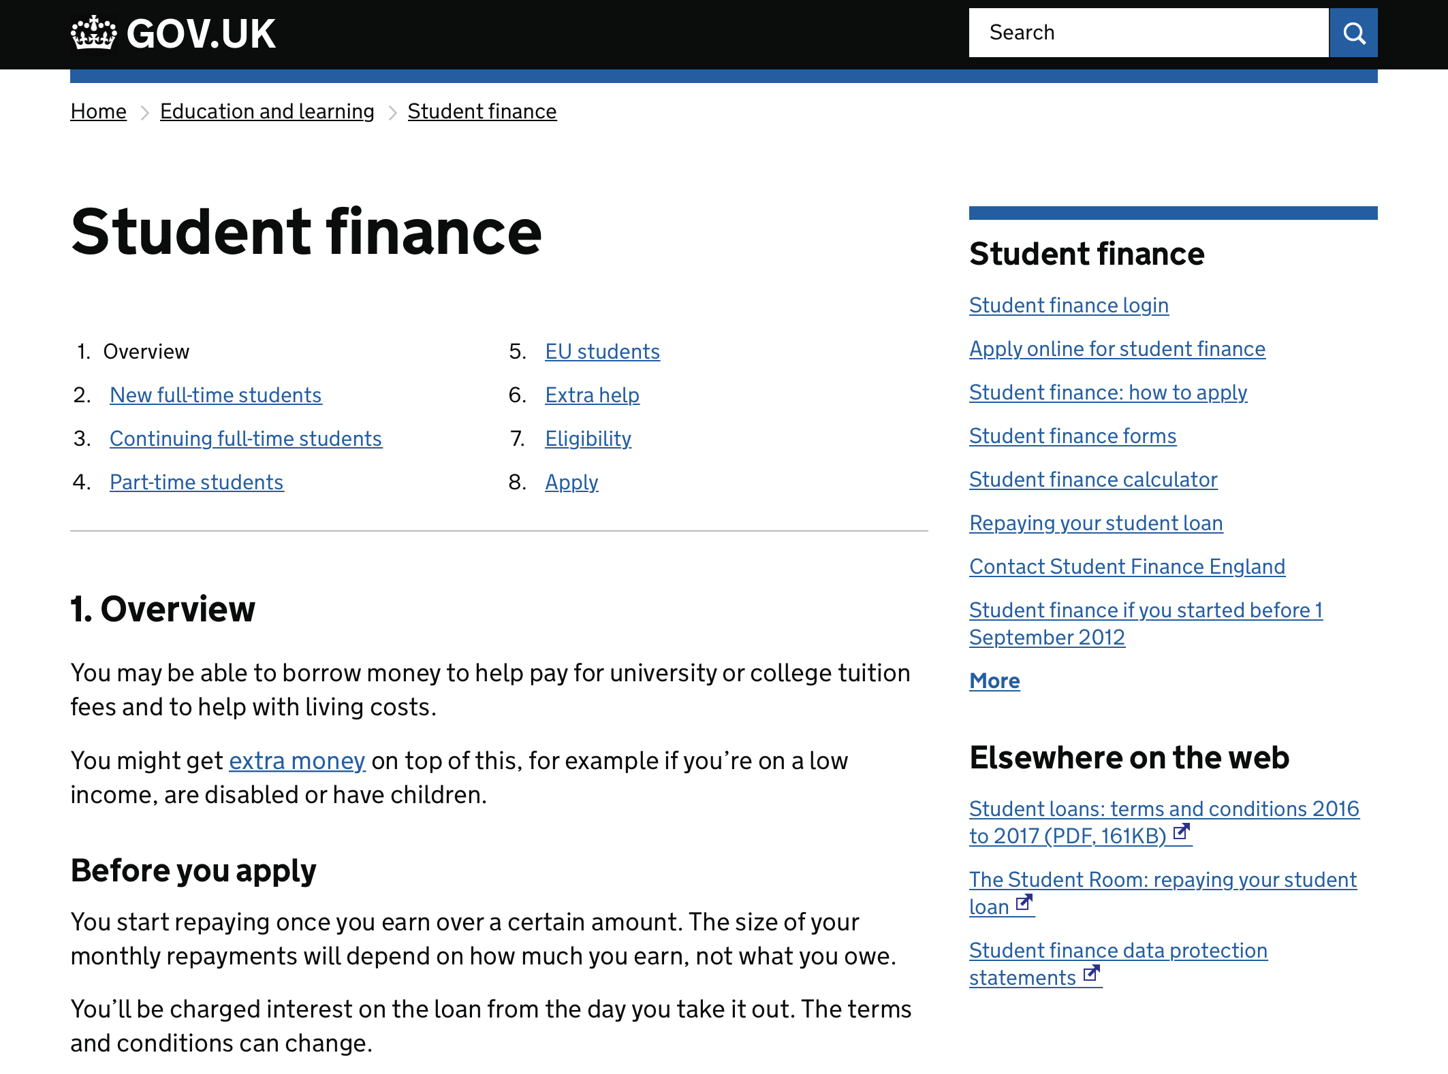
GOV.UK
FOR MORE INFORMATION AND TO APPLY
www.gov.uk/studentfinance
Notes:
Click image to link to page!

Slide 38
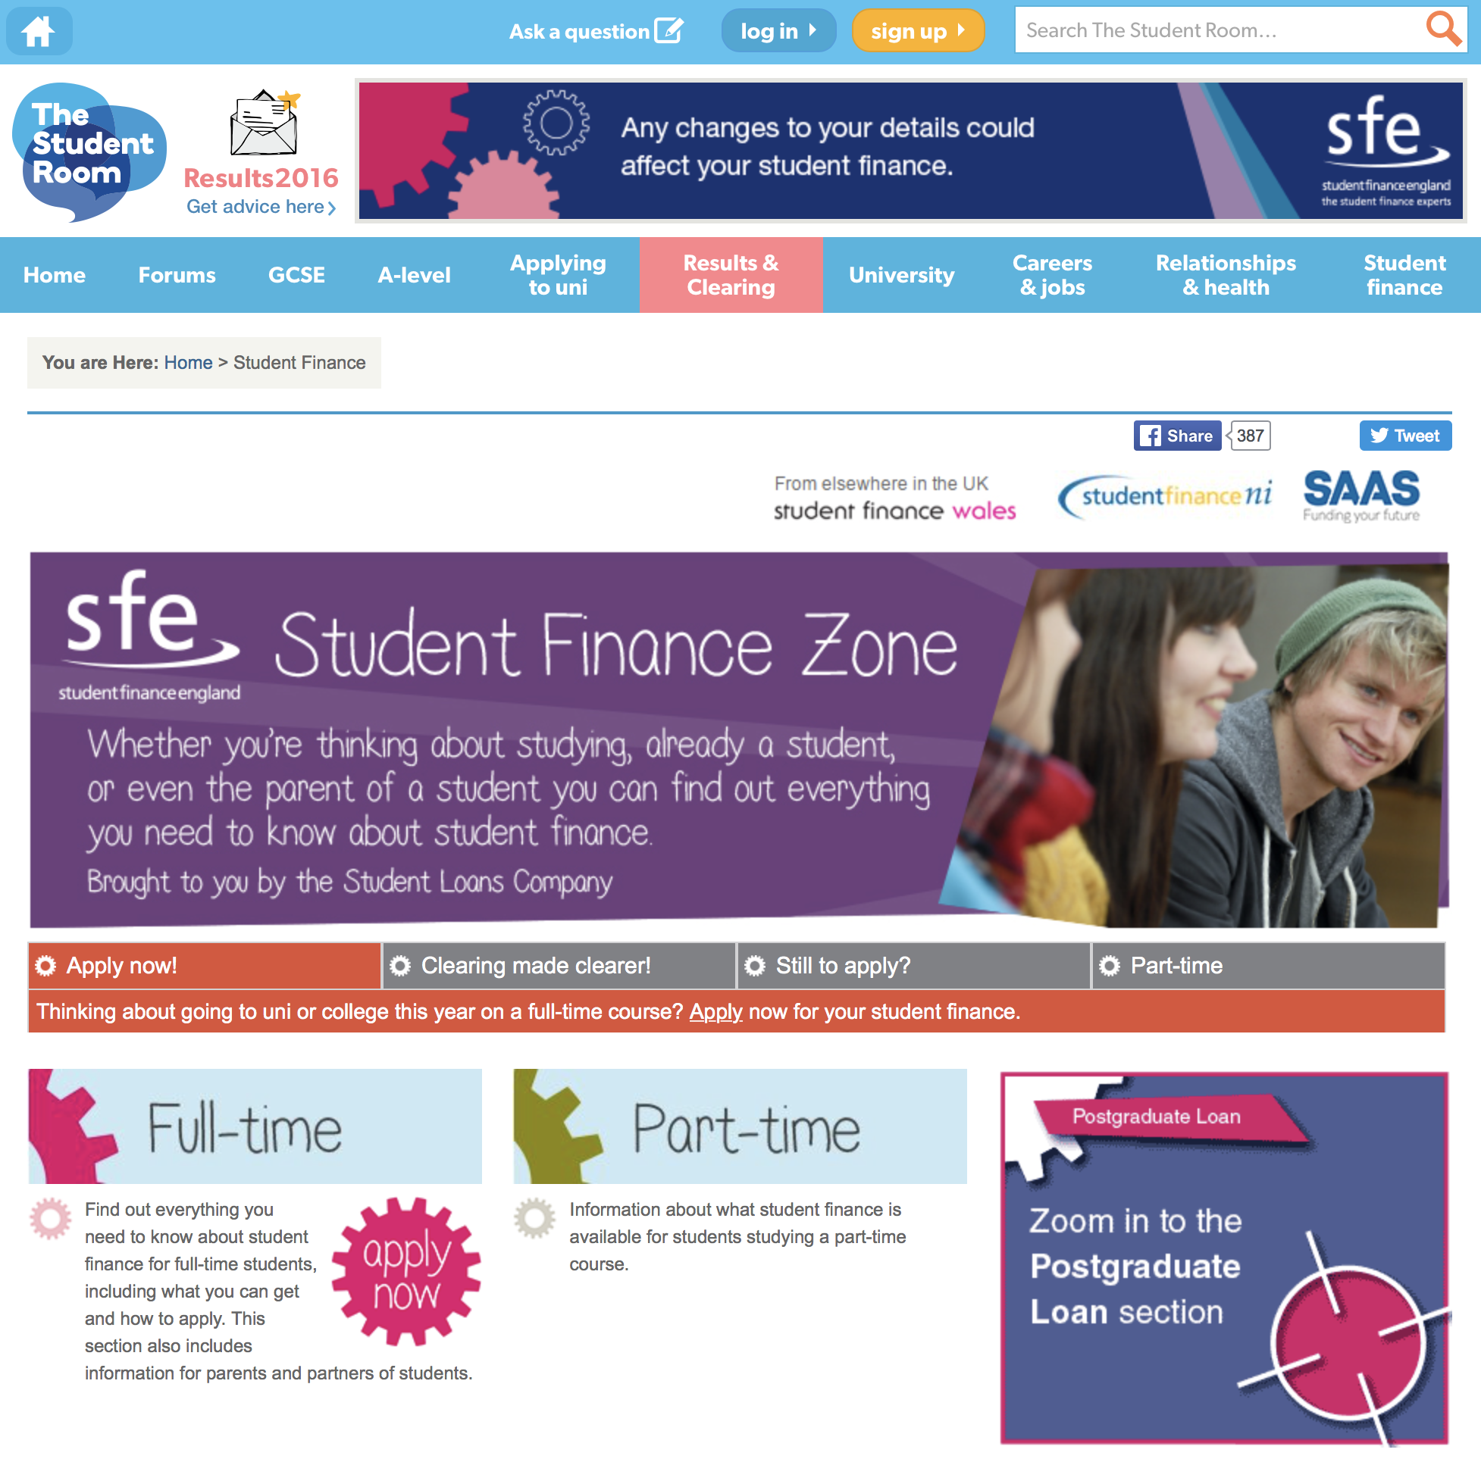
SFE ONLINE
FOR MORE INFORMATION AND RESOURCES
Notes:
Click image to link to page!

Slide 39
SUPPORTING AN APPLICATION
HOUSEHOLD INCOME
If you’re supporting an application for student finance that depends on
household income, SFE will need details of your taxable income and National
Insurance number.
If you’re the parent of a student and live with your partner, they’ll also have to
give us details of their taxable income and National Insurance number.
Taxable earned income includes*:
wages, salaries, tips, and other taxable employee pay
long-term disability benefits received prior to minimum retirement age
net earnings from self-employment
Taxable unearned income includes*:
interest from savings (only the annual summary is required)
benefits and pensions
rent from property or a room
i
*More details/information can be found at
www.gov.uk/income-tax
Notes:
This slide gives information for parents and partners of students who are supporting an application for student finance. You can skip this slide if you’re not presenting to parents/partners.

Slide 40
SECTION 3
HOW DO YOU REPAY?
STUDENT LOAN REPAYMENTS

Slide 41
The FACTS
The INTEREST
SECTION 3
SECTION TITLE IN HERE
SUBHEADER IN HERE
How do
you repay
a student
loan?
The FIGURES

Slide 42
HOW MUCH DO YOU KNOW?
STUDENT LOAN REPAYMENTS
Q
What will your student loan repayments be based on?
a) Your future income
b) How much you have borrowed
c) Neither, you just pay a fixed amount regardless
a) £21,000 a year
b) £25,000 a year
c) Doesn’t matter, repayments will be taken whatever you earn
A
a) Your future income
Q
How much do you need to earn before you start to repay?
A
b) £25,000 a year
Notes:
The repayment threshold is currently £21,000 a year. This is expected to changed to £25,000 a year from 6 April 2018. This change to the repayment threshold in April needs Parliamentary approval.

Slide 43
STUDENT LOAN REPAYMENTS
AN OVERVIEW
You won’t make repayments until your income is over the threshold of £25,000 a year, before tax.
Full-time students will be due to start repaying in the April after graduating/leaving your course.
You’ll repay 9% of your income over £25,000 and if you’re employed your employer will make deductions from your pay through the HMRC tax system.
If your income falls to £25,000 or below your repayments will stop.
You must tell the Student Loans Company if your circumstances change, e.g. if you are travelling or moving overseas you need to complete their Overseas Income Assessment Form, as this may affect your repayments.
i
Any outstanding loan balance will be cancelled 30 years after entering repayment.
Notes:
The current UK earnings threshold is:
£404 a week
£1,750 a month
£21,000 a year
This is expected to change to:
£480 a week
£2,083 a month
£25,000 a year
Students who live or work overseas after they’ve finished their course still need to repay their loans. They’ll get information about this towards the end of their course. For more information, visit www.slc.co.uk/repayment

Slide 44
STUDENT LOAN REPAYMENTS
THE FIGURES (BASED ON REPAYMENT THRESHOLD OF £25,000 A YEAR
Income each year before tax | 9% will be deducted from | Monthly repayment (Approx)
£25,000 | £0 | £0
£27,000 | £2,000 | £15
£29,500 | £4,500 | £33
£31,000 | £6,000 | £45
£33,000 | £8,000 | £60
Income
£28,000
£3,000
9% Deducted from?
£22
Monthly
repayment?
i
Interest is applied to your loan at a maximum rate of RPI +3%
More info can be found on www.slc.co.uk/repayment
Notes:
Link to page is Live!
From example: a basic way of working out the monthly repayment would be:
28,000 – 25,000 = 3,000
3,000 divided by 12 = £250 multiply that by 0.09 giving a monthly payment of £22.
You’re charged interest from the day your first payment is made to you or your uni or college until your loan is repaid in full or cancelled. The interest rate is based on the UK Retail Price Index (RPI) and will vary depending on your circumstances. For more information go to www.slc.co.uk/repayment
The Retail Price Index (RPI) is a measure of UK inflation. It measures changes to the cost of living in the UK.
The interest rate is updated once a year in September, using the rate of RPI from March.
While studying until entering repayment = RPI +3%
On entering repayment interest is linked to earnings on a sliding scale up to a maximum of RPI + 3%

Slide 45
STUDENT LOAN REPAYMENTS
THE INTEREST – FULL-TIME
Interest levels will depend on a students income and circumstances:
£
During study until
entering repayment
%
Interest Rate:
Retail Price Index +3%
Interest rate is:
Set at RPI Only
£
%
Income:
Under £25,000
Interest Rate:
RPI Only
£
%
Income:
£25,000 to £45,000
Interest Rate:
RPI + up to 3%
£
%
Income:
Over £45,000
Interest Rate:
RPI +3%
i
The interest rate is updated once a year using the RPI figure from March (currently 3.1%) which is carried forward and applied in September
Notes:
The interest rate is updated once a year in September, using the rate of RPI from March. RPI as of March 2017 was 3.1% so new students (Sept 17) are being charged 6.1% for academic year 2017/18.
Part Time RPI
While studying on a course until whichever comes first of: The April after graduating or leaving a course; or
The April after the fourth anniversary of the start of a course - RPI + 3%
From the April after you have graduated or left a course, or after the fourth anniversary of the start of a course, but before April 2016 – RPI

Slide 46
STUDENT LOAN REPAYMENTS
THE INTEREST & CHANGES OF CIRCUMSTANCES
Interest on a student loan will start being added as soon as the first payments are
made and the rate applied will vary:
While in study until entering repayment, interest will be applied at RPI +3%
RPI is Retail Prices Index and the rate used for student loan interest is set once
a year using the RPI figure from March which is then applied in September
When you enter repayment, interest rates will be linked to what you earn, from
RPI only if earning under £25,000 to RPI +3% if earning over £45,000 a year
See www.studentloanrepayment.co.uk for more information
Notes:
The interest rate is updated once a year in September, using the rate of RPI from March. RPI as of March 2017 was 3.1% so new students (Sept 17) are being charged 6.1% for academic year 2017/18.
Full-time student interest
While studying until entering repayment = RPI +3%
On entering repayment interest is linked to earnings
Under £25,000 = RPI Only
£25,000 to £45,000 = RPI + up to 3%
Over £45,000 = RPI + 3%
Part-time RPI
While studying on a course until whichever comes first of:
the April after graduating or leaving a course; or
The April after the fourth anniversary of the start of a course - RPI + 3%
From the April after graduating or leaving a course, or after the fourth anniversary of the start of a course - RPI

Slide 47
SECTION 4
MANAGING YOUR MONEY
MAKE SURE YOU’RE READY FOR HIGHER EDUCATION

Slide 48
Consider the COSTS
Remember KEY POINTS
SECTION 3
SECTION TITLE IN HERE
SUBHEADER IN HERE
Make sure
you’re ready
for HE
Plan a BUDGET

Slide 49
MANAGING YOUR MONEY
CONSIDER THE COSTS
It’s important to think about the costs you are likely to face while at uni
and how to manage your money.
Remember, you’ll get a Maintenance Loan payment each term and
you’ll need to pay for things such as...
books and other study/course materials
accommodation, phone bill, food and drink
sports, leisure and social activities
i
There will also be costs you may not have thought of yet, such as insurance or a TV Licence...so think about planning a budget!

Slide 50
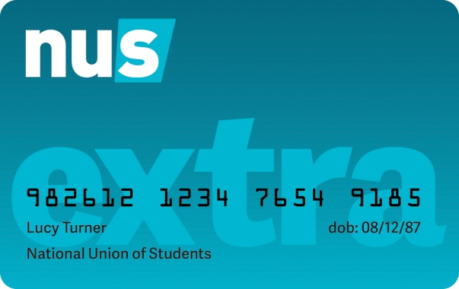
MONEY MANAGEMENT
HOW MUCH?
?
New
£52.24
Q
How much does this textbook cost?
Used
£14.98
(Amazon)
?
?
1 Year
£12
Q
How much is an NUS Extra card?
?
3 Year
£32
Notes:
An NUS Extra card gives students access to hundreds of exclusive discounts both in stores and online covering areas such as fashion, travel, food, drink, leisure and entertainment! www.nus.org.uk/en/nus-extra

Slide 51
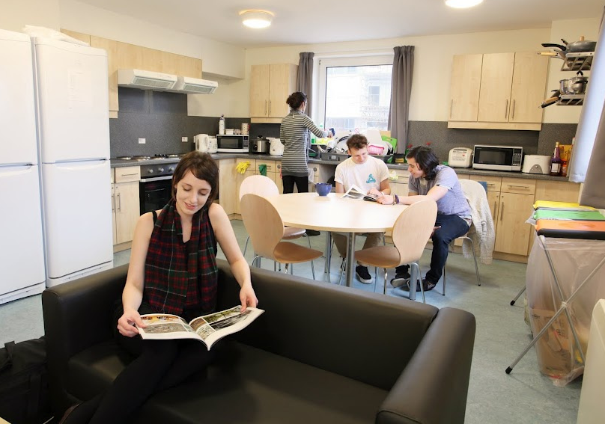
MANAGING YOUR MONEY
HOW MUCH?
?
£130.59
Q
What is the average weekly cost of student accommodation?*
Highest average in UK?
London £222 p/w
Lowest average in UK?
N. Ireland £71 p/w
?
?
?
?
From
£2.25p
From
£4.49p
From
30p
30p
Q
And to make those toast dreams a reality, a basic 2 slice toaster costs...
And food...it’s always good to have the basics. How much is this bag of pasta?
For sandwiches or toast a loaf of sliced bread is available from...
Unless you like it cold and crunchy, one of these might be helpful...
*From Save the Student’s National Student Accommodation Survey 2018: www.savethestudent.org/accommodation/national-student-accommodation-survey-2018.html
Notes:
www.savethestudent.org/accommodation/national-student-accommodation-survey-2018.html
Figures based on over 2,000 responses from students

Slide 52
NOW IT’S YOUR TURN!!
KEY POINTS TO REMEMBER
We hope you will take away and remember a few of the key points from
this session....
#1
RESEARCH
Research ALL the SUPPORT available to you
Make THE RIGHT uni/college choice
#2
#2
APPLY
Apply ONLINE & ON TIME
#1
#3
You DON’T need to WAIT for confirmed offers
#3
REPAY
Not until you earn OVER £25,000 a year
Based on WHAT YOU EARN not what you owe

Slide 53
i
NEED MORE INFORMATION?
REMEMBER SFE IS ONLINE
For further information on student finance and to apply go to
www.gov.uk/studentfinance
For a range of helpful tools and guidance,
visit our student finance zone
www.thestudentroom.co.uk/studentfinance
i
Notes:
Students and their parents/partners can find out more about student finance and all the topics covered in this presentation on Student Finance England’s student finance zone - www.thestudentroom.co.uk/studentfinance - or on Gov.UK - www.gov.uk/studentfinance
Students and their parents or partners can also call SFE to discuss applications, eligibility or assessments on 0300 100 0607
There is more information available for practitioners on our practitioner website - www.practitioners.slc.co.uk

